Slide 1
eGROW Plant Monitoring System
Adam Holler, Clay McKinley – Students
Dr. Alexander Malinowski – Advisor

Slide 2
Outline
Problem Statement
Functional Requirements
Prior Work
Flowchart/Specifications
Operational Modes
Engineering Efforts
Parts Ordered/Current Inventory
Schedule/Division of Labor

Slide 3
Problem Statement
Home automation is a growing market with products related to security, lighting, temperature control, etc…
Solutions for monitoring of house plants and small green-houses are only available on an industrial level
We aim to cure the common problem of helping users remember to care for their plants

Slide 4
Functional Requirements
Features
Long battery life
Moisture
Temperature
Sunlight
Weekly Updates (text, email)
Alarms (plus battery alert)
Battery Upgrade
“Anytime+” Values
Mobile Phone App
Adam & Clay Water+ Emergency Drop
Sound Alarm
Using a modified TI Sensor Tags which will be mounted in each pot
Sensors will read ambient temperature, humidity, light, tip-over detection, soil moisture
Sensors will be able to work indoors and outdoors
Battery life for the sensors must be sufficient enough to not be a burden (Several months+)
Sensors will transmit data to a cloud via ZigBee to an Ethernet gateway
Users will be able to monitor data and receive alerts on a smartphone app

Slide 5
Review of Literature/Prior Work
Research into communication protocols: Bluetooth Low Energy & ZigBee vs Wi-Fi, 6LoWPAN, etc…
Research into other solutions similar to our project

Slide 6
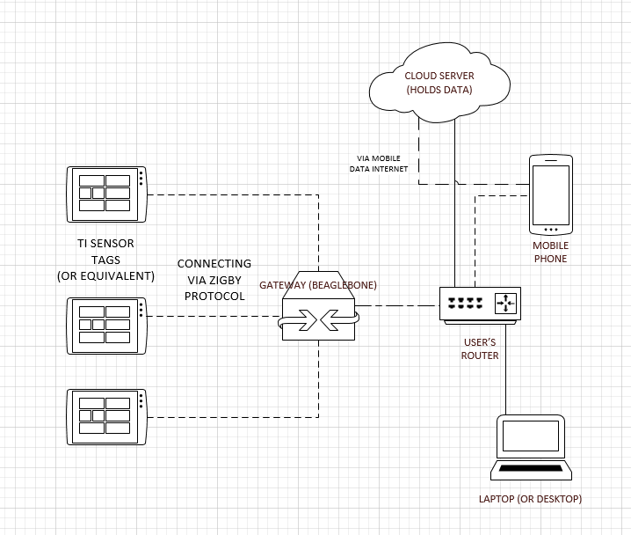
Block Diagram for our System

Slide 7
Specifications
TI Sensor Tag (CC2650 wireless MCU)
10 low-power sensors, including ambient light, digital microphone, magnetic sensor, humidity, pressure, accelerometer, gyroscope, magnetometer, object temperature and ambient temperature.
Ultra low power, coin cell battery, ARM Cortex-M3.
Uses Zigbee or 6LoWPAN.
Capacitive Soil Moisture Sensor v1.2
5V, Analog readings 2.4-4.4V
Digi XBee® Gateway
Protocols: UDP/TCP, DHCP. Security: SSL tunnels, WEP-40, WEP-104, WPA/WPA2, Authentication with PSK and EAP
OS: Digi Embedded Linux

Slide 8
Operational Modes
Sensors
Awake
Gather data
Send data to ZigBee/Ethernet converter
Sleep
Sensor waits a specified amount of time before waking up to transmit again
ZigBee/Ethernet
Receive data from sensors, upload to cloud via Ethernet.
App
Read data from cloud to display for user

Slide 9
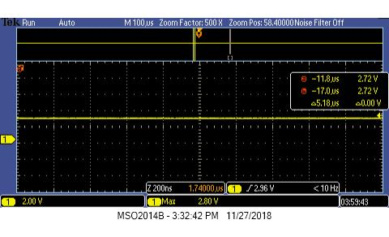
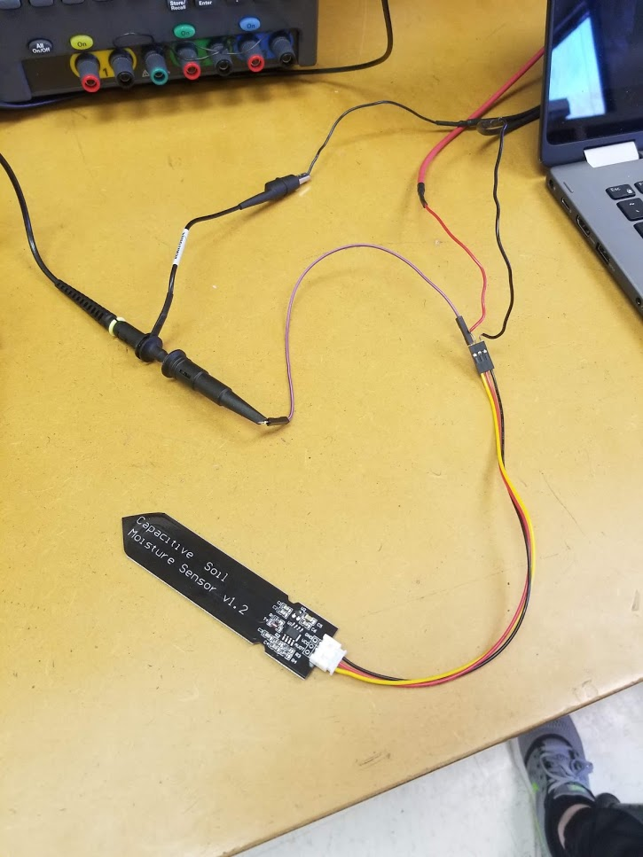
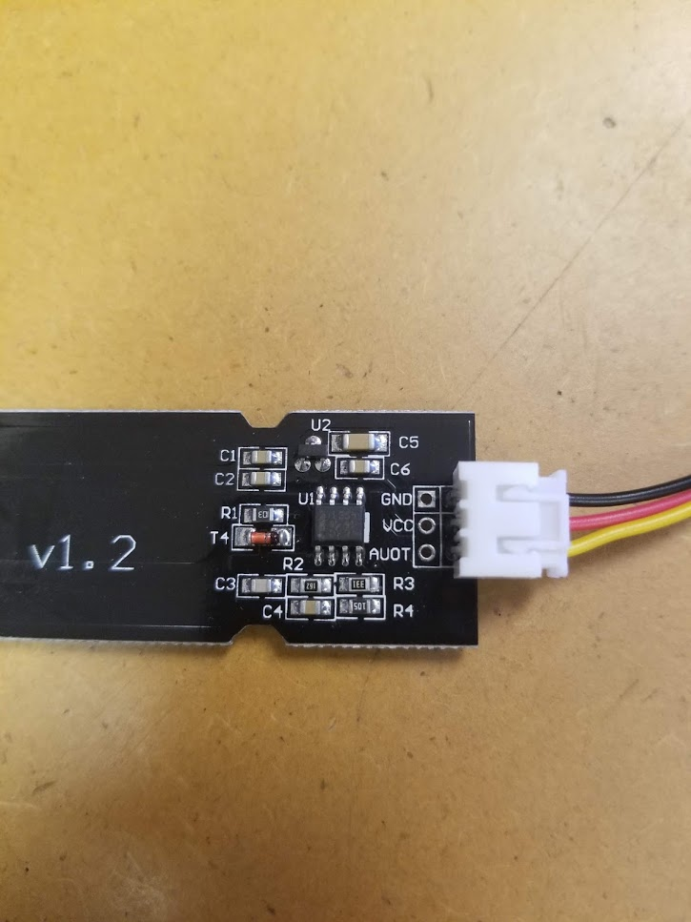
Engineering Efforts
Tested Capacitive Moisture Sensor
Notes:
2.72 – 4.2 V range
No datasheet so
Will order more once confident with sensor
Also pin size wonky?
Water in lab problem

Slide 10
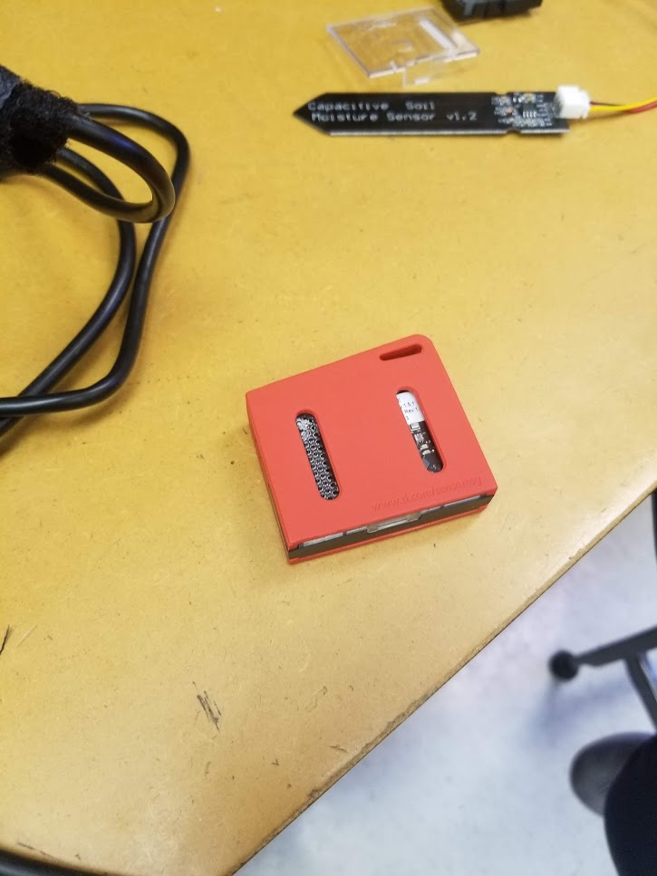
Engineering Efforts
Installed DevPack on TI Sensor Tag
TI Smart Tag App
Installed Code Compiler Studio (took some time)
Read through documentation to program TI Sensor Tags
Read through documentation for Digi Gateway
Notes:
BLE Device Manager
Renamed devices with app
Yes trying to figure out GPIO pins for use or whatever

Slide 11
Parts Ordered and Inventory
4x BLUETOOTH SENSOR TAG * 296-38831-ND
3x DEBUGGER FOR SENSORTAG * 296-42039-ND
1x Networking Modules XBee Gateway ZigBee to Ethernet Intl * 888-X2E-Z3C-E1-W (came with ethernet cable)
1x Capacitive soil moisture sensor (plan to get more later)
Micro USB cables, Personal Computers

Slide 12
Schedule and Division of Labor
Timeline:
November/December/January - Start programming TI Tags and enable firmware for Zigbee
February - Work on Zigbee Networking (and continue programming)
March - Work on App, Alarms, and Cloud
April - Continue development and wrap up work
May - Finish final paper and presentation
Division of Labor
Right now, we are still discovering, so we are working together. Once we get a grip on some things (and now we have multiple debuggers) we can start working separately.

Slide 13
Citations
[1] J. Lee, Y. Su and C. Shen, "A Comparative Study of Wireless Protocols: Bluetooth, UWB, ZigBee, and Wi-Fi," IECON 2007 - 33rd Annual Conference of the IEEE Industrial Electronics Society, Taipei, 2007, pp. 46-51.
[2] swrr134c.pdf CC2650 SensorTag Texas Instruments

