Slide 1
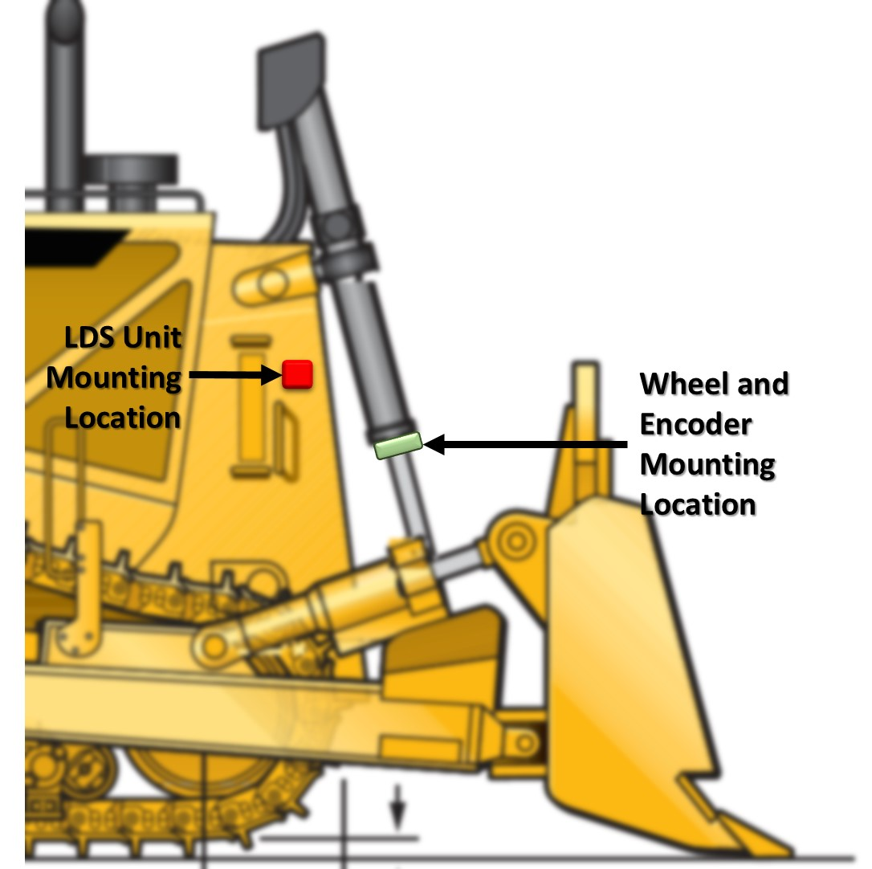

Design of a Robust Position Sensing System
Andrew Aubry¹ ▪ Christopher Costello¹ ▪ Phillip Latka² ▪ Ken Ratekin¹ ▪ Scott Roth³ ▪ Kinzie Sellers⁴ ▪ Leann Vernon² ▪ Rose Wurster⁴
Dr. Martin Morris¹ ▪ Dr. Jose Sanchez² ▪ Nick Schmidt² ▪ Ken Klotz⁴
¹Department of Mechanical Engineering ▪ ²Department of Electrical Engineering ▪ ³Department of Finance ▪ ⁴Department of Marketing
Project Overview
Design Concepts
Objective
This project brought together engineering and business students to develop a new end implement position sensing system for Caterpillar’s D8 tractor. The new system must maintain the same accuracy and robustness of the current system while decreasing cost and repair downtimes.
Background
Precise end implement position is necessary for several of Caterpillar’s current features. Therefore, precision is needed to remain competitive in an industry that is integrating complex ideas and autonomy into tractor designs. The current sensing system uses a magnetostrictive position sensor that has high accuracy. However, the system also has a higher than acceptable failure rate which leads to frequent repairs that are long and expensive.
Motivation
The sensing system designed in this project is meant to replace the current system and reduce the warranty costs that Caterpillar must pay to those whose system’s fail. This goal can be achieved by increasing the reliability and life of the system, decreasing repair downtime, and decreasing maintenance cost.
LDS
In this design, a direct blade measurement system consisting of two LDS units is mounted onto the side of the tractor. The LDS unit contains a rotating laser that takes distance measurements over 360◦. For this application, the readings are limited to a span of -45◦ to +45◦. The LDS units are mounted on both sides of the tractor where the units will measure distances in the vertical plane. These readings are then analyzed using several algorithms to determine the exact location of the blade relative to the ground.
Wheel and Encoder
In this design, three wheels measure the linear displacement of a cylinder that controls the lift tractor’s end implement. These three wheels are protected by a collar. Encoders attached to the wheel’s axel measure the rotation of the wheels. The wheels are slightly compressed against the cylinder rod to increase the friction between the wheels and the cylinder. The design has a two halves which can be separated from one another to allow for easier maintenance and repair.
Theory
For testing purposes this design is implemented using a Neato LDS system. For one full revolution, the LDS unit returns 360◦ distance measurement at corresponding angles.
Algorithms
Motor control
Blade tracking
End blade location
Theory
The wheel and encoder design takes linear motion and turns it into rotational motion. This is preformed by determining the portion of the circumference the wheel has rotated. An important consideration in this design is that the distance is not directly measured but integrated over time travel due to wheel slip. This wheel slip can potentially cause inaccuracies in the measurement. To limit this risk, slip analysis was preformed on the system.
Figure 1: The Two Systems as Implemented on a D8 tractor
Y
(to sky)
P₁₁
φ_{c}
θ_{T}
P₁₂
Figure 3: Pro-E Design of the Wheel and Encoder System
Design Process
d₁₁
d₁₂
BH
d₂₁
P₂₁
Equations
Research Stage
During the research stage the entire team worked on building a strong base knowledge of applicable material. The project’s designs would come from this knowledge base. The research focused on Caterpillar’s existing sensor system, new sensor technology, and patents or other existing designs.
Brainstorming Stage
Initial brainstorming phase
35+ unique solutions
Three different categories: Blade to vehicle, Blade to external reference, and Linkage positioning.
General Elimination Phase
Eliminations based on Caterpillar’s application criteria
Resulted in six designs
Selection Stage
During the selection stage the team took the remaining six designs and analyzed them in more detail. The more detailed analysis included cost analysis, specific sensor model decisions, mathematical computations, and anything else the team deemed necessary. After the end of this stage there were two designs that best fit Caterpillar’s requirement: Laser Distance Sensing (LDS) and Wheel and Encoder.
d₂₂
P₂₂
Rotational to linear motion
$$d=r∗φ$$
LDS Mounted on Tractor
Θ₂₂
X
(to blade)
Slip analysis of the system
$$F_{c}≥\left|\frac{m∗r∗a_{c}+T_{f}}{μ∗r}\right|$$
Figure 2: 2 Dimensional representation of blade position using the LDS system
Figure 4: Prototype of the Wheel and Encoder System
Results
Preliminary results suggest that both of these designs are viable options for Caterpillar to implement. However further design tests and verifications are required to strengthen these conclusion
Business Analysis
Benefits and Drawbacks
The following outlines the pros and cons of each design from a marketing perspective
Current System Analysis
A comprehensive review of warranty data led to the conclusion that the current sensing system maintains approximately a 20-25% failure rate. This number demonstrates how important it is to improve the system.
Return on Investment (ROI)
Based on the two design concepts, an ROI analysis indicates the potential for an $7,076,574 financial gain with a 52% internal rate of return over a 10 year span.
Laser Distance Sensor (LDS) | Sleeve
Triangulation | Push Arm
Wheel and Encoder | Magnetometer
Wheel and Encoder
Pros | Cons
Simple, fast, cheap repairs | Integration of error over time
Quick time to market
LDS
Pros | Cons
Can measure blade tilt | New technology/longer time to market
Short repair times | Environmental working conditions
Acknowledgments: Quinton Burcar, Gayle Deynzer, Dr. Richard Johnson, Steve Krause, Dave Miller, Jarrod Neal

