Slide 1
GPS + Inertial Sensor Fusion
Aleksey Lykov, William Tarpley, Anton Volkov
May 6, 2014
1

Slide 2
Presentation Overview
Introduction
Theory
Project Work
Results
Conclusion
Questions
2

Slide 3
Introduction
Project Overview
Low Cost Navigation
Survivable when GPS is intermittent
Applications
3
Notes:
Low Cost inertial navigation system based on the Raspberry Pi with attached Accel/Gyro/Magn^{et}ometer and Barometer to work with or without GPS signal...

Slide 4
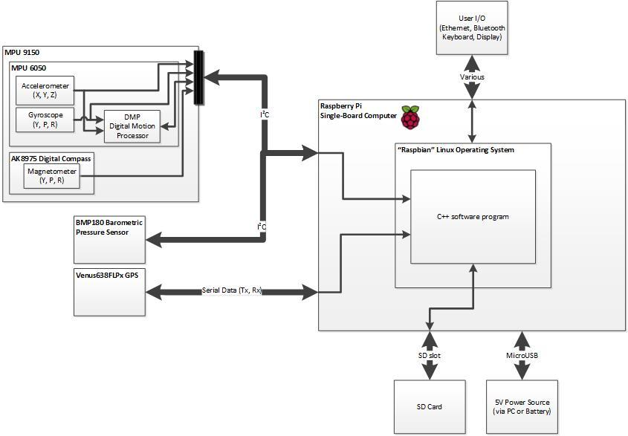
I²C
I²C
Serial/UART
System Hardware Block Diagram
4
Notes:
Connections via I2C, Serial
Notes: Larger labels on bus protocols

Slide 5
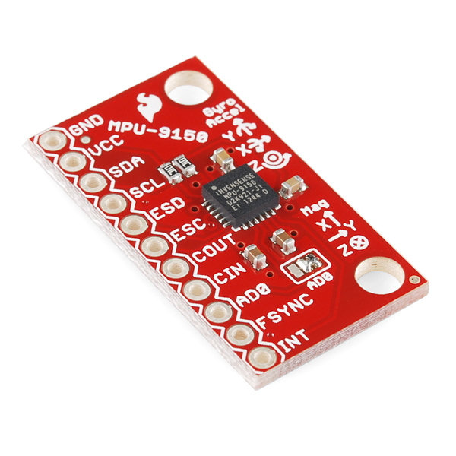
I²C
I²C
Serial/UART
System Hardware Block Diagram
5
Notes:
Connections via I2C, Serial
Notes: Larger labels on bus protocols

Slide 6
I²C
I²C
Serial/UART
System Hardware Block Diagram
6
Notes:
Connections via I2C, Serial
Notes: Larger labels on bus protocols

Slide 7
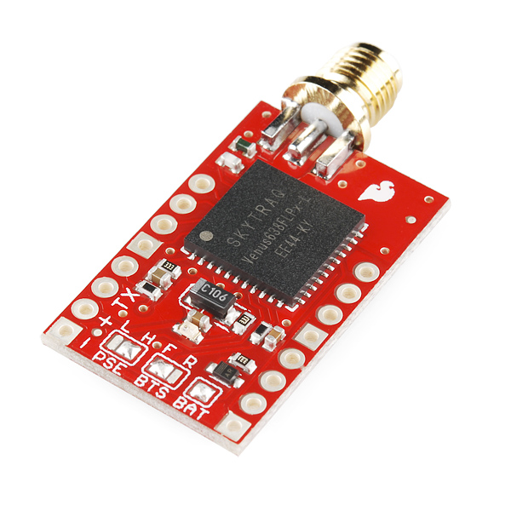
I²C
I²C
Serial/UART
System Hardware Block Diagram
7
Notes:
Connections via I2C, Serial
Notes: Larger labels on bus protocols

Slide 8
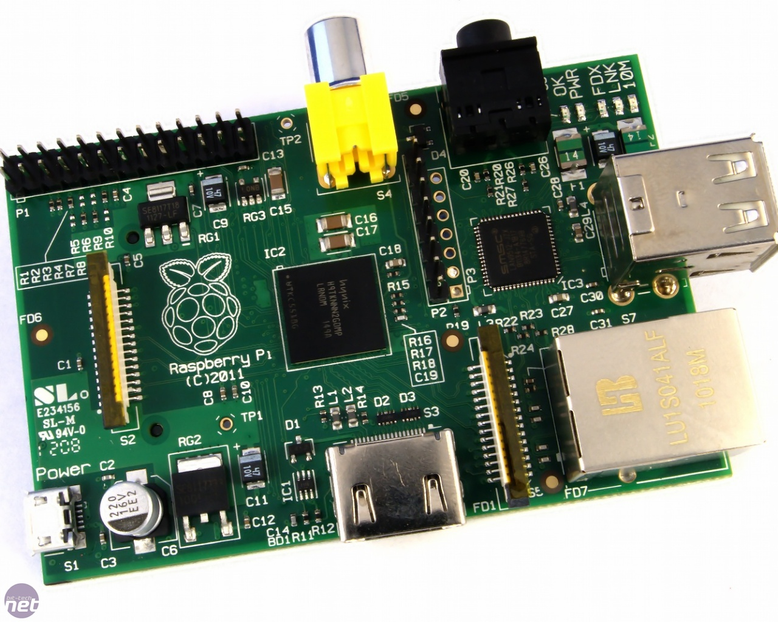
I²C
I²C
Serial/UART
System Hardware Block Diagram
8
Notes:
Connections via I2C, Serial
Notes: Larger labels on bus protocols

Slide 9
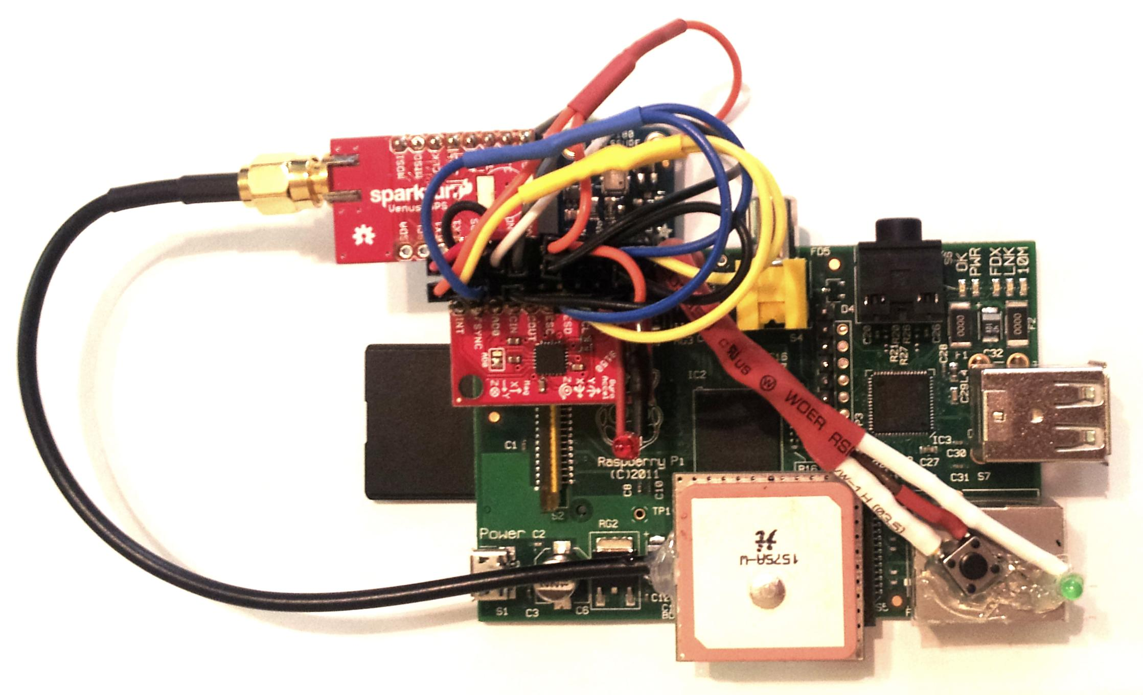
GPS Receiver
Barometer
Raspberry Pi
IMU
PB and LED
GPS Antenna
System Photo
9
Notes:
All sensors and overall system are compact in size and simple to connect

Slide 10
Introduction
Project Overview
Applications
10
Notes:
Applications:
Indoor Navigation
Mapping/Navigating Terrain Underground
Improving GPS Accuracy
Notes: change pictures?

Slide 11
Theory
How the System Works
Sensor Fusion
Kalman Filtering
11

Slide 12
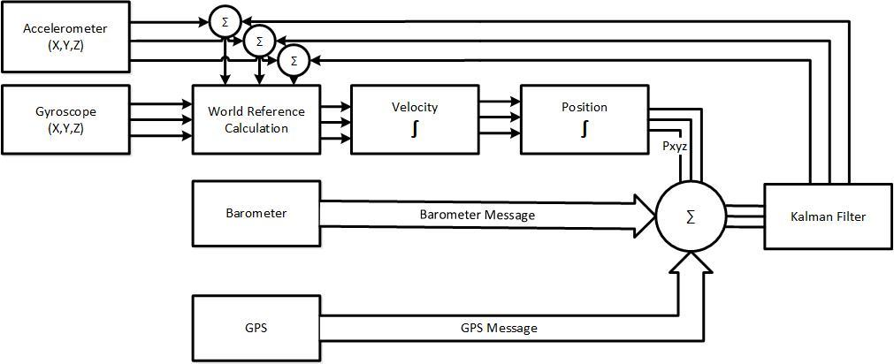
Original System Signal Diagram
12
Notes:
Accel/Gyro values come in
Accel X/Y/Z rotated to World Reference Frame via the MPU-9150’s DMP based on Gyro (Questions: Quaternions, how to rotate Accel XYZ)
World Reference Frame accelerations are integrated to determine velocity and position data
GPS and Barometer data is used to correct calculated velocity and position through a sensor fusion algorithm (such as a Kalman Filter)

Slide 13
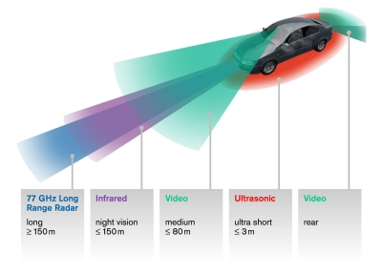
Theory
How the System Works
Sensor Fusion
Kalman Filtering
Source: Ruhr University
13
Notes:
Gyro/Mag relationship - possible to Kalman filter (talk about later)
Accel/GPS relationship - Accel values are good in the very short term, GPS are good in long term (no cumulative error)
Barometer provides Z-axis data in situations when GPS altitude reading is unavailable

Slide 14
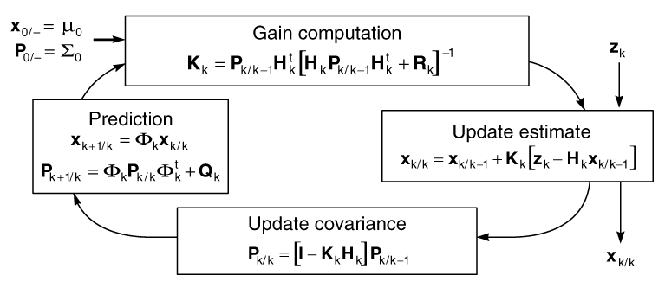
Theory
How the System Works
Sensor Fusion
Kalman Filtering ^{[1]}
Source: University of North Carolina
14
Notes:
Application for this project:
Gyro/Mag Kalman filtering <- good for pose data
GPS/Accel Kalman filtering <- unavailable indoors

Slide 15
Specifications:
After 60 seconds without GPS, error within 5% or 1 meter of true distance | With GPS, less than 5% error from true distance traveled
Acceleration data taken at a minimum of 100 Hz | GPS data taken at a minimum of 1 Hz when GPS signal present
Operate without lapses in data for a minimum of 2 hours on battery | Implement an onboard Kalman filter for acceleration correction
Correct INS measurements with GPS | Save all Accel and GPS data to file
Start data acquisition within 30 s | Accel FS: ±2g, ±4g, ±8g, or ±16g
Alert user to GPS loss | Gyro FS: ±250°/s
Reacquire GPS signal within 30 s in unobstructed environment | Implement real-time display of displacement on LCD
System Requirements
15

Slide 16
Project Work
Interfacing External Sensors
Multithreaded Programming
MATLAB Post-Processing
Source: Bit-Tech.net
16

Slide 17
Source: Sparkfun
InvenSense MPU-9150 9-DOF IMU
17

Slide 18
Velocity and Position via Direct Integration
18

Slide 19
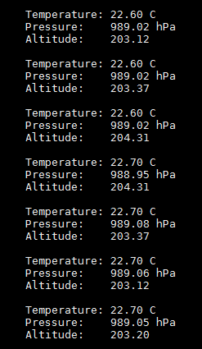
Source: Adafruit
Bosch Sensortec BMP 180 Barometer
19

Slide 20
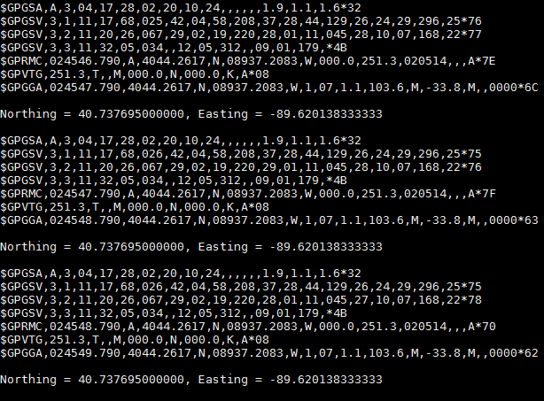
Source: Sparkfun
SkyTraq Venus638FLPx GPS receiver
20

Slide 21
Project Work
Interfacing External Sensors
Multithreaded Programming
MATLAB Post-Processing
21

Slide 22
Main Thread
Main commands all threads to start/stop and records start time
INS Thread
GPS Thread
BAR Thread
Sensor threads save timestamped data for PROC Thread
Shared Memory
The data is read, processed, and saved to a buffer
PROC Thread
Once user stops data acquisition the string buffer is written to file
Output File
Multithreaded Software Block Diagram
22

Slide 23
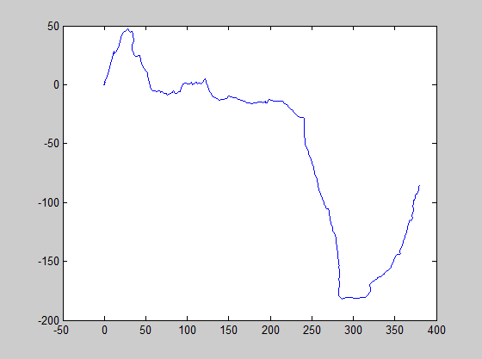
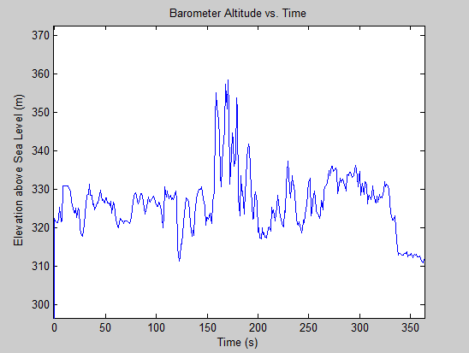
Screen Shot of Output File
INS
GPS X-Y Displacement
GPS
BAR
Output from Concurrent Data Acquisition
23

Slide 24
Project Work
Interfacing External Sensors
Multithreaded Programming
MATLAB Post-Processing
24

Slide 25
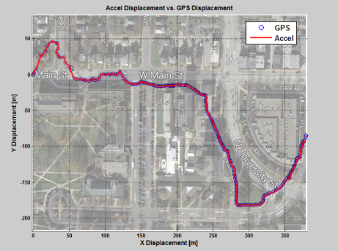
Main Function
Parse Text File(s)
Manipulate Data (Filtering, Unit Conversions)
Perform Integration + Sensor Fusion
Plot Data
MATLAB Post-Processing Diagram and Results
25

Slide 26
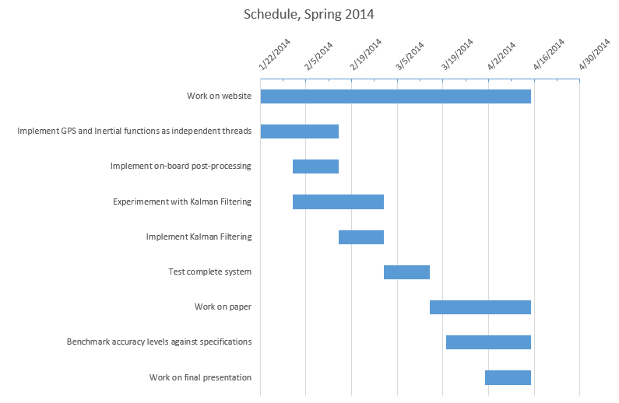
Project Timeline (Original Plan in Darker Blue)
26

Slide 27
Specifications:
After 60 seconds without GPS, error within 5% or 1 meter of true distance | With GPS, less than 5% error from true distance traveled
Acceleration data taken at a minimum of 100 Hz | GPS data taken at a minimum of 1 Hz when GPS signal present
Operate without lapses in data for a minimum of 2 hours on battery | Implement an onboard Kalman filter for acceleration correction
Correct INS measurements with GPS | Save all Accel and GPS data to file
Start data acquisition within 30 s | Accel FS: ±2g, ±4g, ±8g, or ±16g
Alert user to GPS loss | Gyro FS: ±250°/s
Reacquire GPS signal within 30 s in an unobstructed environment | Implement real-time display of displacement on LCD
Desired System Specifications
27

Slide 28
Results
Testing and Data Acquisition
Current System Specifications
28

Slide 29
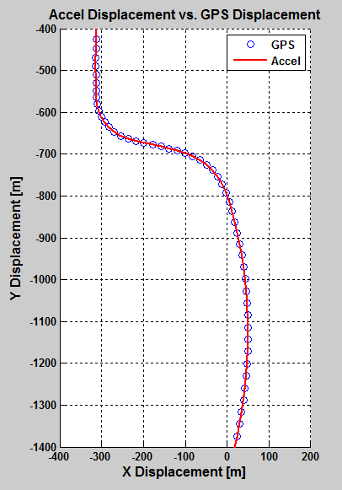
Result of Accel data fused with GPS data
29a

Slide 30
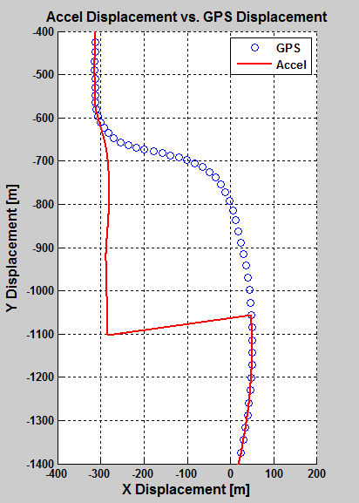
Simulated 30 second loss of GPS signal
29b

Slide 31
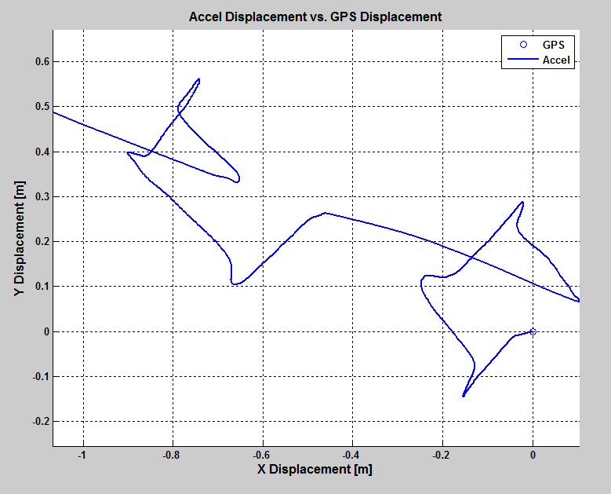
1 Foot Square Displacement Test (Repeated)
30

Slide 32
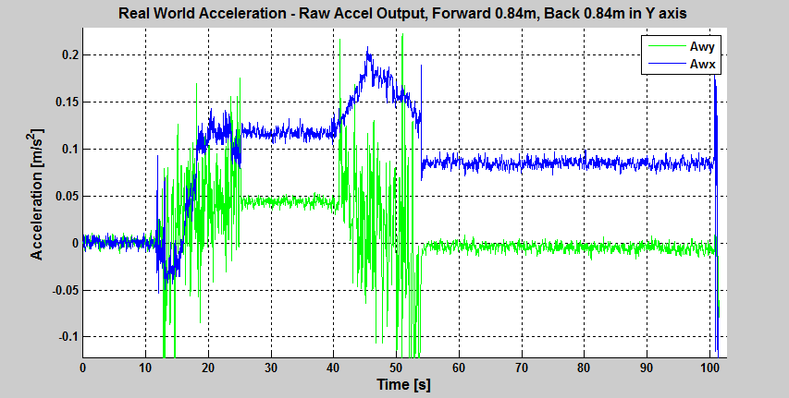
0.04 m/s² Y offset when stationary
X expected to be 0 m/s² entire run
Y-Axis Acceleration, 0.84m Displacement Test
31

Slide 33
Attitude Kalman filtering possible at all times (Compass correcting Gyro)
Tested code^{[5]} on Raspberry Pi, <20% CPU usage
Accurate heading ⇒ accurate acceleration rotation
Acceleration Kalman filtering possible when GPS is available
However, when GPS is unavailable:
No way to correct the X and Y inertial measurements
System relies on MEMS acceleration readings alone
Kalman Filtering Discussion
32

Slide 34
Results
Testing and Data Acquisition
Current System Specifications
33

Slide 35
Specification | Final Result
Accelerometer/Gyroscope Rate | 100 Hz (scalable up to 1 kHz) ^{[3]}
GPS Rate | 1 Hz (scalable up to 20 Hz) ^{[2]}
Barometer Rate | 1 Hz (scalable up to 100 Hz) ^{[4]}
Time to Acquire GPS Lock | 3-4 Minutes from Cold Start 30 Seconds to Reacquire Lock
Program Structure | C++, 5 Threads (Main, 3 Sensor Threads, Post-Processing)
Data Log Storage | Text file on SD card. Fill rate: ~539 kB/min
Post-Processing | GPS displacement/velocity: onboard (<17% CPU usage) Sensor fusion/integration: MATLAB
Final System Specifications
34

Slide 36
System Timestamps
Accelerometer and Gyroscope
Navigation Computer
Velocity Integration
Position Integration
GPS
Displacement Calculation
Sensor Fusion Algorithm
Velocity Calculation
Currently Done Onboard
Currently Done Offboard
Final System Signal Diagram
35

Slide 37
Conclusion
Project Outcomes
Reliable data acquisition platform for navigation
Inertial MEMS sensors found to be unsuitable for indoor navigation via double integration of accel data
Raspberry Pi confirmed to support both data acquisition and onboard post-processing
Future Project Potential
Acknowledgements
36
Notes:
Some outcomes of this project included:
Familiarization with Linux environment
Experience with multithreaded programming
Experience interfacing external sensors with single-board computer
Determined strengths and shortcomings of current-gen MEMS sensors
A fully-functional data acquisition platform for any future development

Slide 38
Conclusion
Project Outcomes
Future Project Potential
Acknowledgements
37
Notes:
Future project work in this project area could include further investigation into:
Improving MEMS accelerometer accuracy via hardware or software changes
Adding an additional sensor to give positioning data indoors
Setting up a Differential GPS antenna to provide accurate GPS positioning indoors

Slide 39
A few possibilities for indoor positioning:
Pedometer algorithm (pedestrian application)
Rotary Encoder (for wheeled robot application)
3D Camera
Pseudolite / Differential GPS antenna (indoor GPS)
Data acquisition program has been ported to Python and tested on the BeagleBone Black
The BeagleBone Black is similar but more versatile
Passing on Python code may be easier
Enables direct interfacing of analog accelerometers via several analog-to-digital converter inputs
Future Project Potential
38

Slide 40
Conclusion
Project Outcomes
Future Project Potential
Acknowledgements
39

Slide 41
Questions?
References…
[1] D. H. Titterton, and J. L. Weston. Strapdown Inertial Navigation Technology. Stevenage: Institution of Electrical Engineers, 2004.
[2] GPS Datasheet: https://dlnmh9ip6v2uc.cloudfront.net/datasheets/Sensors/GPS/Venus/638/doc/Venus638FLPx_DS_v07.pdf
[3] MPU-9150 Datasheet: http://www.invensense.com/mems/gyro/documents/PS-MPU-9150A-00v4_3.pdf
[4] BMP180 Datasheet: http://www.adafruit.com/datasheets/BST-BMP180-DS000-09.pdf
[5] RTIMULib (Kalman-filtered quaternion code): https://github.com/richards-tech/RTIMULib
40

Slide 42
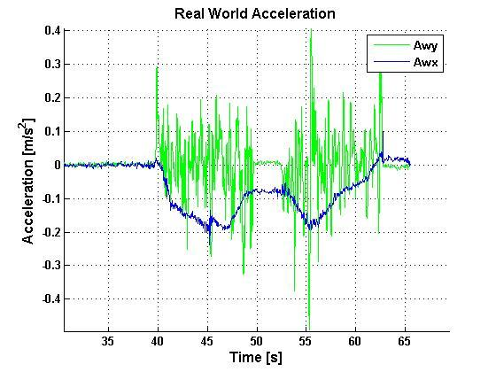
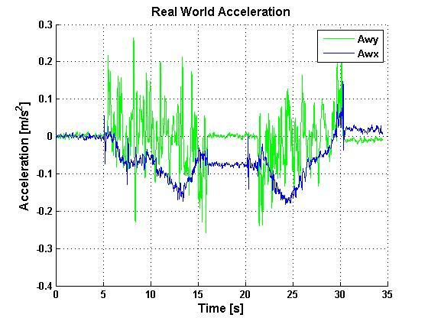
Testing Rigor
Two additional MPU-9150 units tested
MPU-9150 tested at 100, 50, 25, and 20 Hz
Over 60 data samples taken across 24 major code revisions
q1

Slide 43
Cost Comparision
Source:
“A Comparative Evaluation of Low-Cost IMUs for Unmanned Autonomous Systems”
MPU9150 Datasheet

Slide 44
Kalman Filter Specifics
“RTIMULib” code from richards-tech
4 Kalman filter states (4-D quaternion)
Corrected by pose data from accelerometer and magnetometer
Output is Kalman-filtered Euler pose or quaternion
q2

Slide 45
Rotation of Acceleration Data
Quaternion: Attitude representation
Determined by Gyroscope yaw, pitch, and roll
Can be used to quickly rotate a vector in 3D space
Rotation of Accel vector using a Quaternion:
P_{out} = Q * P_{in} * conj(Q)
Where
P_{in} = [ 0 , A_{X} , A_{Y} , A_{Z} ]
Q = [Q_{W}, Q_{X}, Q_{Y}, Q_{Z}]
q3

Slide 46
Post-Processing Methods
Filter Noise
Take idle period and find min/max for each axis
Remove any value +/- this sum
Remove Stationary Bias
Find shifted noise floor (mean stationary accel)
Subtract average value from shift
Remove Bias during Motion
All points between shifted noise floors are slopes
Assuming slope is linear, subtract sloped value.
q4

Slide 47
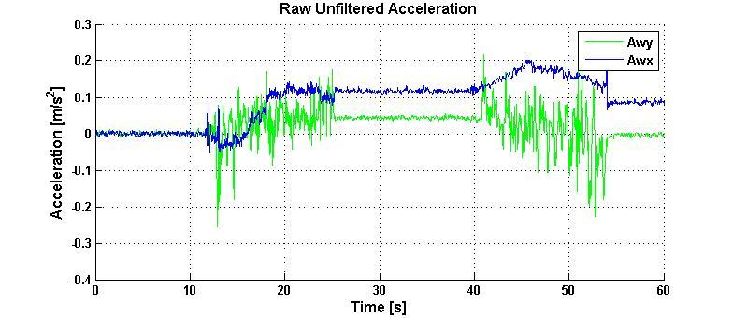
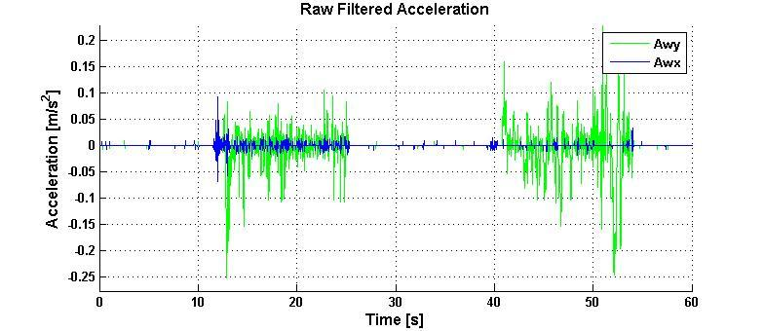
Post Processing Filtering
q5

Slide 48
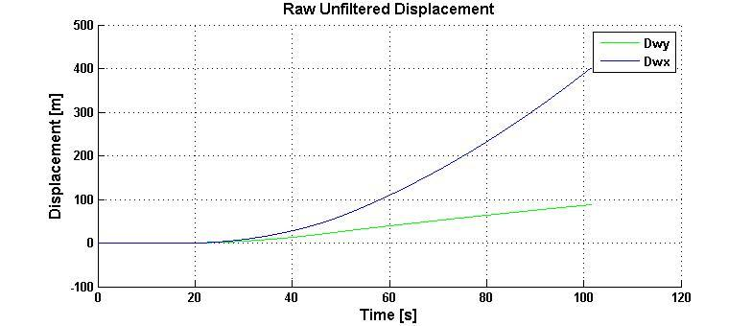
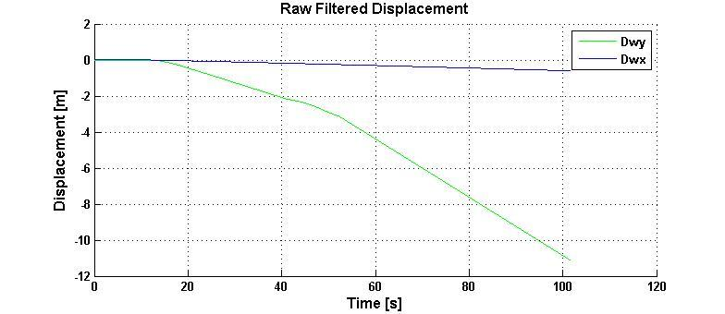
Post Processing Filtering
q6

Slide 49
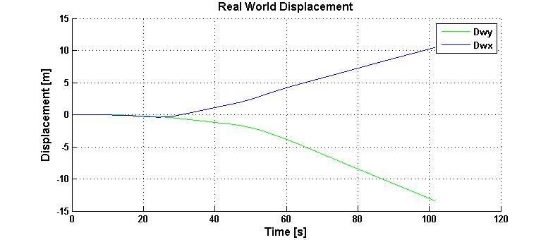
Post Processing Filtering
q7

Slide 50
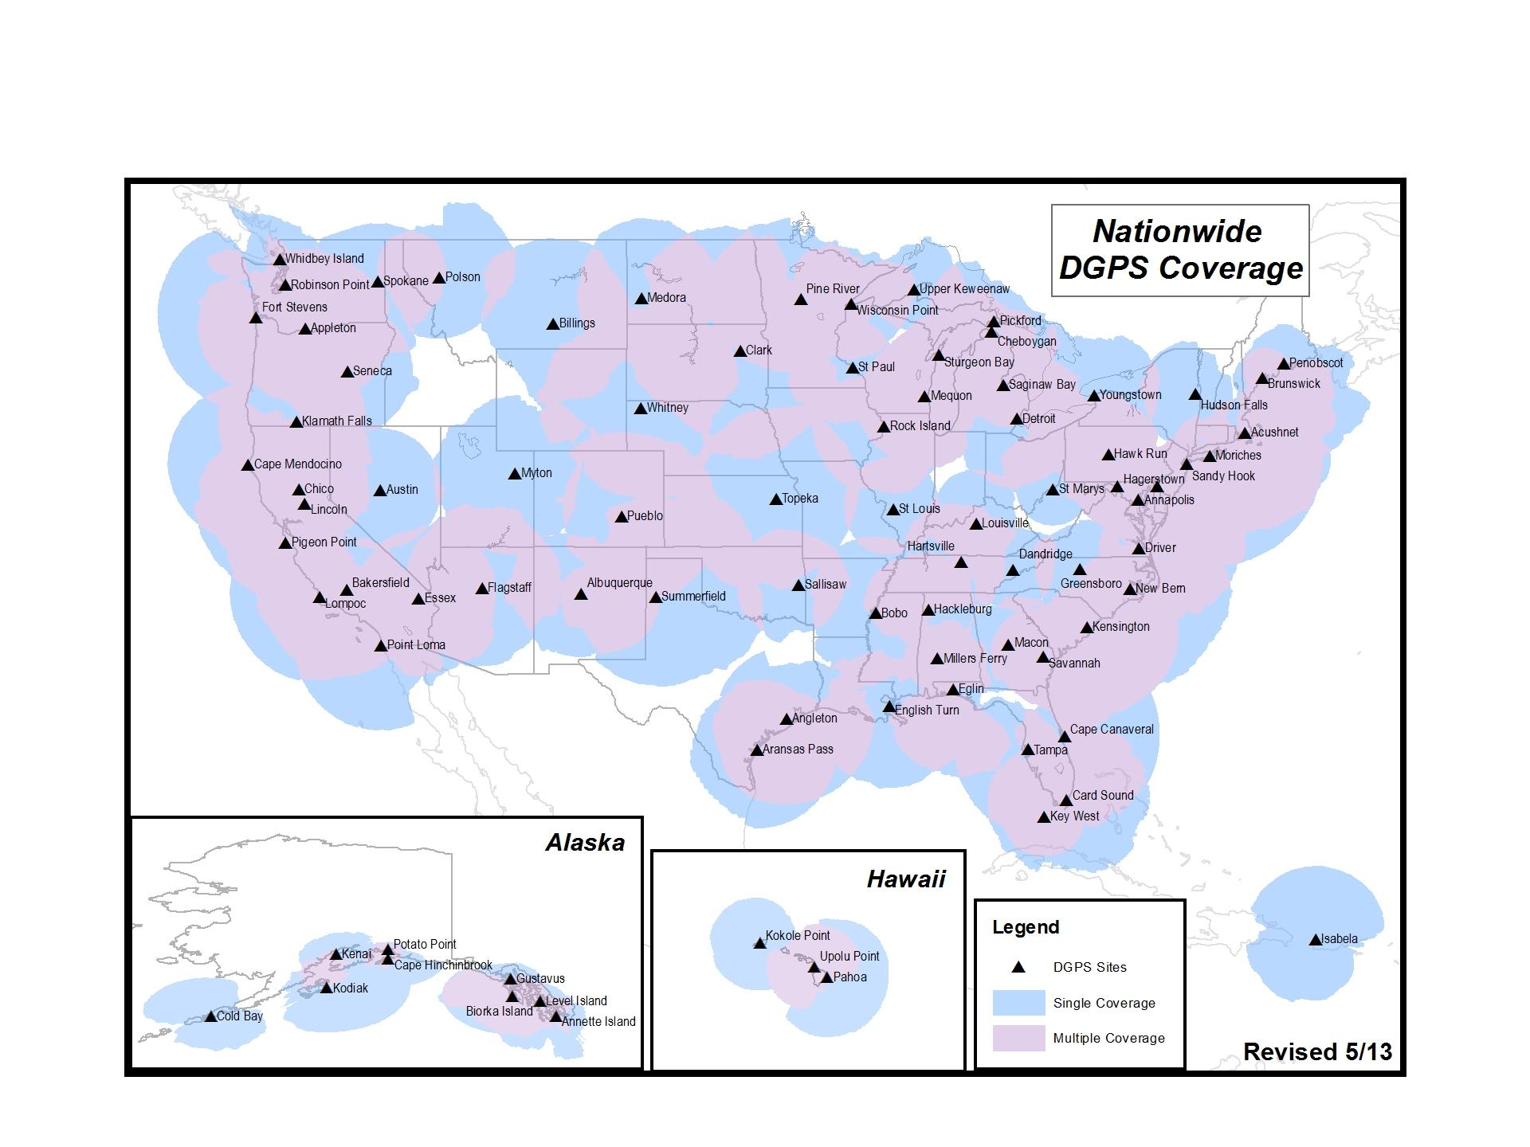
Differential GPS Coverage
Source: United States Coast Guard Navigation Center
q8

