Slide 1
Controller Design for a Linearly Actuated Suspension System (cdlass)
Dan Altman, Tim Reilley & Joseph Sholl
Advisors: Prof. Gutschlag & Prof. Anakwa

Slide 2
Presentation Outline
Introduction of Team Members
Project Summary
Previous Work on Active Suspension System
Project Description
Complete System Block Diagram
Controller Flow Chart
Disturbance using Cam Shaft
Hardware, Software, and Circuitry
Projected Schedule

Slide 3
Project Summary
We will design a controller for an electric linear actuator-based active suspension system. Initially, a position sensor will be used to determine the location of the “vehicle,” relative to the “wheel” position. The controller will use this information to engage the linear actuator to keep the mass at a relatively constant position. The addition of an accelerometer to the system will eventually be investigated to control the acceleration levels experienced throughout the range of available “wheel” displacement. LabVIEW will be used throughout the project as the controller platform.
An additional deliverable of the project will be the creation of a tutorial (or guide) on the use of LabVIEW in controller design and implementation.

Slide 4
Previous Work on Active Suspension System
Replaced the pneumatic actuator with an electric linear actuator
Integrated the linear actuator and H-bridge hardware into the suspension system
Modeled the H-bridge in PSPICE
Modeled the linear actuator and motor using Simulink
Implemented open and closed loop controllers to minimize the error displacement to ¼ [in] with a 1 [in] disturbance

Slide 5
Current Project Goals
Model the system characteristics of the linear actuator
Model the H-bridge in PSPICE
Implement National Instrument’s hardware and software (LabViewTM) to provide data acquisition and power electronics control
Create a tutorial for the use of National Instrument’s hardware and software (LabViewTM)
Implement a feedback position controller using National Instrument’s hardware and software (LabViewTM) to minimize the error
Reintegrate the linear actuator and H-bridge hardware into the suspension system due to the unavailability of the H-bridge hardware used previously

Slide 6
Project Description
This project will involve focused efforts in power electronics design, system modeling and simulation, and feedback controller design. After the system and controller are simulated successfully utilizing Simulink, National Instrument hardware and software will be used to implement the feedback controller and provide control signals to the power electronics driving the active suspension system linear actuator.

Slide 7
Complete System Block Diagram

Slide 8
Controller Flow Chart

Slide 9
Labview

Slide 10
Physical System

Slide 11
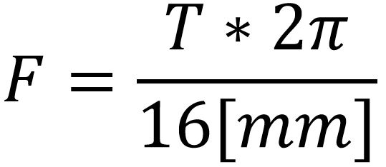
Linear Actuator
Uses controller information from LabVIEW and potentiometer in order react to disturbances
Relationship between torque and applied force:
Feature | EC2
Std. Maximum Stroke Length [in (mm)] | 29.53 (750)
Type of Screw | Ball
Lead [displacement / rev] | 16,5 mm
Nom. Lead Screw Diameter | 16mm
Backlash[in (mm)] | 0.010(0.025)
Dimension Std. | Metric ISO6431 Std.
Bore size | 50mm
Brushless Servomotor | AKM23, NEMA 23
Max. Thrust [lb(N)] | 810 (3600)
Max.Velocity [in/sec(m/s) | 50 (1.27)
Max. Rated Duty Cycle | 100%

Slide 12
Disturbance Control
AC motor drives the cam
Variable Frequency Drive, Controls the speed of the AC motor
Single elliptical cam shape causes the disturbance while rotating

Slide 13
Disturbance Analysis

Slide 14
National Instrument Hardware
• NI cDAQ-9174 NI CompactDAQ 4-slot USB 2.0 Chassis, 9 V - 30 V Input Voltage Range
• NI 9211 4-Channel 24-Bit Thermocouple Input Module, 14 S/s sample rate, ± 80 mV
• NI 9215 4-Channel 16-bit Analog Input Module, 100
kS/s/ch sample rate, ± 10 V
• NI 9221 8-Channel 12-Bit Analog Input Module, 800 kS/s
sample rate, ± 60 V

Slide 15
H-bridge and Gate Driver Hardware
Fairchild FMG2G75US60 IGBT Power Module
IR2110 Driver
IR2110
We will utilize:
Two Fairchild Semiconductor FMG2G75US60 IGBT Power Modules
Two IR2110 High and Low Side Drivers
Four 6N137 High Speed 10MBit/s Logic Gate Optocouplers
6N137 Logic Gate
Optocouplers

Slide 16
Bootstrap Circuit

Slide 17
Optical Isolator Circuit
(One Side of H-Bridge)

Slide 18
Tutorial
Screenshots and other figures
Detailed step-by-step instructions
FIGURE 1
Step one: click on icon and drag to center.

Slide 19
Projected Schedule

Slide 20
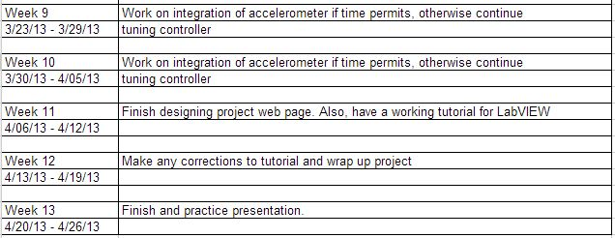
Projected Schedule (cont.)

