Slide 1
Controller Design for a Linearly Actuated Suspension System (cdlass)
Dan Altman, Tim Reilley & Joseph Sholl
Advisors: Prof. Gutschlag & Prof. Anakwa

Slide 2
Presentation Outline
Background
Applications
Motivation
Project Summary
Disturbance Analysis & System Modeling
Hardware, Software, and Circuitry

Slide 3
Background
1991 - Pneumatic Active Suspension System by Dion Thomas and Scott Jones, advisor: Dr. Anakwa
2002 - Dr. Anakwa publishes "Development and Control of a Prototype Pneumatic Active Suspension System" (with students), IEEE Transactions on Education, Vol. 45, No. 1, February 2002, pp. 43-49.
2006 – Active Suspension System by Blake Boe and Tyson Richards

Slide 4
Applications
System could be implemented in:
Seat inside of the cab
Under the cab

Slide 5
Motivation
Shared Interest in:
Electromechanical systems
Power electronics
Controls
Experience using LabVIEW software

Slide 6
Project Summary
H-bridge Design
Controller design using data from position sensor
Use of LabVIEW software
Creation of LabVIEW tutorial

Slide 7
Project Goals
Reintegrate the linear actuator and H-bridge hardware into the suspension system due to the unavailability of the H-bridge hardware used previously
Model the system characteristics of the linear actuator
Implement National Instrument’s hardware and software (LabViewTM) to provide data acquisition and power electronics control

Slide 8
Project Goals cont.
Implement a feedback position controller using National Instrument’s hardware and software (LabVIEWTM) to minimize the error
Create a tutorial for the use of National Instrument’s hardware and software (LabViewTM)

Slide 9
Performance Specifications
A controller capable of driving the linear actuator to maintain a midpoint level, minimizing a displacement for a disturbance with a frequency of up to 5 Hz
Minimized displacement of the cab from the midpoint to ± ⅛” (3.175 mm) with no load
Minimized displacement of the cab from the midpoint to ± ¼” (6.35 mm) with a load

Slide 10
Previous Work on Active Suspension System
Replaced the pneumatic actuator with an electric linear actuator
Modeled the H-bridge in PSPICE
Integrated the linear actuator and H-bridge hardware into the suspension system
Modeled the system including the linear actuator using Simulink
Implemented open and closed loop controllers to minimize the error displacement to ¼ [in] with a 1 [in] disturbance

Slide 11
Complete System Block Diagram

Slide 12
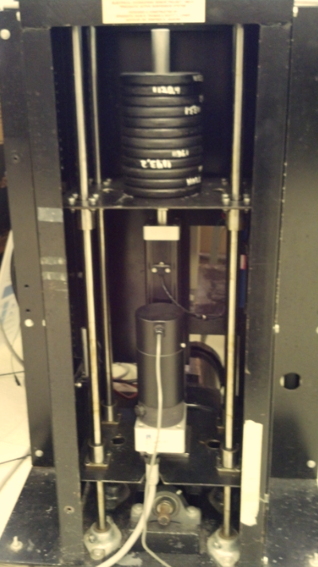
Physical System
Load (mass)
Position
Sensor
Linear
Actuator
Camshaft

Slide 13
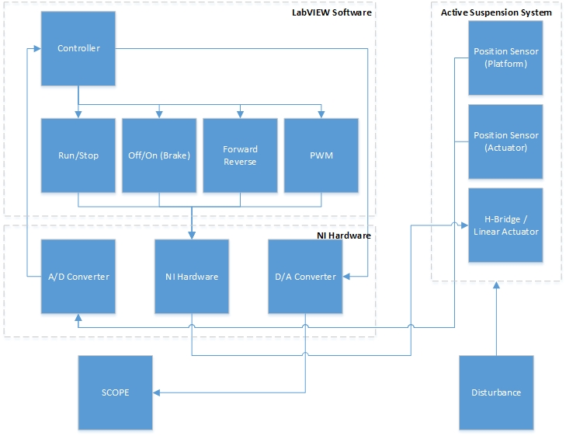
Controller Flow Chart
Position
Sensor
(Platform)
Controller
Position
Sensor
(Actuator)
Off/On
(Brake)
Forward/Reverse
PWM
Run/Stop
H-Bridge /
Linear
Actuator
NI Hardware
ADC
DAC
Scope
Disturbance

Slide 14
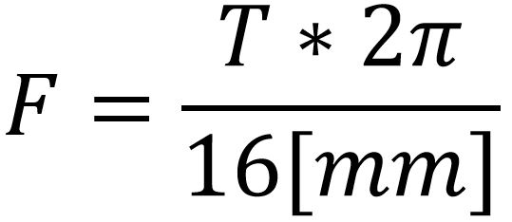
Linear Actuator
Uses controller information from LabVIEW and potentiometer in order react to disturbances
Relationship between torque and applied force:

Slide 15
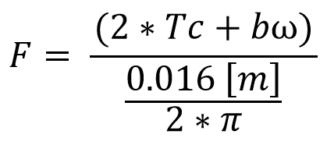
Linear Actuator/System Test
Based on the relationship between torque and applied force we derived the following equation to determine Tc and b:

Slide 16
Linear Actuator/System Test
Trial 1:
20 Lbs (or 9.07 kgs)
of weights used
Steady-State
Approx. 20.5 V

Slide 17
Linear Actuator/System Test
Trial 2:
25 Lbs (or 11.34 kgs)
of weights used
Steady-State
Approx. 49.2 V

Slide 18
Linear Actuator/System Test
Based on the previous group’s work: k_{E}=0.382 [V/rad/sec] so:
Trial 1: ω = 20.5 [V] / .382 [V/rad/sec] = 53.67 [rad/sec]
Trial 2: ω = 49.2 [V] / .382 [V/rad/sec] = 128.80 [rad/sec]
Using simultaneous equation solver:
Tc = 0.09304 b = 7.55 X 10⁻⁴

Slide 19
Disturbance Control
AC motor drives the cam
Variable Frequency Drive, Controls the speed of the AC motor
Single elliptical cam shape causes the disturbance while rotating

Slide 20
Disturbance Analysis

Slide 21
Original H-bridge and Gate Driver Hardware
IRF640N Power MOSFET
6N137 Logic Gate
Optocouplers
We will utilize:
Four IRF640N Power MOSFETs
Two IR2110 High and Low Side Drivers
Four 6N137 High Speed 10MBit/s Logic Gate Optocouplers
IR2110
IR2110 Gate Driver

Slide 22
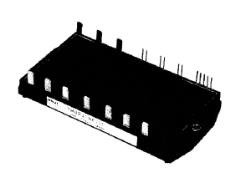
Revised H-bridge and Gate Driver Hardware
We will utilize:
Four (4) HCPL 3120 Gate Drive Optocouplers
One (1) IGBT Full-bridge Power Module
Reason for Change:
HCPL 3120 more robust, fewer chips, built-in optocoupling
MOSFET’s could not handle large current spikes
IGBT Full-bridge Power Module
HCPL 3120
Gate Drive Optocoupler

Slide 23
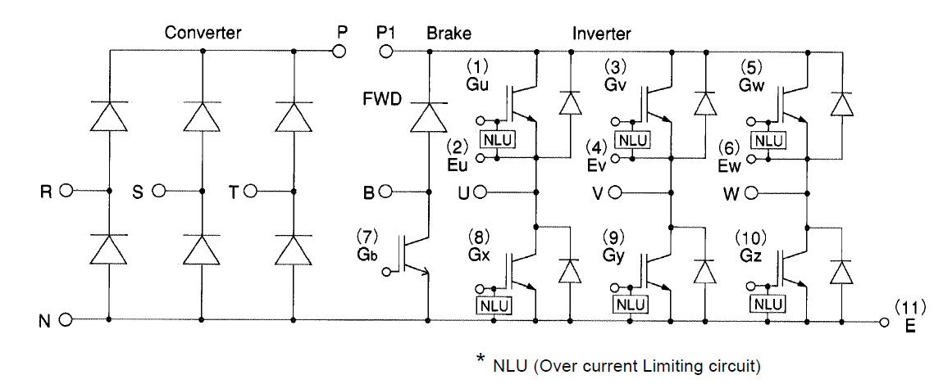
IGBT Circuit Schematic

Slide 24
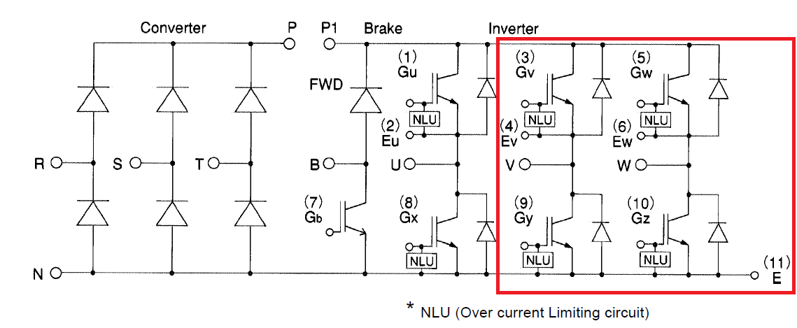
IGBT Circuit Schematic

Slide 25
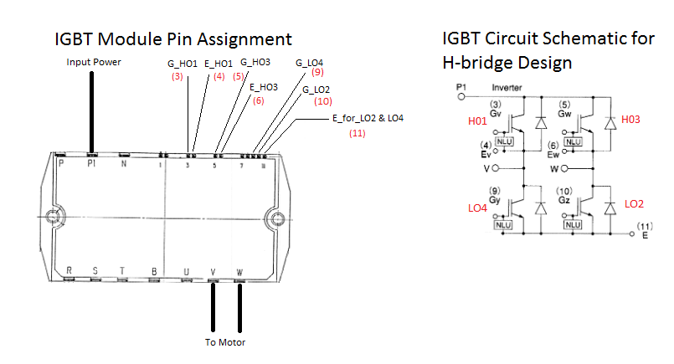
IGBT Module Pin Assignment and Circuit Schematic

Slide 26
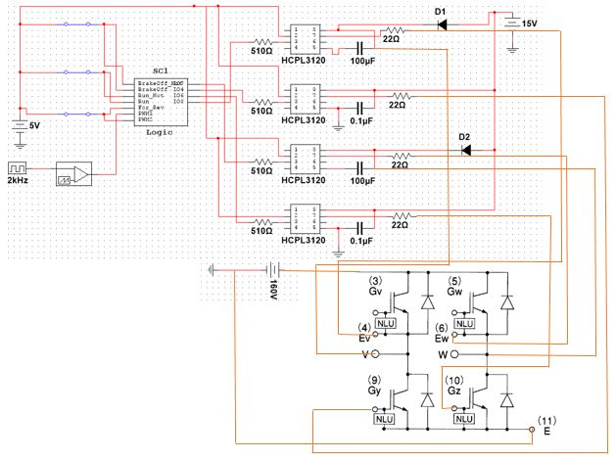
H-Bridge Circuit
H1
H2
L1
L2

Slide 27
H-Bridge Circuit: Forward Mode
H1
H2
L1
L2

Slide 28
H-Bridge Circuit: Reverse Mode
H1
H2
L1
L2

Slide 29
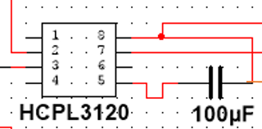
Bootstrap Circuit

Slide 30
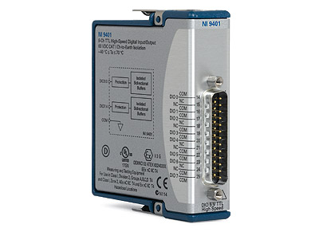
National Instrument Hardware
• NI cDAQ-9174 NI CompactDAQ 4-slot USB 2.0 Chassis, 9 V - 30 V Input Voltage Range
• NI 9401 8-Channel Ultra-high Speed Digital I/O Module
• NI 9221 8-Channel 12-Bit Analog Input Module

Slide 31
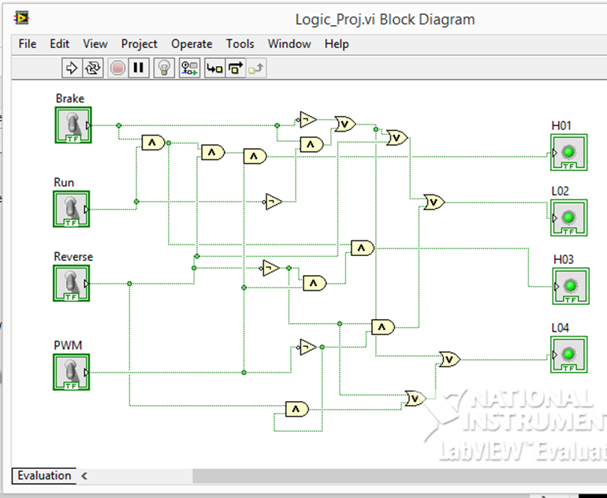
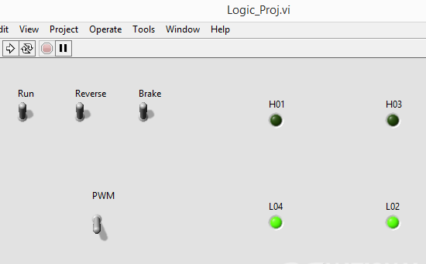
Logic in LabVIEW

Slide 32
Logic in NI Multisim

Slide 33
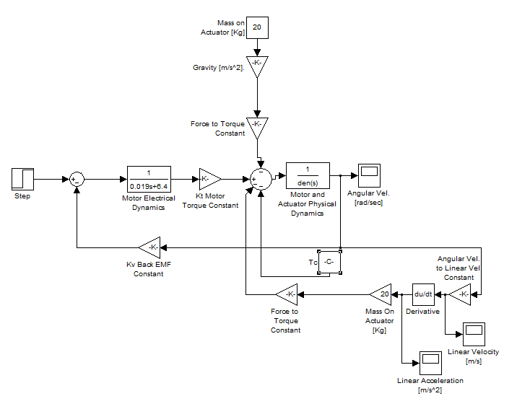
Motor Modeling in Sumulink

Slide 34
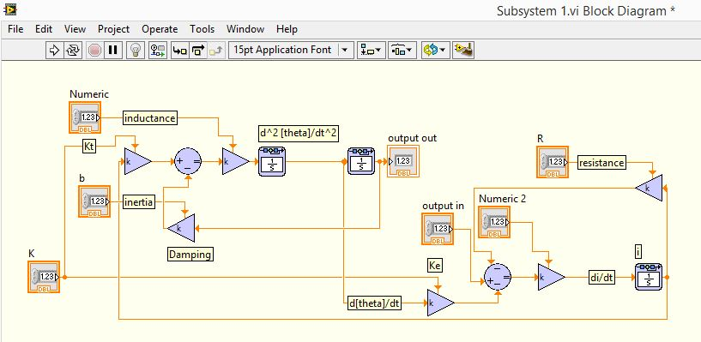
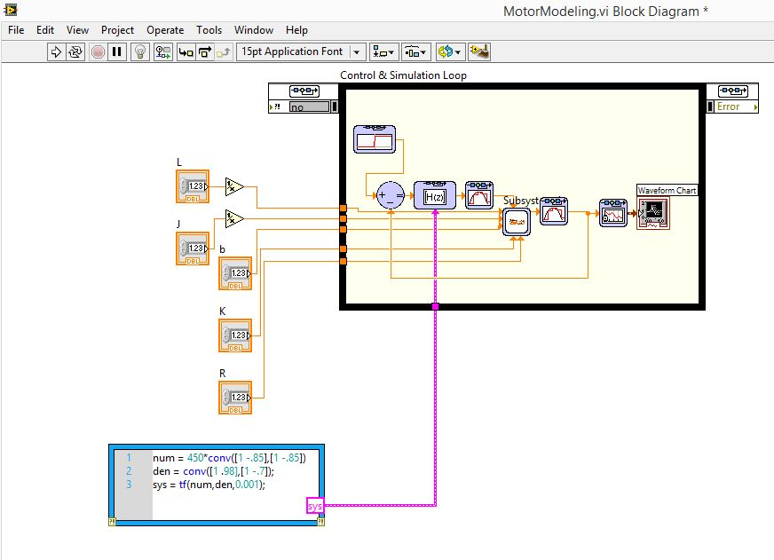
Motor Modeling in LabVIEW

Slide 35
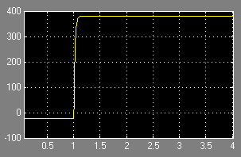
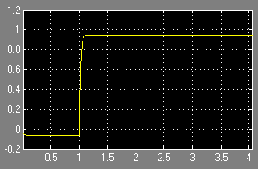
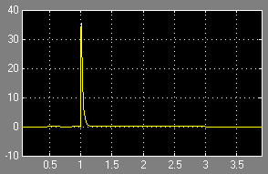
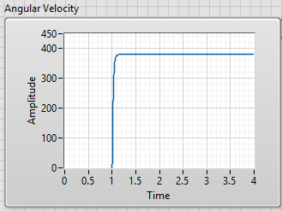
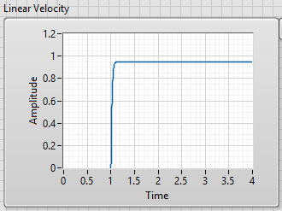
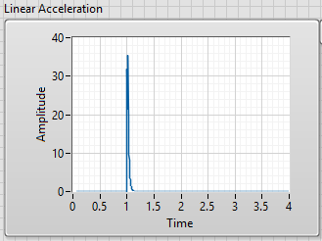
Motor Modeling Simulations
Angular Velocity
Linear Velocity
Linear
Acceleration
Simulink
LabVIEW

Slide 36
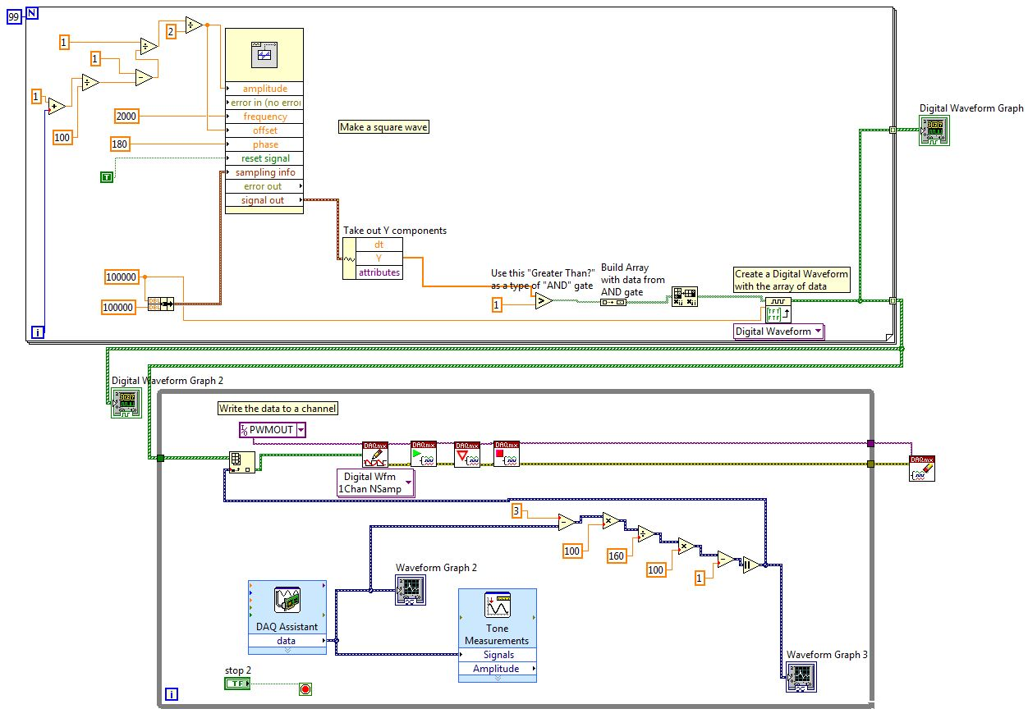
PWM Generator in LabVIEW

Slide 37
Front Panel of PWM Generator
Let Amplitude = A
Duty Cycle = (A-1)/A

Slide 38
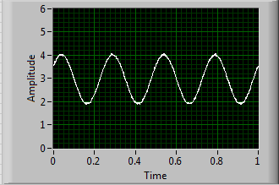
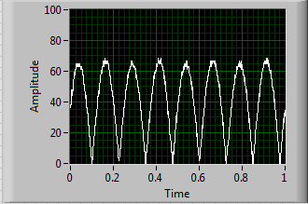
Front Panel of PWM Generator
Disturbance Signal
Processed Error Signal

Slide 39
Overview
Working H-Bridge design
System model created and simulated in LabVIEW
PWM signal generator created in LabVIEW
Data acquisition merged with PWM signal generator in LabVIEW

Slide 40
Future Work
Integration of H-Bridge and controller in LabVIEW
Expanding experience with National Instruments hardware and software such as using RIO and additional software modules

Slide 41
References
References
[1] Blake Boe and Tyson Richards. “Active Suspension System”, Senior Project, Electrical and Computer Engineering Department, Bradley University, May 2006, http://cegt201.bradley.edu/projects/proj2006/actss/
[2] IDC Motion EC2 Series Linear Actuator Data Sheet
[3] National Instruments Hardware Data Sheets
[4] Anakwa, Dr. Winfred, "Development and Control of a Prototype Pneumatic Active Suspension System" (with students), IEEE Transactions on Education, Vol. 45, No. 1, February 2002, pp. 43-49.

Slide 42
Bootstrap Capacitor Calculation

Slide 43
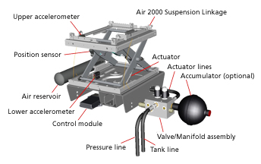
Background
John Deere introduced the hydraulic powered actuated active suspension seat in 2001

