Slide 1
Ultrasound Simulations using REC and SAFT
Presenter:
Tony Podkowa
November 13, 2012
Advisor: Dr José R. Sánchez
Department of Electrical and Computer Engineering

Slide 2
Outline
I. Introduction
II. Project Summary
III. Block Diagram
IV. Preliminary Work
V. Schedule

Slide 3
Outline
I. Introduction
II. Project Summary
III. Block Diagram
IV. Preliminary Work
V. Schedule

Slide 4
Introduction
Medical Applications
Tumor detection
Blood flow imaging
Cardiac imaging
Piezoelectric Transducer
Ultrasonic Pulses
Tissue Density reflects Pulses

Slide 5
Outline
I. Introduction
II. Project Summary
III. Block Diagram
IV. Preliminary Work
V. Schedule

Slide 6
Project Summary
Specialized techniques improve image resolution and SNR.
Resolution Enhancement Compression (REC)
Improves Axial Resolution and SNR
Synthetic Aperture Focusing Techniques (SAFT)
Improve Lateral Resolution and SNR
Goal:
To simulate the combination of both REC and SAFT in an ultrasound system using the Matlab addon Field II.

Slide 7
Outline
I. Introduction
II. Project Summary
III. Block Diagram
IV. Preliminary Work
V. Schedule

Slide 8
System Block Diagram
Received Echo Signals
Beamformed Signals
V_{pc}(t)
V_{in}(t)
REC
Transducer
SAFT
Image
Recon.
Image Output
V_{lc}(t)

Slide 9
Resolution Enhancement Compression
Pulse Compression Technique
Uses Convolution Equivalence
Exchange the transducer impulse response a desired response
Increases bandwidth
Better resolution

Slide 10
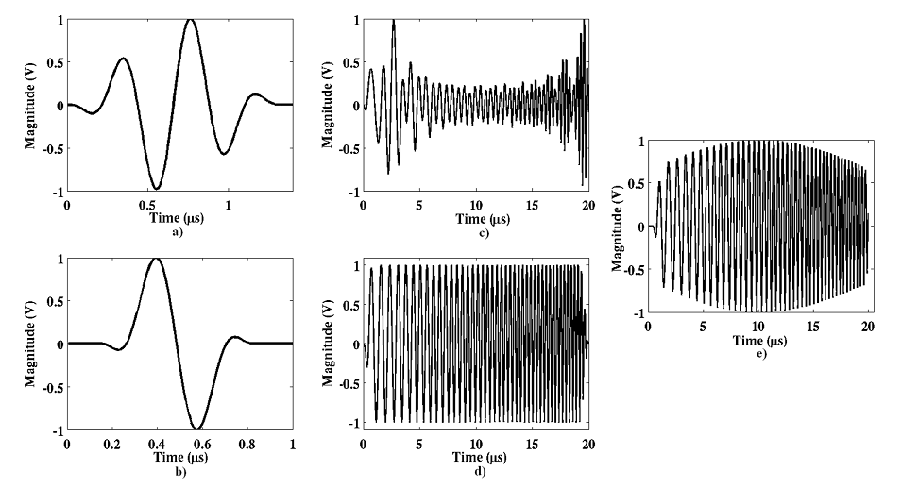
Source:
M. Oelze, “Bandwidth and Resolution Enhancement through Pulse Compression,” IEEE Trans. Ultrason., Ferroelec. and Freq. Control, vol. 54, pp. 768–781, Apr. 2007.

Slide 11
REC Subsystem
V_{ulc}(f)
V_{upc}(f)
V_{pc}(f)
Waveform
Generator
Tukey
Window
V_{lc}(f)

Slide 12
System Block Diagram
Received Echo Signals
Beamformed Signals
V_{pc}(t)
V_{in}(t)
REC
Transducer
SAFT
Image
Recon.
Image Output
V_{lc}(t)

Slide 13
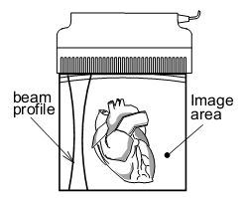
Transducer
Linear Array Transducer consisting of several elements
Capable of emitting and receiving ultrasonic pulses
Generates several signals to be processed to form an image.
S. I. Nikolov, Synthetic Aperture Tissue and Flow Ultrasound Imaging. PhD thesis, Technical University of Denmark, Aug. 2001.

Slide 14
Transducer Specifications
256 Elements
3 MHz Center Frequency
200 MHz Sampling Frequency
4 mm Element Height
0.26 mm Element Width
0.04 mm Element Kerf
20 mm Focus
Kerf
Height
Width

Slide 15
System Block Diagram
Received Echo Signals
Beamformed Signals
V_{pc}(t)
V_{in}(t)
REC
Transducer
SAFT
Image
Recon.
Image Output
V_{lc}(t)

Slide 16
Synthetic Aperture Focusing Techniques
Electrically focuses signals to create an artificial aperture.
Uses different excitation schemes
Three Variations:
Generic Synthetic Aperture Ultrasound (GSAU)
Synthetic Transmit Aperture Ultrasound (STAU)
Synthetic Receive Aperture Ultrasound (SRAU)
Results generated by delay and sum beamforming.

Slide 17
GSAU
Transmit with one and receive with one.
Each transmit event generates a low resolution image.
Information needs to be delayed appropriately for each pixel before summing.
Gain in SNR:

Slide 18
STAU
Transmit with one and receive with all.
Additional degree of freedom
Gain in SNR:

Slide 19
SRAU
Transmit with all and receive with one.
Gain in SNR:

Slide 20
SAFT
Received Echo Signals
Image Scan Lines
Apodization
Delay and Sum
Beamforming

Slide 21
Apodization
Spatial Windowing
Used to shape the beam profile
Reweighting by apodization coefficients
Several different windowing techniques can be studied
Rectangular
Triangular
Raised Cosine
a₁
a₂
a_{N}

Slide 22
System Block Diagram
Received Echo Signals
Beamformed Signals
V_{pc}(t)
V_{in}(t)
REC
Transducer
SAFT
Image
Recon.
Image Output
V_{lc}(t)

Slide 23
Image Reconstruction Subsystem
Beamformed Signal
Wiener
Filter
Envelope
Detection
Logarithmic
Compression
Limiter
Image Scan Line
V_{lc}(t)

Slide 24
Outline
I. Introduction
II. Project Summary
III. Block Diagram
IV. Preliminary Work
V. Schedule

Slide 25
Preliminary Work
Image Reconstruction subsystem completed.
STAU partially completed
Conventional pulsing instead of REC
Individual low resolution images generated.
Output image generated.
Rectangular apodization
64 elements instead of 256

Slide 26
Individual STAU Images

Slide 27
Effect of Beamforming

Slide 28
Outline
I. Introduction
II. Project Summary
III. Block Diagram
IV. Preliminary Work
V. Schedule

Slide 29
Schedule
1/28 – 2/8: REC
2/11 – 2/22: GPGPU implementation of STAU
2/25 – 3/8: GSAU
3/11 – 3/29: SRAU
4/1 – 4/12: Prepare for Student Scholarship Expo
4/15 – 4/19: Expo
4/22 – 5/3: Write Final Report & Presentation

Slide 30
Ultrasound Simulations using REC and SAFT
Presenter:
Tony Podkowa
November 13, 2012
Advisor: Dr José R. Sánchez
Department of Electrical and Computer Engineering

Slide 31
Generic Synthetic Aperture Ultrasound
Object

Slide 32
Generic Synthetic Aperture Ultrasound
Object

Slide 33
Matched Filter
Echo Signal
Pre-
amplifier
ADC
Matched
filter
A
A
SAFT
Reconstructed image

