Slide 1
Ultrasonic Imaging using Resolution Enhancement Compression and GPU-Accelerated Synthetic Aperture Techniques
Presenter:
Anthony Podkowa
May 2, 2013
Advisor: Dr José R. Sánchez
Department of Electrical and Computer Engineering

Slide 2
Outline
I. Motivation & project summary
II. Block diagram
A. REC
B. GSAU
III. Results
IV. Areas of Expansion

Slide 3
Outline
I. Motivation & project summary
II. Block diagram
A. REC
B. GSAU
III. Results
IV. Areas of Expansion

Slide 4
Motivation
Key medical imaging technique
Tumor detection
Seek to improve
  Spatial resolution
  Signal-to-noise ratio (SNR)

Slide 5
Project Summary
Resolution enhancement compression (REC)
  Coded excitation and pulse compression technique
  Improved axial resolution
  Improved SNR
Generic synthetic aperture ultrasound (GSAU)
  Synthetic aperture technique
  Improves lateral resolution
  Improves SNR
  Computationally expensive, but parallelizable

Slide 6
Goals:
1. To investigate the combination of both REC and GSAU in an ultrasound system using MATLAB and Field II.
2. To accelerate the GSAU algorithm using a graphics processing unit (GPU) to achieve real-time processing of the images.

Slide 7
Outline
I. Motivation & project summary
II. Block diagram
A. REC
B. GSAU
III. Results
IV. Areas of Expansion

Slide 8
System Block Diagram
Received Echo Signals
Compressed Signals
Beamformed Signals
V_{pc}(t)
Image Output
V_{in}(t)
Encoder
Transducer
Wiener
Filter
GSAU
Image
Recon.
256
256
256
256
V_{lc}(t)

Slide 9
Outline
I. Motivation & project summary
II. Block diagram
A. REC
B. GSAU
III. Results
IV. Areas of Expansion

Slide 10
Resolution Enhancement Compression
Received Echo Signals
Compressed Signals
V_{pc}(t)
V_{in}(t)
Encoder
Transducer
Wiener
Filter
256
256
V_{lc}(t)
Based on the convolution equivalence principle
Encoder shapes excitation signal
Wiener Filter:
  Compresses the received signals
  Removes corrupting noise

Slide 11
Convolution Equivalence Principle
Some input
Desired system
Desired Response
Some other input
Transducer
Make h_{t}(t) act like h_{d}(t) by shaping v₁(t)
Wiener deconvolution.

Slide 12
Encoder Subsystem
V_{ulc}(f)
Wiener
Deconvolution
Filter
V_{upc}(f)
Tukey
Window
V_{pc}(f)
Inverse
Filter
V_{lc}(f)

Slide 13
Encoder Subsystem
V_{ulc}(f)
Wiener
Deconvolution
Filter
V_{upc}(f)
Tukey
Window
V_{pc}(f)
Inverse
Filter
V_{lc}(f)

Slide 14
Encoder Subsystem
V_{ulc}(f)
Wiener
Deconvolution
Filter
V_{upc}(f)
Tukey
Window
V_{pc}(f)
Inverse
Filter
V_{lc}(f)

Slide 15
Encoder Subsystem
V_{ulc}(f)
Wiener
Deconvolution
Filter
V_{upc}(f)
Tukey
Window
V_{pc}(f)
Inverse
Filter
V_{lc}(f)

Slide 16
System Block Diagram
Received Echo Signals
Compressed Signals
Beamformed Signals
V_{pc}(t)
Image Output
V_{in}(t)
Encoder
Transducer
Wiener
Filter
GSAU
Image
Recon.
256
256
256
256
V_{lc}(t)

Slide 17
Transducer Specifications
256 elements
8 MHz center frequency
200 MHz sampling frequency
4 mm element height
0.26 mm element width
0.04 mm element kerf
20 mm focus
Kerf
Height
Width

Slide 18
System Block Diagram
Received Echo Signals
Compressed Signals
Beamformed Signals
V_{pc}(t)
Image Output
V_{in}(t)
Encoder
Transducer
Wiener
Filter
GSAU
Image
Recon.
256
256
256
256
V_{lc}(t)

Slide 19
Outline
I. Motivation & project summary
II. Block diagram
A. REC
B. GSAU
III. Results
IV. Areas of Expansion

Slide 20
GSAU Technique
Transmit and receive with one element at a time.
Calculate delays associated with the distances from element to each pixel:
256 x 30000 pixels
Parallel processing

Slide 21
GPU Programming (CUDA)
Up to 8 cores
Hundreds of cores
Host
Device
Memory
Memory
Transfer

Slide 22
CUDA C
Allocate data memory on device
Copy data from the host memory to the device
Spawn several threads to process the data
Each thread runs the same chunk of code (kernel)
Each thread processes the pixel corresponding to its thread index.
Copy data back from device memory
Free device memory

Slide 23
Test Hardware Specifications
CPU: Intel Core i7-2600K
  4 Cores
  Processor Clock: 3.4 GHz
RAM: 16 GB
GPU: NVIDIA Quadro 5000
  352 CUDA cores
  Processor Clock: 1026 MHz
  RAM: 2560 MB GDDR5
  Memory Bandwidth: 120 GB/s

Slide 24
System Block Diagram
Received Echo Signals
Compressed Signals
Beamformed Signals
V_{pc}(t)
Image Output
V_{in}(t)
Encoder
Transducer
Wiener
Filter
GSAU
Image
Recon.
256
256
256
256
V_{lc}(t)

Slide 25
Image Reconstruction Subsystem
Beamformed Signal
Image Scan Line
Envelope
Detection
Logarithmic
Compression
Limiter

Slide 26
Outline
I. Motivation & project summary
II. Block diagram
A. REC
B. GSAU
III. Results
IV. Areas of Expansion

Slide 27
Simulation Settings
Point imaged at 20mm
Tukey window taper: α = 0.08
γ = 1 (Wiener filter)
Additive noise injected (σ_{n} = 0.1 σ_{s})
Excitation schemes studied:
  REC
  Conventional pulsing (Delta function)

Slide 28
Encoding
Linear chirp:
  0 – 17.12 MHz
  12.5 μs
Desired Response:
  200% BW
Transducer Response:
  100% BW
MSE: 4.46x10⁻⁷

Slide 29
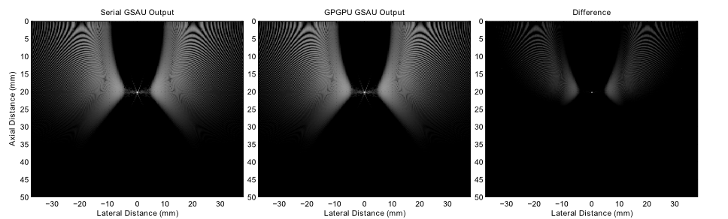
GPU Acceleration
GPUs perform faster using single precision
4.5% round off error
Computation time decreased from 29.25 s to 0.25 s

Slide 30
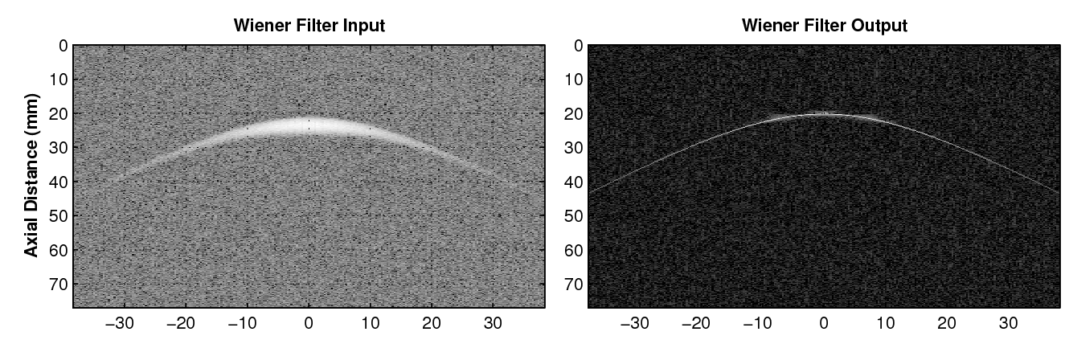
Wiener Filter
Received signals compressed axially
3 dB gain in SNR

Slide 31
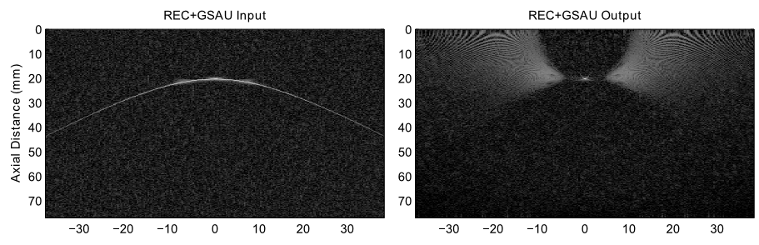
REC + GSAU
Received signals compressed laterally
5 dB gain in SNR

Slide 32
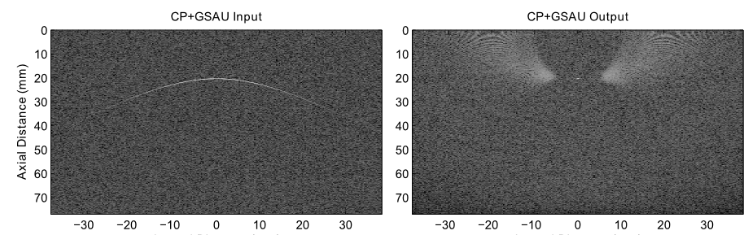
CP + GSAU
Received signals compressed laterally
SNR loss of 0.3 dB
10 dB less SNR than REC + GSAU, and 5 dB less than REC alone

Slide 33
Resolution Analysis
Resolution computed from the modulation transfer function (MTF)
MTF is the spatial Fourier transform of the point spread function (PSF).
Critical wavenumber k₀ computed by determining the point where normalized MTF crosses 0.1
Resolution given by:

Slide 34
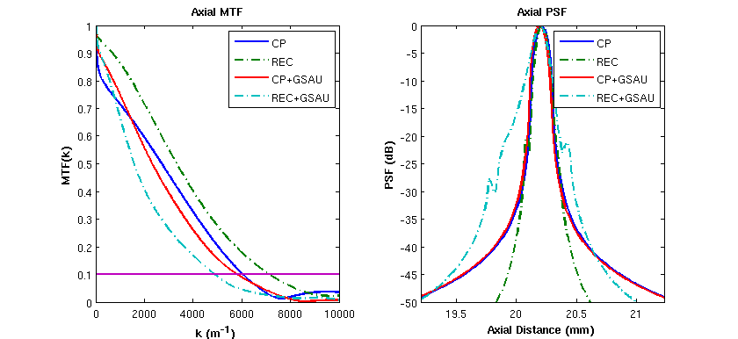
Axial Resolution
CP: 0.52022 mm
REC: 0.44062 mm
CP+GSAU: 0.54117 mm
REC+GSAU: 0.64507 mm

Slide 35
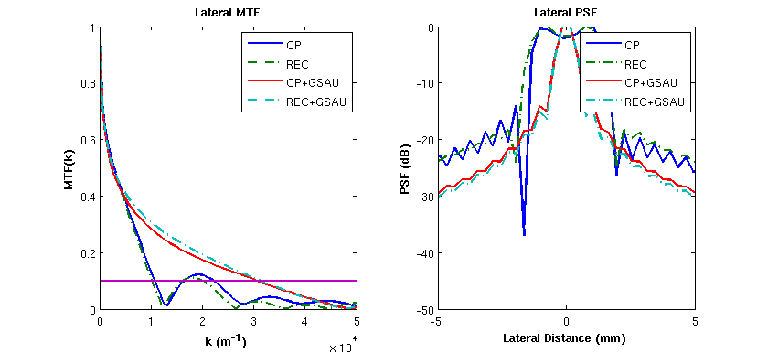
Lateral Resolution
CP: 0.28149 mm
REC: 0.29489 mm
CP+GSAU: 0.10321 mm
REC+GSAU: 0.10321 mm

Slide 36
Outline
I. Motivation & project summary
II. Block diagram
A. REC
B. GSAU
III. Results
IV. Areas of Expansion

Slide 37
Potential Areas of Expansion
GSAU
  Improved interpolation (linear, polynomial)
  Alternative reweighting schemes
Other SA techniques:
  Synthetic transmit aperture ultrasound (STAU)
  Synthetic receive aperture ultrasound (SRAU)
GPU speedup
  Use of optimized libraries (CUBLAS, MAGMA)
  Reduce thread overhead

Slide 38
Conclusions
REC + GSAU exhibit the best performance in SNR.
CP + GSAU exhibit the best performance in spatial resolution.
GPU acceleration results in a speedup by a factor of 116.

Slide 39
References
[1] M. Oelze, “Bandwidth and resolution enhancement through pulse compression,” IEEE Trans. Ultrason., Ferroelec., and Freq. Contr., vol. 54, no. 4, pp. 768-781, Apr. 2007.
[2] J. Sanchez and M. Oelze, “An ultrasonic imaging speckle-suppression and contrast-enhancement technique by means of frequency compounding and coded excitation,” IEEE Trans. Ultrason., Ferroelec., and Freq. Contr., vol. 56, no. 7, pp. 1327-1339, Jul. 2009.
[3] S. Nikolov, “Synthetic aperture tissue and flow ultrasound imaging,” Ph.D. dissertation, Technical University of Denmark, 2001. [Online]. Available: https://svetoslavnikolov.wordpress.com/synthetic-aperture-ultrasound-imaging/
[4] J. Jensen, “Field: A program for simulating ultrasound systems,” in Medical & Biological Engineering & Computing, vol. 34, 1996, pp 351-353
[5] J. Jensen, and N. Svendsen, “Calculation of pressure fields from arbitrary shaped, apodized, and excited ultrasound transducers,” IEEE Trans. Ultrason., Ferroelec. and Freq. Contr.

Slide 40
Ultrasonic Imaging using Resolution Enhancement Compression and GPU-Accelerated Synthetic Aperture Techniques
Presenter:
Anthony Podkowa
May 2, 2013
Advisor: Dr José R. Sánchez
Department of Electrical and Computer Engineering

Slide 41
Importing into MATLAB
Generate PTX file from CUDA code
Initialize kernel object using PTX file
Convert input data to a gpuArray
Evaluate kernel
Bring the output data back using the gather() function

Slide 42
Derivation of Envelope Detection

Slide 43
Apodization
Spatial Windowing
Used to shape the beam profile
Reweighting by apodization coefficients
a₁
a₂
a_{N}

Slide 44
Generic Synthetic Aperture Ultrasound
Electrically focus signals to create an artificial aperture.
Pros:
  Improved lateral resolution.
  Improved SNR.
Cons:
  Computationally expensive.

