Slide 1

Reconfigurable Communication System Design
Anthony Gaught
Advisors:
Dr. In Soo Ahn and Dr. Yufeng Lu
Department of Electrical and Computer Engineering
Bradley University, Peoria, Illinois
May 7, 2013

Slide 2
Outline
Motivation
Project Goals
Introduction to QPSK
System Block Diagram
Design Methodology
Simulation Results
Hardware Results
Conclusions
References

Slide 3
Motivation
In cellular systems, different data rates are achieved by adjusting modulation and channel coding schemes. A reconfigurable system can meet the ever-increasing demands and reduce the cost of system.
Quadrature Phase Shift Keying (QPSK) is one of the modulation methods adopted in various wireless communication standards.
Different design tools are available to design and implement communication systems. Each has its own advantages and disadvantages.

Slide 4
Project Goals
Design a complete QPSK communication system on Field Programmable Gate Arrays(FPGAs) using hardware description language (HDL).
Implement a carrier recovery circuit and a digital phase locked loop to resolve carrier offset in the receiver.
Design and verify the communication system in an efficient way.
Construct the system with hardware-efficient modules which can be reusable and expandable with additional features in the future.

Slide 5
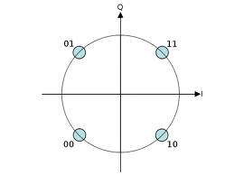
QPSK Constellation Plot
s(t) = I(t)cos(2πf_{c}t) – Q(t)sin(2πf_{c}t)
Each symbol represents two bits of data.
I and Q bits are determined based on the phase of the received symbol.

Slide 6
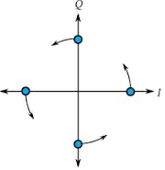
Carrier Recovery
Carrier signals from the transmitter and receiver need to be synchronized in order to correctly demodulate the received data.
A small frequency offset is present between the transmitter and receiver.
Coherent detection is achieved by using a phase locked loop (PLL).
A direct digital synthesizer creates coherent sine and cosine carriers.

Slide 7
Calculating Phase Error
I_{hat}(n) and Q_{hat}(n) are the outputs from decimators.
I(n) and Q(n) are estimated hard-decoded data.
Φ is the phase error.
Phase error is used to adjust the frequency and phase of the local oscillator.

Slide 8
Proportional and Integral (PI) Control
PI control provides a means to control bandwidth and dampening factor.
By optimizing K_{p} and K_{i} fast locking time and reduced jitter can be achieved.
Bandwidth is chosen first and other parameters are derived using the equations to the left.

Slide 9
Phase Ambiguity
Static phase error can occur at integer multiples of 90 degrees
Four possible states as seen on the constellation grid
Can be corrected by differential coding or transmitting a known sequence to synchronize the system

Slide 10
Signal Shaping
Raised cosine filter
Reduces inter-symbol interference (ISI)
Improves bandwidth

Slide 11
System Specifications
Specification one FPGA two FPGAs
System clock frequency 50 MHz 50 MHz
Carrier Frequency 12.5 MHz 184 KHz
Symbol Rate 6.25 Msps 91.9 Ksps
Data Rate 12.5 Mbps 184 Kbps
Maximum Carrier Offset 1 KHz 14.7 Hz

Slide 12
System Block Diagram
The QPSK signal, s(t), includes in-phase component, I(t), and quadrature component, Q(t).
r(t) = s(t) + n(t) where n(t) is noise.

Slide 13
Design Methodology

Slide 14


Simulation Results
VHDL simulation results plotted are against the SIMULINK model results using MATLAB.
Fixed point representation is used throughout the HDL design.

Slide 15
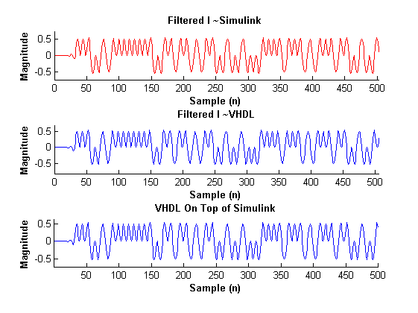
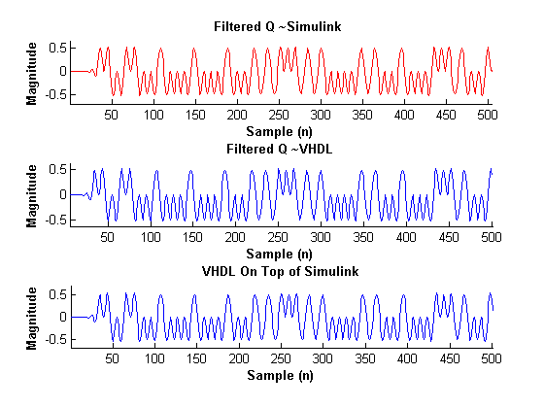
Pulse Shaping Filter Outputs
Data type: FIX 12_11

Slide 16
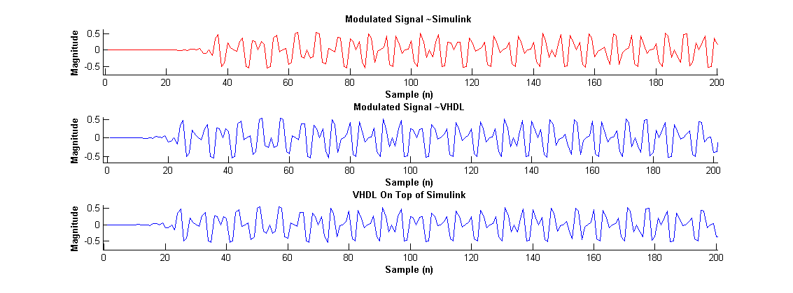
Modulated Signal s(n)
Data type: FIX 12_11

Slide 17
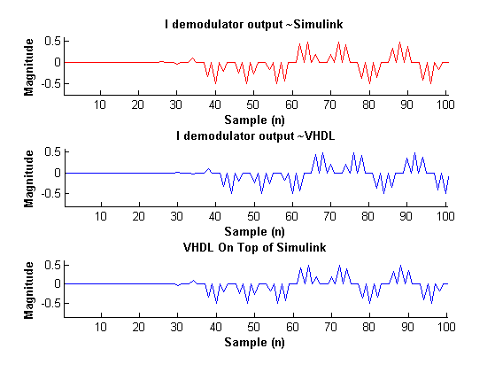
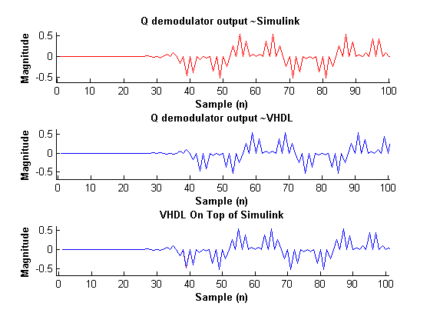
Demodulator Outputs
Data type: FIX 12_11

Slide 18
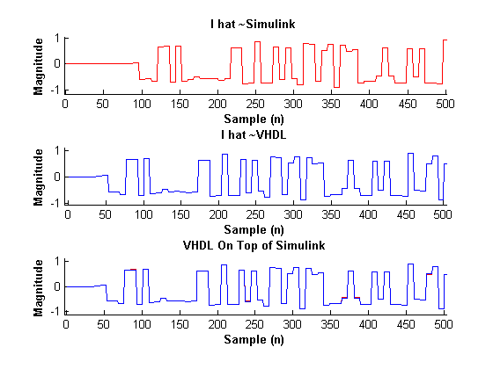
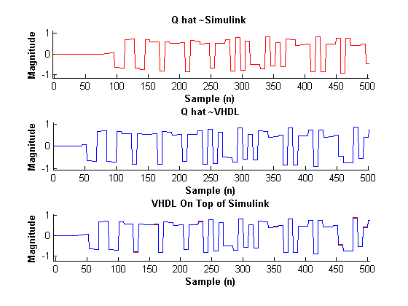
Decimator Outputs
Data type: FIX 16_15

Slide 19
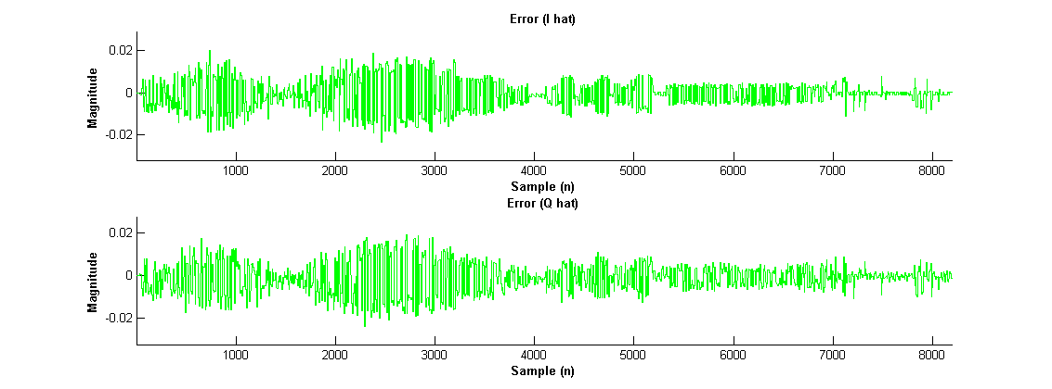
SIMULINK VS. VHDL (I_{hat} & Q_{hat})
Error on Ihat and Qhat due to fixed point representation and truncation
I_{hat} Mean square error = 5.44 x 10⁻⁵
Q_{hat} Mean square error = 5.68 x 10⁻⁵

Slide 20
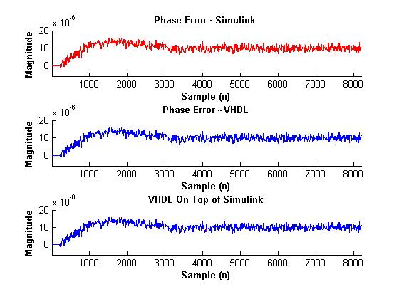
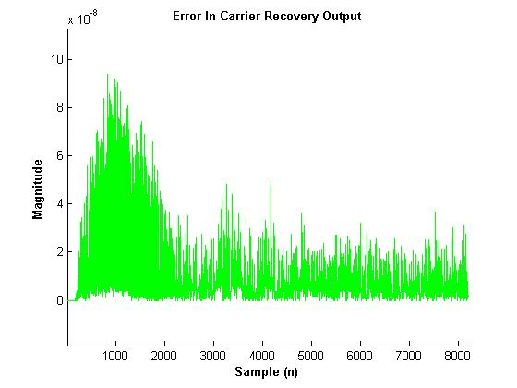
Carrier Recovery Output
Data type: FIX 32_31
Frequency offset = 500 Hz Mean square error = 1.86 x 10⁻¹¹

Slide 21
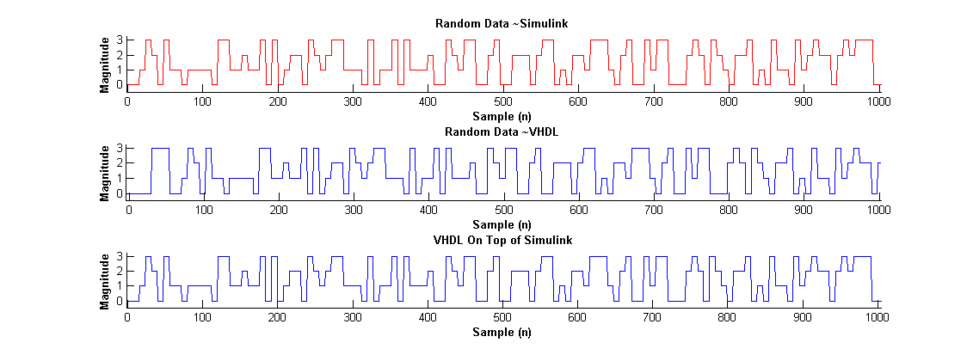
Transmitted vs. Received Data
Data type: FIX 2_0

Slide 22
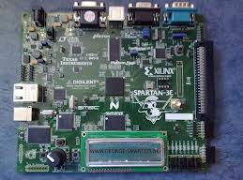
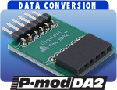
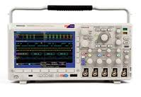

Hardware Results
The design is implemented on Spartan 3E Boards.
P-mod DA2 and P-mod AD1 modules are used transmit the signal between FPGAs.
Signals of interest are displayed on an oscilloscope.

Slide 23
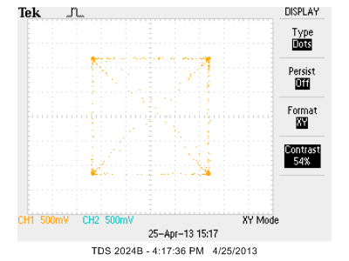
Transmitted Data
Constellation plot for the transmitted data

Slide 24
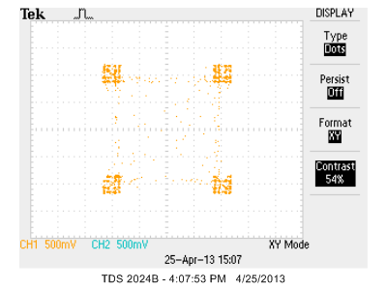
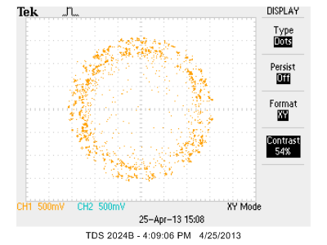
Received Data
Constellation plot for the received data
Transmitter and receiver on the same FPGA
s(n) is an internal digital signal.
Frequency offset < 1 KHz Frequency offset > 1 KHz

Slide 25
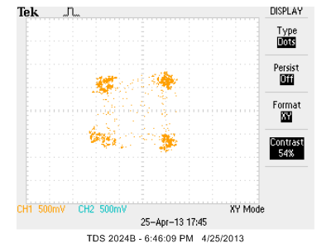

Received Data Cont.
Constellation plot for the received data
Transmitter and receiver on separate FPGAs
s(t) is an external analog signal.
Frequency offset < 14.7 Hz Frequency offset > 14.7 Hz

Slide 26
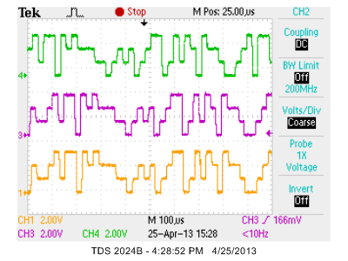
Transmitted vs. Received Data
Data type: FIX 2_0
(From top down)
Transmitted data
Received data on the same FPGA
Received data on separate FPGAs

Slide 27
Observed Phase Ambiguity
(From top down)
It
Qt
I_{r}
Q_{r}

Slide 28
Observed Phase Ambiguity Cont.
(From top down)
It
Qt
I_{r}
Q_{r}

Slide 29
Possible Future Features
Correct for phase ambiguity
Wireless transmission of the modulated signal
Implementation of other modulation schemes such as higher order PSK, quadrature amplitude modulation (QAM) or others

Slide 30
Conclusions
In this project, a reconfigurable QPSK communication system has been designed using HDL.
The system has been implemented on low-cost Xilinx Spartan3E boards.
An efficient verification flow has been applied to the design.
Carrier recovery circuit and digital phase locked loop are used to resolve carrier offset which is essential for decoding of the transmitted data.

Slide 31
References
Anton Rodriguez, and Michael Mensinger Jr., “Software-defined Radio using Xilinx”, Senior Project Report, Department of Electrical and Computer Engineering, Bradley University, Peoria Illinois, May 2011.
Anthony Gaught, Alexander Norton, and Christopher Brady., “FPGA-based 16 QAM communication system”, Digilent design contest Report, Department of Electrical and Computer Engineering, Bradley University, Peoria Illinois, April 2012.
Leon Couch, “Digital and analog communication systems”, 8th edition, Boston: Pearson, 2013.

Slide 32

Questions

