Slide 1
Closed Loop Control of Halbach Array Magnetic Levitation System Height
By: Kyle Gavelek
Victor Panek Christopher Smith
Advised by: Dr. Winfred Anakwa
Mr. Steven Gutschlag

Slide 2
Closed Loop Control of Halbach Array Magnetic Levitation System Height
Introduction
Background
CLCML Project
Development
Planning
Motor Model
Controller
Lookup Table
Microcontroller
Conclusion
Summarize Results
Questions

Slide 3
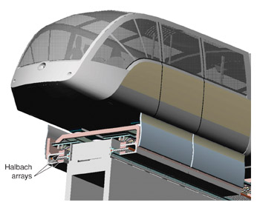
Closed Loop Control of Halbach Array Magnetic Levitation System Height
Background
CLCML Project
Planning
Motor Model
Controller
Lookup Table
μController
Conclusion
Depiction of Halbach array implementation on high speed train

Slide 4
Closed Loop Control of Halbach Array Magnetic Levitation System Height
Objectives
Background
CLCML Project
Planning
Motor Model
Controller
Lookup Table
μController
Conclusion
Improve the rotational stability of the inductrack by balancing the wheel
Construct an enclosure in order to safely reach high rotational velocities
Model the DC motor and verify its accuracy to within +/- 5% of steady state
Designed a controller to achieve closed loop control of displacement height
Use a microcontroller to implement the controller

Slide 5
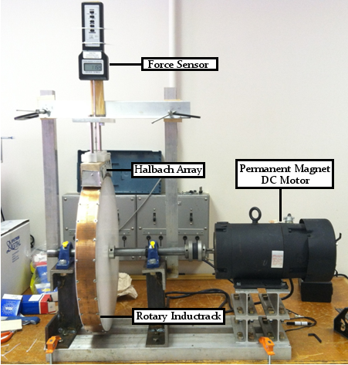
Closed Loop Control of Halbach Array Magnetic Levitation System Height
Background
CLCML Project
Planning
Motor Model
Controller
Lookup Table
μController
Conclusion
Last year’s final inductrack system

Slide 6
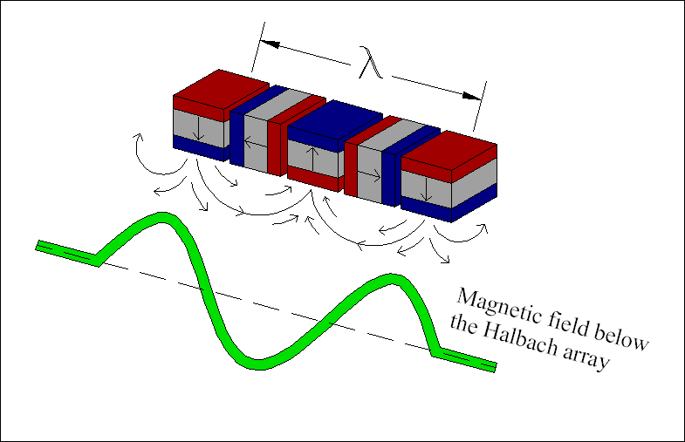
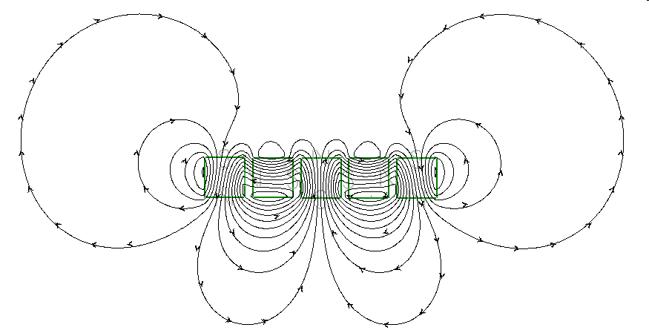
Closed Loop Control of Halbach Array Magnetic Levitation System Height
Halbach Array Theory
Background
CLCML Project
Planning
Motor Model
Controller
Lookup Table
μController
Conclusion
Magnetic Field Lines
Sinusoidal Magnetic Field Generated
$$B_{0}=\frac{B_{r}\left(1−e^{−\frac{4πd}{λ}}\right)\sin\left(π/M\right)}{π/M}$$
T
B_{r} – Individual Magnet’s Strength d – Thickness of magnets
λ – wavelength M – # of magnets per wavelength

Slide 7
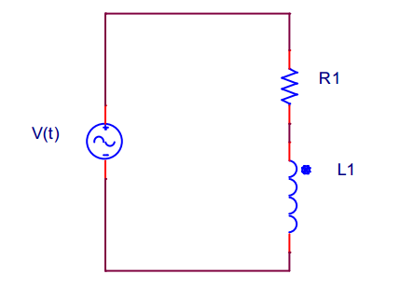
Closed Loop Control of Halbach Array Magnetic Levitation System Height
Inductrack Theory
Background
CLCML Project
Planning
Motor Model
Controller
Lookup Table
μController
Conclusion
Copper inductrack
Velocity of Halbach Array’s Magnetic Field
Inductrack Properties

Slide 8
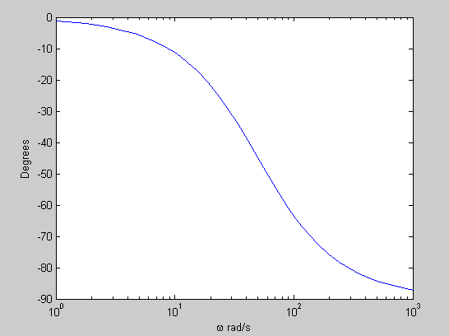
Closed Loop Control of Halbach Array Magnetic Levitation System Height
Inductrack Theory
Background
CLCML Project
Planning
Motor Model
Controller
Lookup Table
μController
Conclusion
Excitation Frequency:
$$ω_{e}=kv$$
v – velocity of Halbach Array
k – wavenumber of Halbach Array’s magnetic field
RL Bode Phase Response

Slide 9
Closed Loop Control of Halbach Array Magnetic Levitation System Height
Inductrack Theory
Background
CLCML Project
Planning
Motor Model
Controller
Lookup Table
μController
Conclusion
Excitation Frequency:
$$ω_{e}=kv$$
v – velocity of Halbach Array
k – wavenumber of Halbach Array’s magnetic field

Slide 10
Closed Loop Control of Halbach Array Magnetic Levitation System Height
Halbach Array – Inductrack Interaction
Background
CLCML Project
Planning
Motor Model
Controller
Lookup Table
μController
Conclusion
Magnetic Flux:
$Ф\left(t\right)=\frac{B_{0}w}{k}e^{−ky}sin⁡(ω_{e}t)(1−e^{−ky})$ [Wb]
w – width of Halbach Array k – wave number =2π/λ
ω_{e} – excitation frequency = kv y – vertical distance
Peak Magnetic Flux:
$Ф_{0}=\frac{B_{0}w}{k}e^{−ky}$ [Wb]

Slide 11
Closed Loop Control of Halbach Array Magnetic Levitation System Height
Halbach Array – Inductrack Interaction
Background
CLCML Project
Planning
Motor Model
Controller
Lookup Table
μController
Conclusion
Induced Voltage:
$v\left(t\right)=ω_{e}Φ_{0}\cos\left(ω_{e}t\right)]$ [V]
Induced Current:
$i\left(t\right)=\frac{Φ_{0}}{L}\left[\frac{1}{1+{\left(\frac{R}{ω_{e}L}\right)}^{2}}\right][\sin\left(ω_{e}t\right)+\cos\left(ω_{e}t\right)]$ [A]
Inductrack Properties:
R – inductrack resistance L – inductrack inductance

Slide 12
Closed Loop Control of Halbach Array Magnetic Levitation System Height
Halbach Array – Inductrack Interaction
Background
CLCML Project
Planning
Motor Model
Controller
Lookup Table
μController
Conclusion
Vertical Force:
$Fy\left(ω_{e},y\right)=\frac{B_{0}^{2}wA}{2kLd_{c}}\left[\frac{1}{1+{\left(R/{ω_{e}L}\right)}^{2}}\right]e^{−2ky}$ [N]
Drag Force:
$Fx\left(ω_{e},y\right)=\frac{B_{0}^{2}wA}{2kLd_{c}}\left[\frac{R/{ω_{e}L}}{1+{\left(R/{ω_{e}L}\right)}^{2}}\right]e^{−2ky}$ [N]
A – Area under the Halbach Array
d_{C} – Spacing of Inductors

Slide 13
Closed Loop Control of Halbach Array Magnetic Levitation System Height
Inductrack Resistance:
Inductrack Inductance:
$$R=R_{c}\frac{l}{A}$$
$$L=μ_{0}\frac{P_{c}}{4πd_{c}/λ }$$
Background
CLCML Project
Planning
Motor Model
Controller
Lookup Table
μController
Conclusion
Ω
H
Revised Parameter Calculations
B₀ = 0.8060 T R = 2.12 x 10⁻⁴ Ω
L = 6.86 x 10⁻⁸ H
R_{C} – Resistivity of Copper
l – Length of Inductor circuit
A – Inductrack Cross-sectional Area
μ₀ – Permeability of free space
λ – Wavelength of magnetic field
P_{C} – Mean Perimeter of Inductrack circuit
d_{C} – Spacing of Inductors
Peak Magnetic Field:
$$B_{0}=\frac{B_{r}\left(1−e^{−\frac{4πd}{λ}}\right)\sin\left(π/M\right)}{π/M}$$
2011-2012 Calculated Parameters
B₀ = 0.8060 T R = 1.9 x 10⁻⁴ Ω
L = 7.532 x 10⁻⁸ H

Slide 14
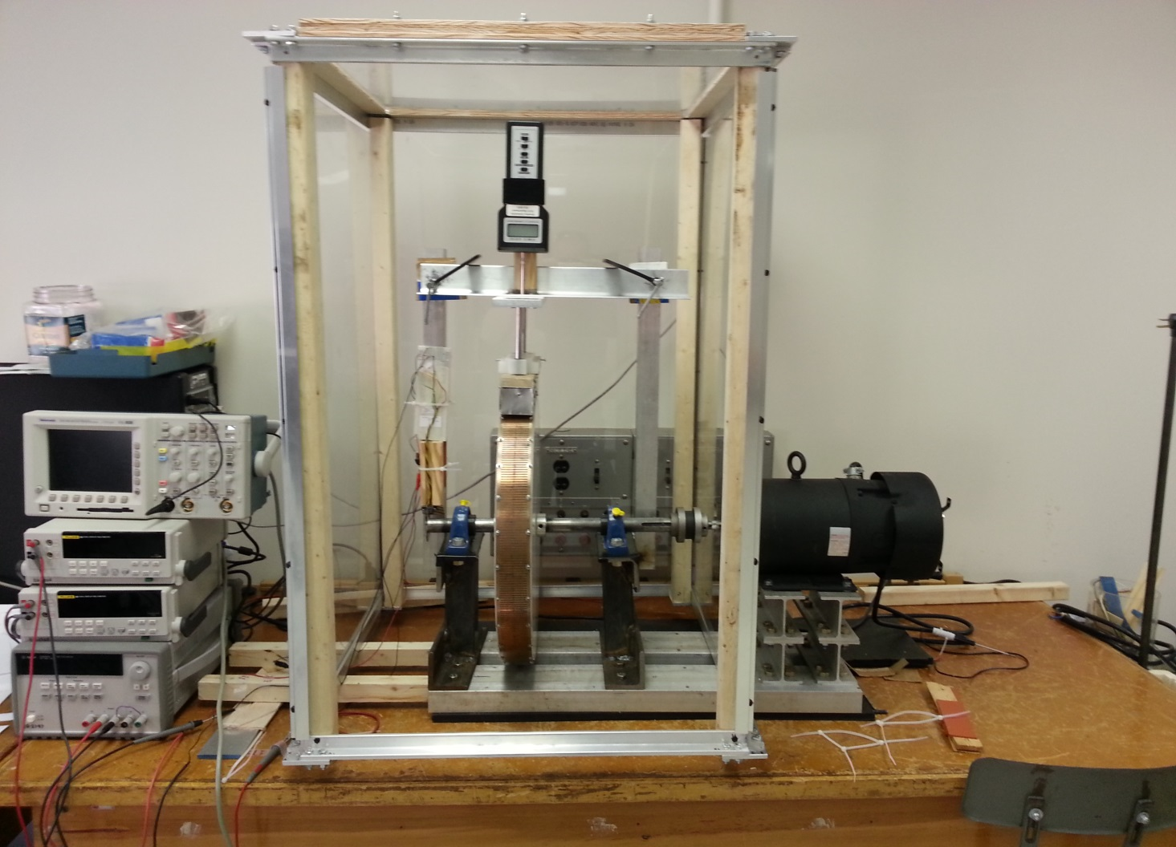
Closed Loop Control of Halbach Array Magnetic Levitation System Height
System Improvements
Background
CLCML Project
Planning
Motor Model
Controller
Lookup Table
μController
Conclusion
Last year’s final inductrack system
Inductrack System with safety enclosure

Slide 15
Closed Loop Control of Halbach Array Magnetic Levitation System Height
Background
CLCML Project
Planning
Motor Model
Controller
Lookup Table
μController
Conclusion
Notes:
All Visio diagrams need to be redrawn

Slide 16
Closed Loop Control of Halbach Array Magnetic Levitation System Height
Background
CLCML Project
Planning
Motor Model
Controller
Lookup Table
μController
Conclusion
Lookup Table Specifications:
Contain data points to allow a resolution of 0.5 mm
Controller Design Specifications:
Maximum overshoot less than 10%
Steady state error equal zero for unit step input
Minimize settling time based on other specifications
Motor Model Performance Specifications:
Steady State accuracy within +/- 5%
Notes:
All Visio diagrams need to be redrawn

Slide 17
Closed Loop Control of Halbach Array Magnetic Levitation System Height
Motor Model Design Equations
Background
CLCML Project
Planning
Motor Model
Controller
Lookup Table
μController
Conclusion
Common DC Motor Circuit Schematic
Measurable Quantities:
ω_{m} – machine rotational speed i – amature current
V_{a} – source voltage V_{b} – back emf voltage
$L_{a}\frac{di}{dt}+R_{a}i=V_{a}−V_{b}$ $T=k_{T}$i
$J\frac{dω_{m}}{dt}={T−Bω}_{m}−T_{cf}$ $V_{b}=k_{v}ω_{m}$
Parameters to determine:
R_{a} – armature resistance L_{a} – armature inductance
k_{v} – motor torque constant k_{T} – back emf constant
B – motor viscous friction T_{cf} – columbic friction
J – moment of inertia

Slide 18
Closed Loop Control of Halbach Array Magnetic Levitation System Height
Determination of Armature Resistance
$$R_{a}$$
V_{a} [V] | i [A] | R_{a} [Ω]
Digital Multimeter | Current Probe | R=V_{a}/I_{a}
1.0 | 0.20 | 5.00
2.0 | 0.45 | 4.40
3.2 | 1.00 | 3.20
5.2 | 2.00 | 2.60
6.5 | 3.00 | 2.16
8.0 | 4.00 | 2.00
9.3 | 5.00 | 1.86
11.0 | 6.00 | 1.83
Background
CLCML Project
Planning
Motor Model
Controller
Lookup Table
μController
Conclusion
Common DC Motor Circuit Schematic
$L_{a}\frac{di}{dt}+R_{a}i=V_{a}−V_{b}$ $V_{b}=k_{v}ω_{m}$
$$V_{a}=R_{a}i$$
[V]
$$R_{a}={V_{a}}/i$$
[Ω]
R_{a} = 2.00 Ω

Slide 19
Closed Loop Control of Halbach Array Magnetic Levitation System Height
Determination of Armature Inductance
$$L_{a}$$
Background
CLCML Project
Planning
Motor Model
Controller
Lookup Table
μController
Conclusion
Common DC Motor Circuit Schematic
$$L_{a}\frac{di}{dt}+R_{a}i=V_{a}$$
$$i\left(τ_{e}\right)≈.632i_{ss}$$
$τ_{e}≈10.8$ ms
$L_{a}=R_{a}τ_{e}$ $=0.0216$ H

Slide 20
Closed Loop Control of Halbach Array Magnetic Levitation System Height
Determination of Back emf Constant and Motor Torque Constant
$$k_{v}, k_{T}$$
Background
CLCML Project
Planning
Motor Model
Controller
Lookup Table
μController
Conclusion
$k_{v1}=0.6175$ ^{V}/_{rad/s}
$k_{v2}=0.6122$ ^{V}/_{rad/s}
Average $k_{v}=0.615$ ^{V}/_{rad/s}
$k_{T}=0.615$ N m/A
Common DC Motor Circuit Schematic
 | V_{a} [V] | i_{a} [A] | ω_{m} [RPM] | ω_{m} [rad/s]
 | Digital Multimeter | Current Probe | Tachometer | [rad/s]= [RPM]*π/30
Trial 1: | 20.5 | 0.95 | 270 | 28.274
Trial 2: | 50.45 | 1.04 | 735 | 76.969
$L_{a}\frac{di}{dt}+R_{a}i=V_{a}−V_{b}$ $V_{b}=k_{v}ω_{m}$
$$R_{a}i=V_{a}−k_{v}ω_{m}$$
$$k_{v}=\frac{V_{a}−R_{a}i}{ω_{m}}$$

Slide 21
Closed Loop Control of Halbach Array Magnetic Levitation System Height
Determination of Viscous Friction and Coulombic Friction Torque
$$B, T_{cf}$$
Background
CLCML Project
Planning
Motor Model
Controller
Lookup Table
μController
Conclusion
$$J\frac{dω_{m}}{dt}={T−Bω}_{m}−T_{cf}$$
$T=k_{T}$i
$$0=k_{T}\text{i}−{Bω}_{m}−T_{cf}$$
 | i_{a} [A] | ω_{m} [RPM] | ω_{m} [rad/s]
 | Current Probe | Tachometer | [rad/s]=RPM*π/30
Trial 1: | 1.038 | 200 | 20.93
Trial 2: | 1.350 | 735 | 76.93
B = 0.0061 ^{N m}/_{rad/s} T_{cf} = 0.5105 N m

Slide 22
Closed Loop Control of Halbach Array Magnetic Levitation System Height
Determination of Moment of Inertia
$J$
Background
CLCML Project
Planning
Motor Model
Controller
Lookup Table
μController
Conclusion
Common DC Motor Circuit Schematic
$$J\frac{dω_{m}}{dt}={T−Bω}_{m}−T_{cf}$$
$$ω_{m}(t)=\left[ω_{m}\left(0^{+}\right)+\frac{T_{cf}}{B}\right]e^{−\left(B/J\right)t}−\frac{T_{cf}}{B}$$
$$V_{b}=k_{v}ω_{m}=k_{v}\left[\left[ω_{m}\left(0^{+}\right)+\frac{T_{cf}}{B}\right]e^{−\left(B/J\right)t}−\frac{T_{cf}}{B}\right]$$

Slide 23
Closed Loop Control of Halbach Array Magnetic Levitation System Height
Determination of Moment of Inertia
$J$
Background
CLCML Project
Planning
Motor Model
Controller
Lookup Table
μController
Conclusion
 | ω(0⁺)[RPM] | ω(0⁺)[rad/s] | t[sec] | Vb(t)[V]
 | Tachometer | [rad/s]=[RPM]*π/30 | Voltage Probe | Voltage Probe
Trial 1: | 498 | 52.15 | 0.20 | 26.0
 |  |  | 0.80 | 8.6
Trial 2: | 1010 | 105.77 | 0.40 | 52.6
 |  |  | 1.50 | 18.0
J₁ = 0.2471 kg m² J₂ = 0.2920 kg m²
J₃ = 0.2413 kg m² J₄ = 0.2603 kg m²
$$V_{b}=k_{v}ω_{m}=k_{v}\left[\left[ω_{m}\left(0^{+}\right)+\frac{T_{cf}}{B}\right]e^{−\left(B/J\right)t}−\frac{T_{cf}}{B}\right]$$
Average $J=0.261$ kg m²

Slide 24
Closed Loop Control of Halbach Array Magnetic Levitation System Height
Background
CLCML Project
Planning
Motor Model
Controller
Lookup Table
μController
Conclusion
Introduction
Background
CLCML Project
Development
Planning
Motor Model
Controller
Lookup Table
Microcontroller
Conclusion
Summarize Results
Questions
24
Notes:
24

Slide 25
Closed Loop Control of Halbach Array Magnetic Levitation System Height
$$V_{a}−V_{b}=L_{a}\frac{di}{dt}+R_{a}i$$
$$J\frac{dω_{m}}{dt}={T−Bω}_{m}−T_{cf}$$
Background
CLCML Project
Planning
Motor Model
Controller
Lookup Table
μController
Conclusion
$T=k_{T}$i
$$V_{a}−V_{b}=L_{a}si+R_{a}i$$
$$T−T_{cf}=Jsω_{m}+{Bω}_{m}$$
$$V_{b}=k_{v}ω_{m}$$
$$\frac{i}{V_{a}−V_{b}}=\frac{1}{L_{a}s+R_{a} }$$
$$\frac{ω_{m}}{T−T_{cf}}=\frac{1}{Js+B}$$
$$T_{cf}$$
–
+
$$V_{a}$$
$$i$$
$$T$$
$$\frac{1}{Js+B}$$
$$ω_{m}$$
$$\frac{1}{Ls+R}$$
$$k_{T}$$
+
–
$$V_{b}$$
$$k_{v}$$

Slide 26
Closed Loop Control of Halbach Array Magnetic Levitation System Height
R = 2.00 Ω L = 0.0216 H
k_{t} = 0.615 ^{Nm}/_{A} k_{v} = 0.615 ^{V}/_{(rad/s)}
T_{cf} = 0.5105 N m B = 0.0061 ^{Nm}/_{(rad/s)}
J = 0.216 kg m²
Background
CLCML Project
Planning
Motor Model
Controller
Lookup Table
μController
Conclusion
$$0.5105$$
–
+
$$V_{a}$$
$$\frac{1}{0.0216s+2.00}$$
$$i$$
$$T$$
$$\frac{1}{0.261s+0.0061}$$
$$ω_{m}$$
$$0.615$$
+
–
$$V_{b}$$
$$0.615$$

Slide 27
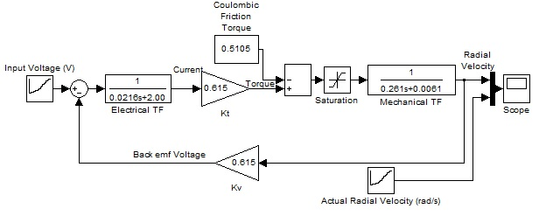
Closed Loop Control of Halbach Array Magnetic Levitation System Height
Voltage | Velocity
V_{a} (V) | F_{enc} (Hz) | v_{RPM} (rpm) | ω_{m} (rad/s)
7.15 | 5.600 | 84.000 | 8.792
8.32 | 6.800 | 102.000 | 10.676
9.76 | 8.100 | 121.500 | 12.717
11.15 | 9.500 | 142.500 | 14.915
13.00 | 11.300 | 169.500 | 17.741
14.65 | 12.800 | 192.000 | 20.096
16.85 | 15.200 | 228.000 | 23.864
20.34 | 19.000 | 285.000 | 29.830
24.95 | 23.800 | 357.000 | 37.366
30.29 | 28.700 | 430.500 | 45.059
35.71 | 34.500 | 517.500 | 54.165
40.60 | 39.900 | 598.500 | 62.643
45.35 | 45.000 | 675.000 | 70.650
49.96 | 49.000 | 735.000 | 76.930
54.86 | 54.750 | 821.250 | 85.958
59.92 | 60.000 | 900.000 | 94.200
64.70 | 65.000 | 975.000 | 102.050
Background
CLCML Project
Planning
Motor Model
Controller
Lookup Table
μController
Conclusion

Slide 28
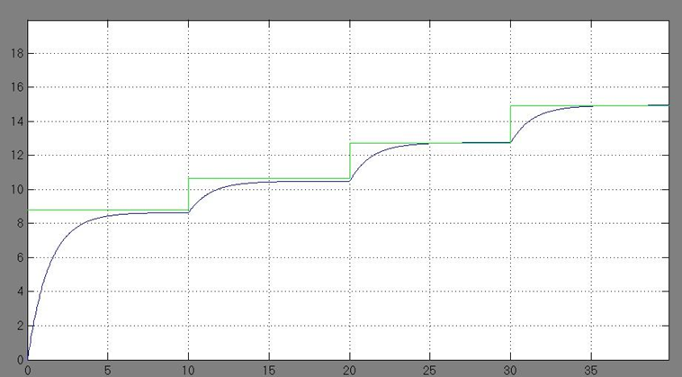
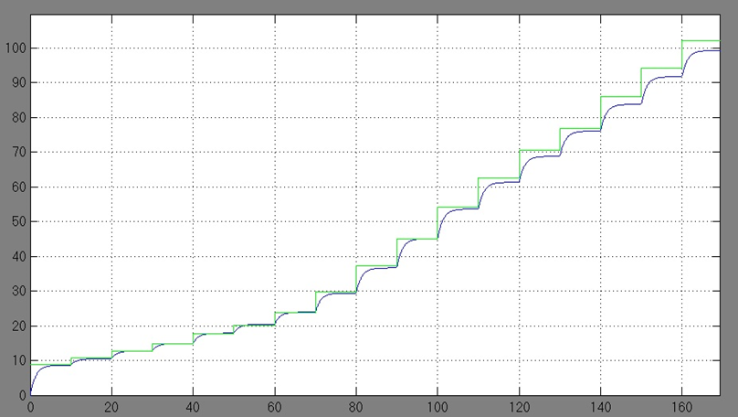
Closed Loop Control of Halbach Array Magnetic Levitation System Height
Green = Experimental Steady State Blue = Model Simulation
Background
CLCML Project
Planning
Motor Model
Controller
Lookup Table
μController
Conclusion
Rotational Velocity (rad/s)
Time (seconds)

Slide 29
Closed Loop Control of Halbach Array Magnetic Levitation System Height
Voltage | Velocity | SIMULINK Model | % Error
V_{a} (V) | ω_{m} (rad/s) | ω_{m} (rad/s)
7.15 | 8.792 | 8.643 | -1.69%
8.32 | 10.676 | 10.490 | -1.75%
9.76 | 12.717 | 12.758 | 0.32%
11.15 | 14.915 | 14.947 | 0.22%
13.00 | 17.741 | 17.861 | 0.68%
14.65 | 20.096 | 20.460 | 1.81%
16.85 | 23.864 | 23.925 | 0.26%
20.34 | 29.830 | 29.421 | -1.37%
24.95 | 37.366 | 36.682 | -1.83%
30.29 | 45.059 | 45.092 | 0.07%
35.71 | 54.165 | 53.630 | -0.99%
40.60 | 62.643 | 61.333 | -2.09%
45.35 | 70.650 | 68.815 | -2.60%
49.96 | 76.930 | 76.077 | -1.11%
54.86 | 85.958 | 83.795 | -2.52%
59.92 | 94.200 | 91.765 | -2.58%
64.70 | 102.050 | 99.295 | -2.70%
Background
CLCML Project
Planning
Motor Model
Controller
Lookup Table
μController
Conclusion

Slide 30
Closed Loop Control of Halbach Array Magnetic Levitation System Height
Input Voltage
V_{a}=9.65 V
Steady State Velocity
ω_{ss}=12.4 rad/s
Background
CLCML Project
Planning
Motor Model
Controller
Lookup Table
μController
Conclusion
Input Voltage
V_{a}=20.6 V
Steady State Velocity
ω_{ss}=29.4 rad/s
Input Voltage
V_{a}=39.5 V
Steady State Velocity
ω_{ss}=59.7 rad/s

Slide 31
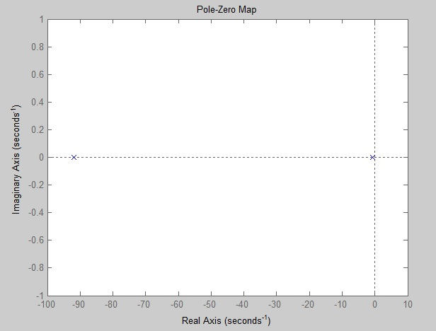
Closed Loop Control of Halbach Array Magnetic Levitation System Height
$$G\left(s\right)=109.09\frac{1}{s^{2}+92.62s+69.25}$$
Background
CLCML Project
Planning
Motor Model
Controller
Lookup Table
μController
Conclusion
$p_{1}=−91.86$ [rad/s] $p_{2}=−0.75$ [rad/s]

Slide 32
Closed Loop Control of Halbach Array Magnetic Levitation System Height
$$G\left(s\right)=109.09\frac{1}{s^{2}+92.62s+69.25}$$
Background
CLCML Project
Planning
Motor Model
Controller
Lookup Table
μController
Conclusion
$p_{1}=−91.86$ [rad/s] $p_{2}=−0.75$ [rad/s]
Design Specification 1: Steady State Error = 0 for unit step input
Controller Transfer Function will have an integrator.
Design Specification 2: Less than 10% Overshoot
Damping Ratio: ζ = 0.707
Design Specification 3: Settling Time less than 4 second
Settling Time: t_{s} < 4 seconds

Slide 33
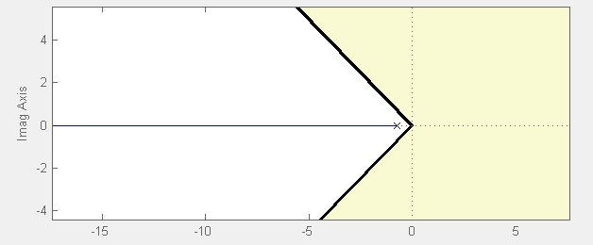
Closed Loop Control of Halbach Array Magnetic Levitation System Height
$$G\left(s\right)=109.09\frac{1}{s^{2}+92.62s+69.25}$$
Background
CLCML Project
Planning
Motor Model
Controller
Lookup Table
μController
Conclusion
Design Specification 1: steady state error = 0
Design Specification 2: Less than 10% overshoot. ζ = 0.707
Design Specification 3: t_{s} < 4 seconds

Slide 34
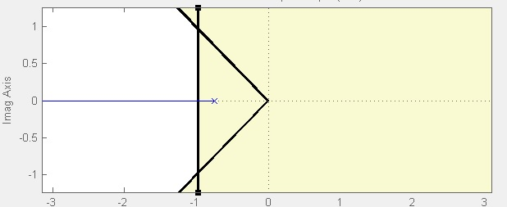
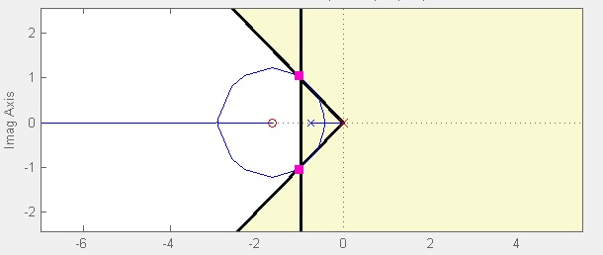
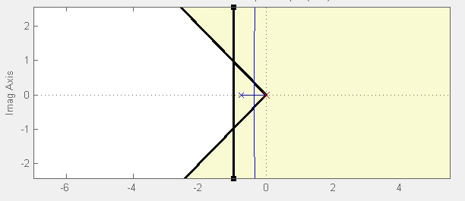
Closed Loop Control of Halbach Array Magnetic Levitation System Height
$$G\left(s\right)=109.09\frac{1}{s^{2}+92.62s+69.25}$$
Background
CLCML Project
Planning
Motor Model
Controller
Lookup Table
μController
Conclusion
Design Specification 1: steady state error = 0
Design Specification 2: Less than 10% overshoot. ζ = 0.707
Design Specification 3: t_{s} < 4 seconds

Slide 35
Closed Loop Control of Halbach Array Magnetic Levitation System Height
Controller Transfer Function:
$$C\left(s\right)=k_{p}\frac{s+z}{s}$$
Background
CLCML Project
Planning
Motor Model
Controller
Lookup Table
μController
Conclusion
A more realistic Transfer Function:
$$C\left(s\right)=k_{p}\frac{s+z}{s(s+p)}$$
A lead network with integral action.

Slide 36
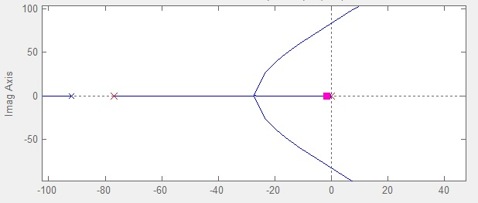
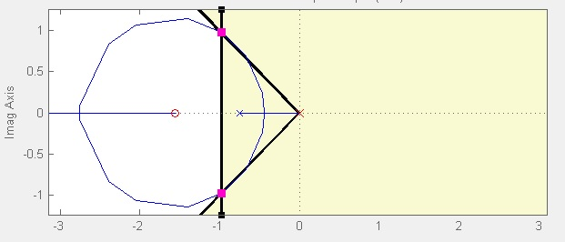
Closed Loop Control of Halbach Array Magnetic Levitation System Height
Background
CLCML Project
Planning
Motor Model
Controller
Lookup Table
μController
Conclusion
$$C\left(s\right)=75.71\frac{s+1.56}{s(s+76.92)}$$

Slide 37
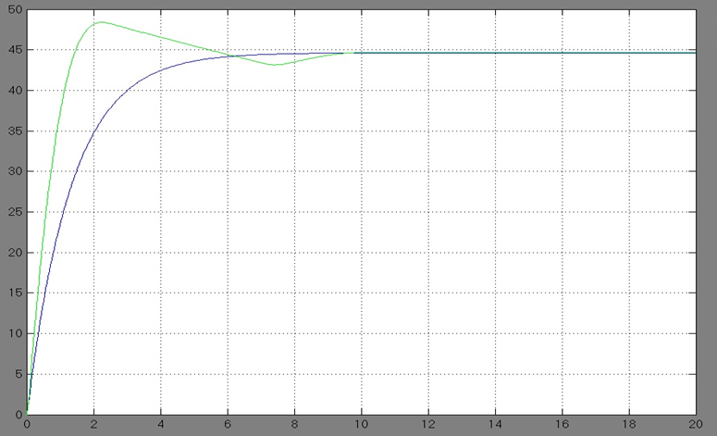
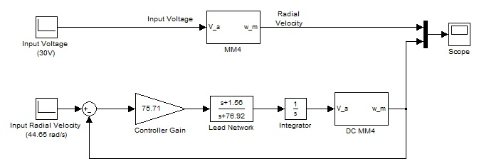
Closed Loop Control of Halbach Array Magnetic Levitation System Height
Green = Controller Blue = Uncontrolled
Background
CLCML Project
Planning
Motor Model
Controller
Lookup Table
μController
Conclusion
.
.
ω_{ss} = 44.65
.
0.95ω_{ss} = 42.42
1.05ω_{ss} = 46.88
Rotational Velocity (rad/s)
ω_{peak} = 48.41
Time (seconds)

Slide 38
Closed Loop Control of Halbach Array Magnetic Levitation System Height
Determination of Sampling Time
$$C\left(s\right)=75.71\frac{s+1.56}{s(s+76.92)}$$
$$G\left(s\right)=109.09\frac{1}{s^{2}+92.62s+69.25}$$
Background
CLCML Project
Planning
Motor Model
Controller
Lookup Table
μController
Conclusion
Desired Rotational Velocity
Resulting Rotational Velocity
$$C(s)$$
$$G(s)$$
+
–
$$G_{cl}\left(s\right)=1.42\frac{s+1.56}{s^{4}+169.54s^{3}+7193.85s^{2}+13776.92s+13207.69}$$

Slide 39
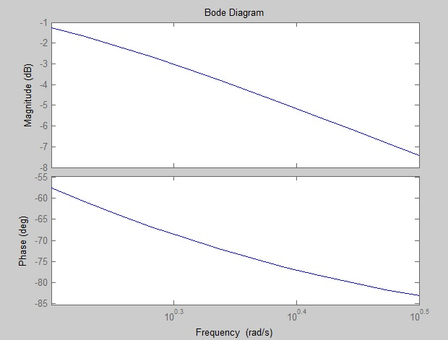
Closed Loop Control of Halbach Array Magnetic Levitation System Height
Determination of Sampling Time
Background
CLCML Project
Planning
Motor Model
Controller
Lookup Table
μController
Conclusion
$$T_{s}<\frac{1}{40×BW}$$
$$T_{s}<\frac{1}{40×{10}^{0.3}}$$
$T_{s}<.0125$ sec

Slide 40
Closed Loop Control of Halbach Array Magnetic Levitation System Height
Digital Controller Design
Continuous Time Controller:
$$C\left(s\right)=75.71\frac{s+1.56}{s(s+76.92)}$$
Background
CLCML Project
Planning
Motor Model
Controller
Lookup Table
μController
Conclusion
Discrete Time Controller:
$T_{s}=0.01$sec
$$C\left(z\right)=\frac{0.5453−0.5369z^{−1}}{1−1.463z^{−1}+0.4634z^{−2}}$$
Difference Equation form:
$$y\left(k\right)−1.463 y\left(k−1\right)−0.4634 y\left(k−2\right)=0.5453 x\left(k\right)−0.5369 x(k−1)$$

Slide 41
Closed Loop Control of Halbach Array Magnetic Levitation System Height
Background
CLCML Project
Planning
Motor Model
Controller
Lookup Table
μController
Conclusion
$$F\left(ω_{e},y\right)=\frac{B_{0}^{2}wA}{2kLd_{c}}\left[\frac{1}{1+{\left(R/{ω_{e}L}\right)}^{2}}\right]e^{−2ky}$$
$$F\left(ω_{e},y\right)=\left[\frac{1061.06}{1+\frac{9.55×{10}^{6}}{ω_{e}^{2}}}\right]e^{−448.8y}$$

Slide 42
Closed Loop Control of Halbach Array Magnetic Levitation System Height
Background
CLCML Project
Planning
Motor Model
Controller
Lookup Table
μController
Conclusion
$$F\left(ω_{e},y\right)=\left[\frac{1061.06}{1+\frac{9.55×{10}^{6}}{ω_{e}^{2}}}\right]e^{−448.8y}$$
$$y\left(ω_{e}\right)=0.002228 ln\left(\frac{232.69}{1+\frac{9.55×{10}^{6}}{ω_{e}^{2}}}\right)$$
$$F=mg=4.56$$
N

Slide 43
Closed Loop Control of Halbach Array Magnetic Levitation System Height
Background
CLCML Project
Planning
Motor Model
Controller
Lookup Table
μController
Conclusion
Introduction
Background
CLCML Project
Development
Planning
Motor Model
Controller
Lookup Table
Microcontroller
Conclusion
Summarize Results
Questions
43
Notes:
43

Slide 44
Closed Loop Control of Halbach Array Magnetic Levitation System Height
Vs
Background
CLCML Project
Planning
Motor Model
Controller
Lookup Table
μController
Conclusion
uController
User Input
PWM
Power
MOSFET
Optical Encoder
Displacement Sensor
Motor – μController Interface

Slide 45
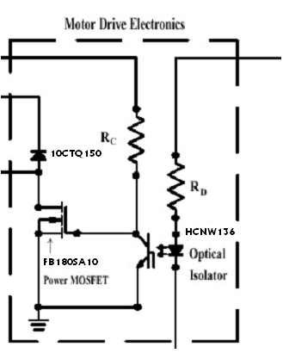
Closed Loop Control of Halbach Array Magnetic Levitation System Height
Background
CLCML Project
Planning
Motor Model
Controller
Lookup Table
μController
Conclusion
V_{s} = 80 V
+5 V
To Motor
To Motor
PWM from microcontroller

Slide 46
Closed Loop Control of Halbach Array Magnetic Levitation System Height
uController
Background
CLCML Project
Planning
Motor Model
Controller
Lookup Table
μController
Conclusion
uController Inputs:
User Input: Desired Displacement
Optical Encoder: Current Speed
Displacement Sensor: Resulting Displacement

Slide 47
Closed Loop Control of Halbach Array Magnetic Levitation System Height
Background
CLCML Project
Planning
Motor Model
Controller
Lookup Table
μController
Conclusion
Funtions of the STR2NUM function:
Stores user input as characters in array
Converts char stored in array to int data type
Ones value input > 6 is reverted to 6
Decimal value input rounded down to 0 or 5.
Stores final integer result in VALUE to be used in PWM.

Slide 48
Closed Loop Control of Halbach Array Magnetic Levitation System Height
Background
CLCML Project
Planning
Motor Model
Controller
Lookup Table
μController
Conclusion
Functions of CONTROLLER:
Calculate velocity error
Output voltage calculated using difference equation (shown below)
Store previous voltage and velocity error values for next iteration
y$\left(k\right)=1.46 y\left(k−1\right)− .46 y\left(k−2\right)$
$$+ .54 x\left(k\right)− .54 x(k−1)$$

Slide 49
Closed Loop Control of Halbach Array Magnetic Levitation System Height
Background
CLCML Project
Planning
Motor Model
Controller
Lookup Table
μController
Conclusion
Functions of PWM:
Read duty cycle (DC) % from VALUE
Set TH0 and TL0 based on DC %
Set P4.4 output
Reset on Timer 0 overflow
The high and low portions of the PWM signal both follow this procedure to produce the proper output.

Slide 50
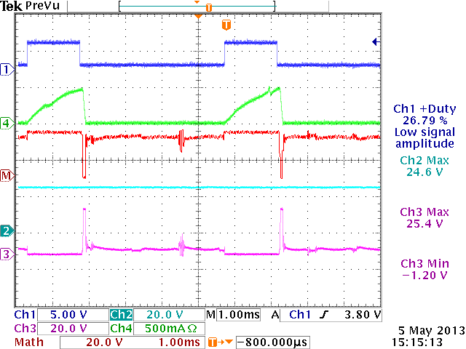
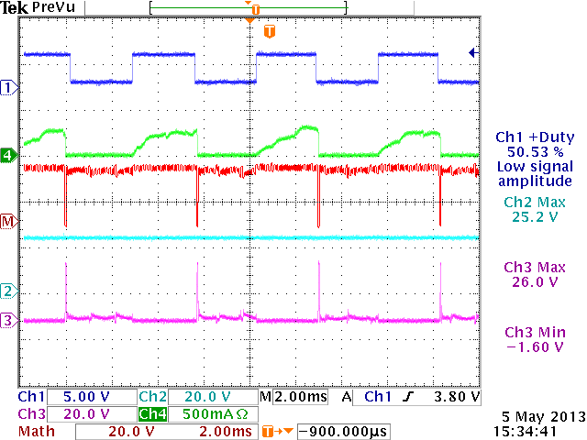
Closed Loop Control of Halbach Array Magnetic Levitation System Height
Background
CLCML Project
Planning
Motor Model
Controller
Lookup Table
μController
Conclusion
~ 25% Duty Cycle ~ 50% Duty Cycle
PWM Outputs from microcontroller
Ch 1: PWM Output Ch 2: V_{s}
Ch 3: Drain Vtg Ch 4: Source Current
MATH: Ch 2 – Ch 3 = Motor Vtg

Slide 51
Closed Loop Control of Halbach Array Magnetic Levitation System Height
Improve the rotational stability of
the inductrack by balancing the
wheel
Construct an enclosure in order to
safely reach high rotational
velocities
Model the DC motor and verify its
accuracy to within +/- 5% of steady
state
Designed a controller to achieve
closed loop control of displacement
height
Use a microcontroller to implement
the controller
Wheel has been balanced to within 2g
Safety enclosure designed and built in Jobst shop
Modelled DC motor within +/- 3% of steady state
values for rotational velocity up to 1000 RPM
Designed continuous time controller to achieve
closed loop control of rotational velocity
Converted controller to discrete time. Formed
difference equation to be used in microcontroller
Programmed microcontroller to accept user input
within range of operation (0 to 6.0 mm)
Successfully provide accurate PWM output using the
microcontroller
Collected displacement data and created lookup table
for starting displacement of 7.0 mm
Built and tested PWM circuit
Background
CLCML Project
Planning
Motor Model
Controller
Lookup Table
μController
Conclusion
51

Slide 52
Closed Loop Control of Halbach Array Magnetic Levitation System Height
Richard F. Post
Magnetic Levitation System for Moving Objects
U.S. Patent 5,722,326
March 3, 1998
Richard F. Post
Inductrack Magnet Configuration
U.S. Patent 6,633,217 B2
October 14, 2003
Richard F. Post
Inductrack Configuration
U.S. Patent 629,503 B2
October 7, 2003
Richard F. Post
Laminated Track Design for Inductrack Maglev System
U.S. Patent Pending US 2003/0112105 A1
June 19, 2003
Coffey; Howard T.
Propulsion and stabilization for magnetically levitated vehicles
U.S. Patent 5,222,436
June 29, 2003
Coffey; Howard T.
Magnetic Levitation configuration incorporating levitation,
guidance and linear synchronous motor
U.S. Patent 5,253,592
October 19, 1993
Levi;Enrico; Zabar;Zivan
Air cored, linear induction motor for magnetically levitated
systems
U.S. Patent 5,270,593
November 10, 1992
Background
CLCML Project
Planning
Motor Model
Controller
Lookup Table
μController
Conclusion
Lamb; Karl J. ; Merrill; Toby ; Gossage; Scott D. ; Sparks;
Michael T. ;Barrett; Michael S.
U.S. Patent 6,510,799
January 28, 2003

Slide 53
Closed Loop Control of Halbach Array Magnetic Levitation System Height
[1] Dirk DeDecker, Jesse VanIseghem. Senior Project. “Development of a Halback Array Magnetic Levitation System”. Final Report, May 2012
[2] Glenn Zomchek. Senior Project. “Redesign of a Rotary Inductrack for Magnetic Levitation Train Demonstration.” Final Report, 2007.
[3] Paul Friend. Senior Project. Magnetic Levitation Technology 1. Final Report, 2004.
[4] Post, Richard F., Ryutov, Dmitri D., “The Inductrack Approach to Magnetic Levitation,” Lawrence Livermore National Laboratory.
[5] Post, Richard F., Ryutov, Dmitri D., “The Inductrack: A Simpler Approach to Magnetic Levitaiton,” Lawrence Livermore National Laboratory.
[6] Post, Richard F., Sam Gurol, and Bob Baldi. "The General Atomics Low Speed Urban Maglev Technology Development Program." Lawrence Livermore National Laboratory and General Atomics.
Background
CLCML Project
Planning
Motor Model
Controller
Lookup Table
μController
Conclusion

