Slide 1
Reconfigurable Patch Antenna
With Matching Network
Presented by: Mike Bly, Josh Rohman Advisor: Dr. Prasad N. Shastry

Slide 2
Presentation Outline
Introduction to Reconfigurable Antenna
Alternative Options
Design Criteria
Patch Antenna Design
Switching Method and Implementation
Simulation
Matching Network
Schedule

Slide 3
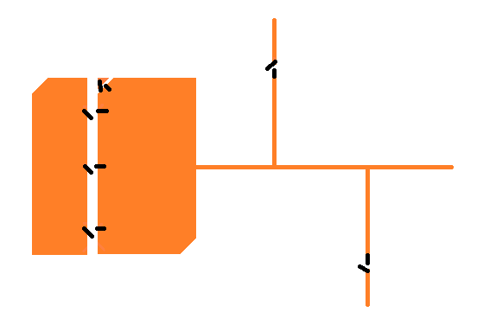
Reconfigurable Antenna?
One antenna system that supports multiple single frequency bands.
Types: Patch Antennas, Wire Antennas, PIFAs

Slide 4
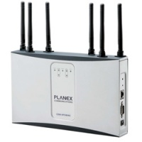
Alternative Option 1: Multiple Antennas
More Antennas = More Required Space
Single Band

Slide 5
Alternative Option 2: Wideband Antenna
One antenna supports all frequency bands needed
Reduced space compared to multiple antennas, but large bandwidth
Noise from large bandwidth

Slide 6
Proposed Design Criteria
Patch antenna on microstrip board
2 GPS application frequencies
1.227 GHz
1.575 GHz
Double stub impedance matching network
Matched to 50Ω
MEMS preferred switching method

Slide 7
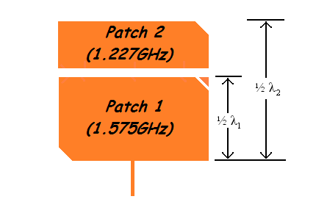
Patch Antenna
Rogers Corporation RO3010 Microstrip Board
ε_{r} = 10.2, h = 5 mils
1.227 GHz, 1.575 GHz
Right Hand Circular Polarization

Slide 8
Patch Antenna
Equations:
L1 = W = 2.988 cm
L2 (total) = 3.795 cm
dL2 = 0.807 cm

Slide 9
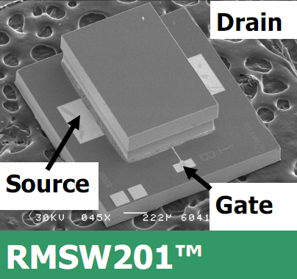
Switching Method
MEMS Switch
RMSW201, RADANT MEMS
SPST
DC to 20 GHz
0.3dB Insertion Loss @ 2GHz
35dB Isolation Loss @ 2GHz
1.9mm x 1.85mm package size
+/- 90V Gate-Source Voltage
Wire bonding to board

Slide 10
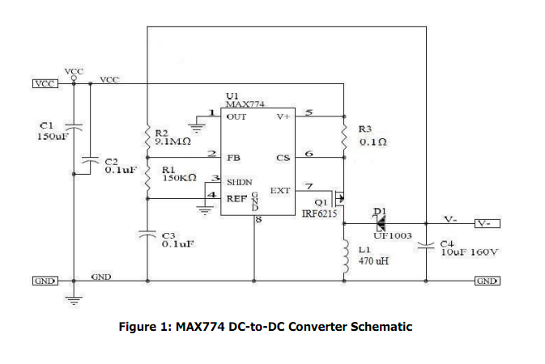
Switching Method
DC-DC Converter: +5V to -90V

Slide 11
Implementing MEMS
Via holes to ground plane

Slide 12
Implementing MEMS
Conductive epoxy over via hole
Wire bonding, gold plating

Slide 13
Simulations: Linear Patch Antenna
PCAAD 6.0
Simulate Linear Patch Antenna (square or rectangle) to determine resonant frequency
Simulate both patches separately before integration into one system

Slide 14
Simulations: Polarized Patch Antenna
Sonnet or Momentum
Right Hand Circular Polarization
Modify linear patch antenna design to truncate corners.

Slide 15
Simulations: Include Switches
Patches connected or not connected

Slide 16
Double Stub Matching Network
A matching network allows maximum power transfer
Useable for most load admittances

Slide 17
Double Stub Matching Network
Reconfigurable to match different patch resonant frequencies
Can not be analyzed until patch antenna system is designed
Methods:
Using Smith Charts:
Cancel out all imaginary impedances
Match impedance to 50Ω
Must be done for each patch (Reconfigurable)

Slide 18
Task Schedule
Research (completed)
Antenna Type
Switching Device
Polarization Methods
Simulations (in progress)
Linear Patch Antenna
1.575 GHz, 1.227 GHz
Polarized Patch Antenna
Determine Switch Parameters
Polarized Patch Antenna w/ switches (on/off)

Slide 19
Task Schedule (cont.)
Impedance Matching – Double Stub
Smith Chart
Stub Lengths
Open or Short Circuit
Board Fabrication
Microstrip Board
Implement MEMS
Switching Device

Slide 20
Task Schedule (cont.)
Analysis
Resonant Frequencies
Efficiency
Comparison to Simulation Results

Slide 21
Tentative Remaining Schedule
Simulations – Purchasing of Parts
Complete by end of Fall ’11 Semester
Impedance Matching
Weeks 1-2
Fabrication
Weeks 3-10
Analysis
Weeks 11-15

Slide 22
Questions?

