Slide 1
Frequency Reconfigurable Patch Antenna
Design Review Presentation
Presented by: Mike Bly, Josh Rohman Advisor: Dr. Prasad N. Shastry

Slide 2
Presentation Outline
MEMS Switch
DC-DC Converter, Evaluation Board, Implementation
Linear Patch Antenna Design
1.227 GHz, 1.575 GHz
Preliminary Impedance Matching Network
Remaining Task Schedule

Slide 3
Design Criteria Overview
Patch antenna on microstrip board
2 GPS application frequencies
24 MHz Bandwidth
1.575 GHz Center Frequency (Patch 1)
1.227 GHz Center Frequency (Patch 2)
Double stub impedance matching network
Matched to 50Ω
MEMS used for switching method

Slide 4
System Block Diagram

Slide 5
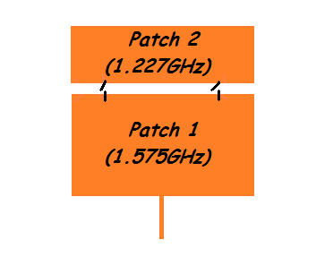
Design Changes Since Proposal
Rogers Corporation RO3010 Microstrip Board
ε_{r} = 10.2, h = 25 mils
Linear Polarization

Slide 6
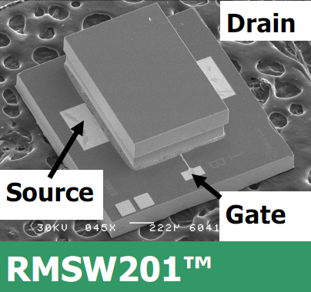
Switching Method
MEMS Switch
RMSW201, RADANT MEMS
SPST
DC to 20 GHz
0.3dB Insertion Loss @ 2GHz
35dB Isolation Loss @ 2GHz
1.9mm x 1.85mm package size
+/- 90V Gate-Source Voltage
Wire bonding to board

Slide 7
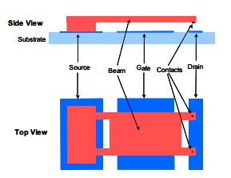
RMSW201 MEMS Operation
+/- 90 V_{GS} Actuation Voltage

Slide 8
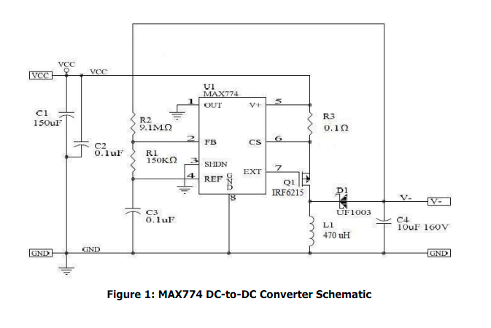
Switching Method
DC-DC Converter: +5V to -90V

Slide 9
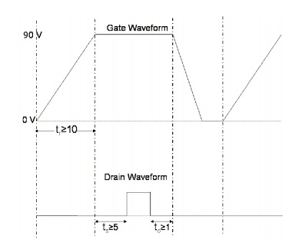
DC-DC Converter Timing

Slide 10
Switching Method

Slide 11
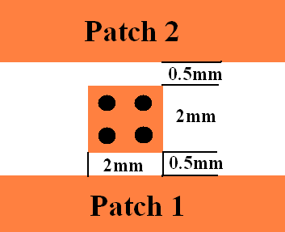
Implementing MEMS
Via holes to ground plane
Four 25 mil (0.635mm) diameter via holes

Slide 12
Implementing MEMS
Conductive epoxy over via hole
Wire bonding, gold plating

Slide 13
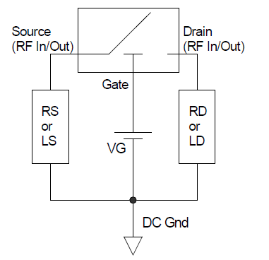
Implementing MEMS
RS = RD = 100kΩ
Minimizes Hot-Switching
Stability

Slide 14
MEMS Evaluation Board
VT-42 (FR-4) 30 mil Substrate
1.5” by 1.5”
Gold Plating Required
2 Coax Connectors
Purpose is to test DC-DC Converter; Isolation and Insertion Losses.

Slide 15
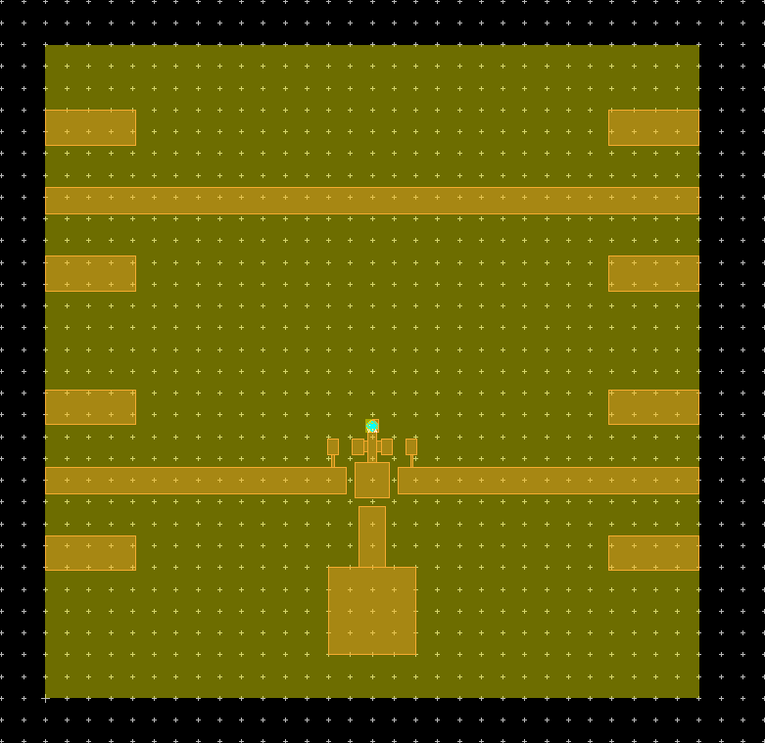
MEMS Evaluation Board

Slide 16
Micro-Circuits, Inc.
Printed Circuit Board Manufacturer
Contact: Robert Modica
(630) 628-5764
microcir@aol.com

Slide 17
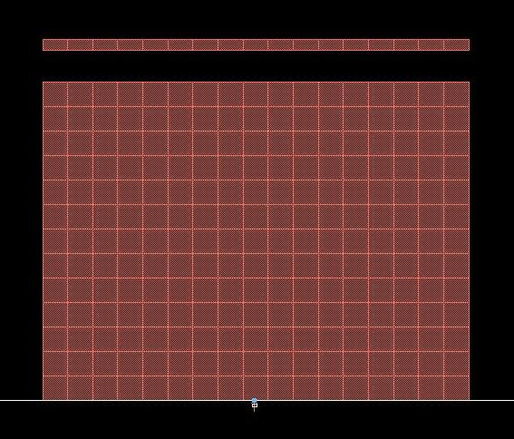
1.575 GHz Patch Antenna Design

Slide 18
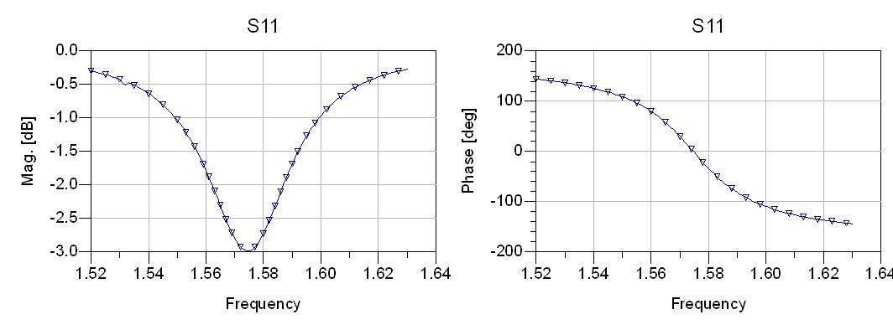
Simulations: 1.575 GHz Patch Antenna

Slide 19
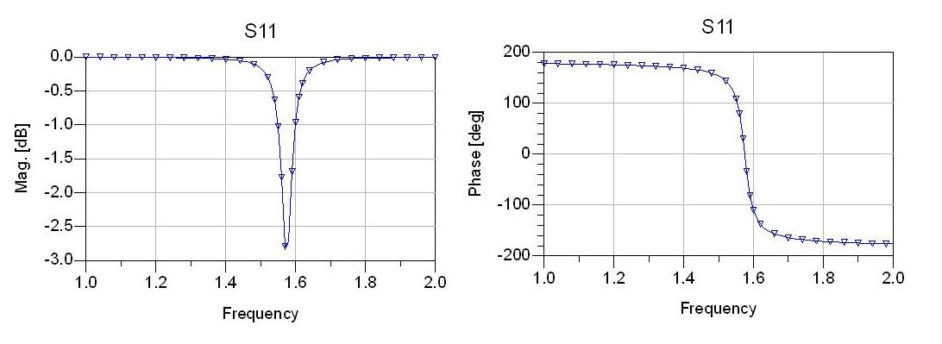
Simulations: 1.575 GHz Patch Antenna
1 to 2 GHz Simulation

Slide 20
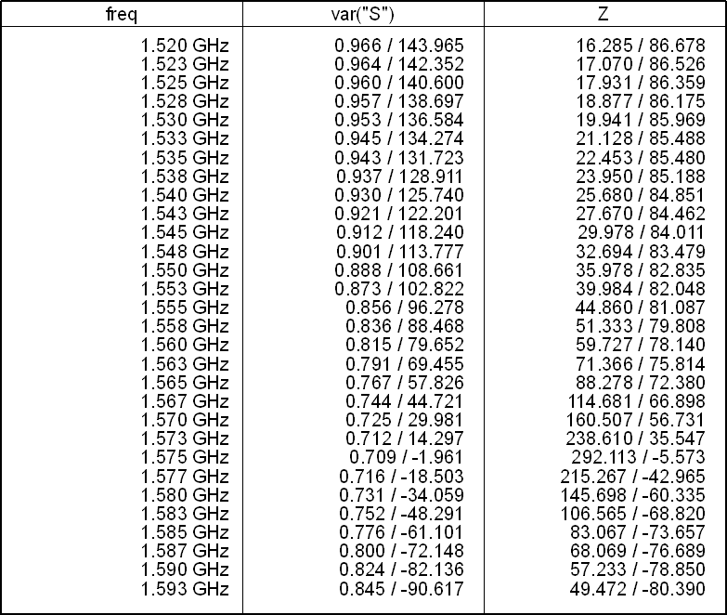
1.575 GHz Results

Slide 21
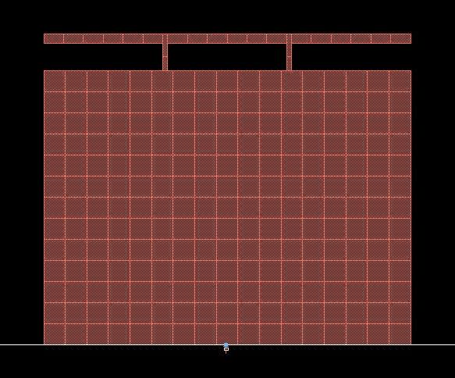
1.227 GHz Patch Antenna Design

Slide 22
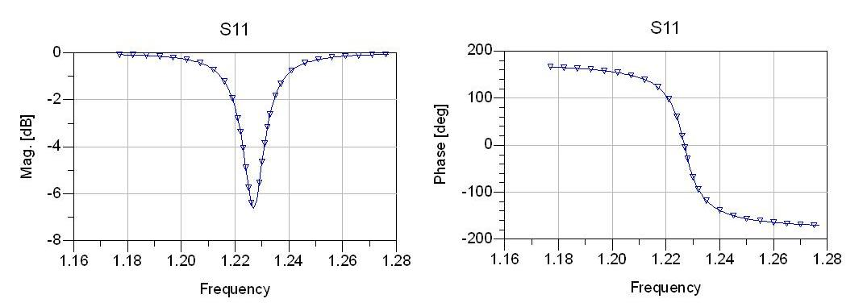
Simulations: 1.227 GHz Patch Antenna

Slide 23
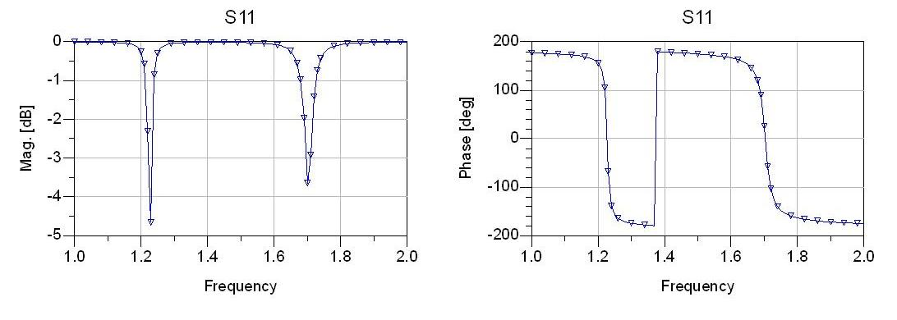
Simulations: 1.227 GHz Patch Antenna
1 to 2 GHz Simulation

Slide 24
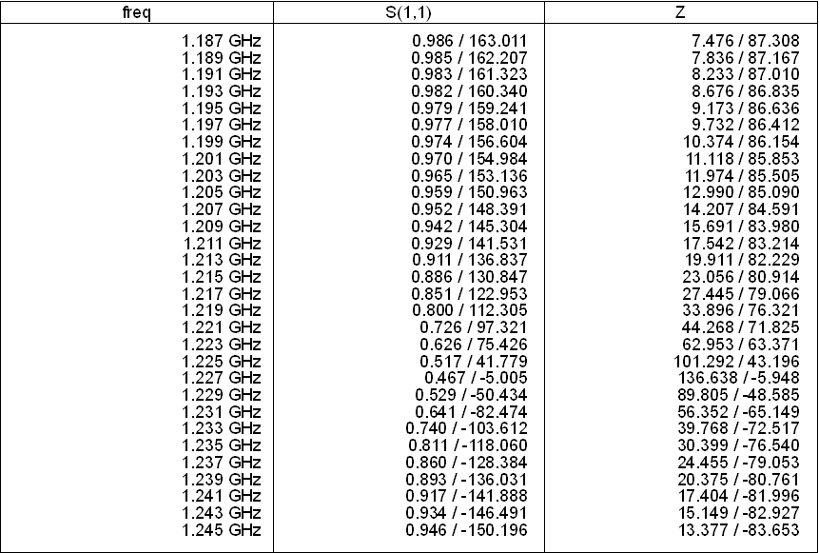
1.227 GHz Results

Slide 25
Double Stub Matching Network

Slide 26
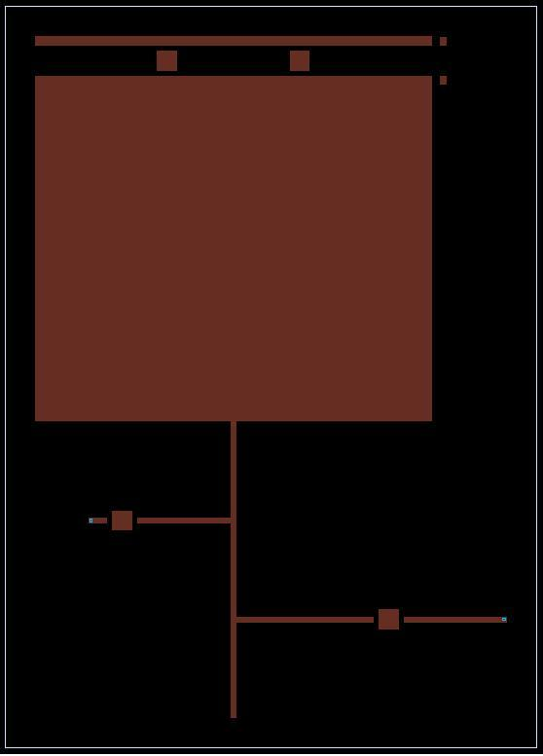
Antenna and Matching Network

Slide 27
Task Schedule
Simulations (in progress)
Linear Patch Antenna w/ switches (on/off)
1.227 GHz, 1.575 GHz
Impedance Matching Network
Board Fabrication
MEMS Evaluation Board
Microstrip Board
Implement MEMS (epoxy/wire bonding)
DC-DC Converter

Slide 28
Task Schedule (cont.)
Analysis
Resonant Frequencies
Bandwidth
Efficiency
Comparison to Simulation Results

Slide 29
Tentative Remaining Schedule
Simulations with Impedance Matching
Weeks 7-9
Fabrication of Evaluation Board
Weeks 7-10
Fabrication of Antenna Network
Weeks 8-11
Analysis
Weeks 10-End of Semester

Slide 30
Questions?

Slide 31
Sources:
Balanis, Constantine A. Antenna Theory: Analysis and Design. 3rd ed. Hoboken, NJ: John Wiley, 2005. Print.
DeSignor, Jessica A., and Jayanti Venkataraman. "Reconfigurable Dual Frequency Microstrip Patch Antenna Using RF MEMS Switches." IEEE Xplore. May 2007. Web. 20 Sept. 2011.
RadantMEMS. APPLICATION NOTE FOR TEST & HANDLING OF SPST RF-MEMS SWITCHES. RadantMEMS, 2011. Web. 03 Nov. 2011. <http://www.radantmems.com/radantmems.data/Library/App_notes_1.6.pdf>.
Rebeiz, Gabriel M., and Jeremy B. Muldavin. "RF MEMS Switches and Switch Circuits." IEEE Xplore. Dec. 2001. Web. 20 Sept. 2011.
Yang, Songnan, Chunna Zhang, Helen K. Pan, Aly E. Fathy, and Vijay K. Nair. "Frequency Reconfigurable Antennas for Multiradio Wireless Platforms." IEEE Microwave Magazine (2009): 67-84. Print.

