Slide 1
Autonomous Quadrocopter Proposal
Brad Bergerhouse, Nelson Gaske, Austin Wenzel
Dr. Malinowski

Slide 2
Outline
Introduction
Goals
Project Description
Tests
Schedule

Slide 3
Outline
Introduction
Goals
Project Description
Tests
Schedule

Slide 4
What is a Quadrocopter?
A quadrocopter is an aircraft that is lifted and propelled by four rotors.

Slide 5
Why is this technology important?
Quadrocopters are inherently stable platforms which share advantages with helicopters and airplanes, without the disadvantages
Microprocessor and DSP chip integration provides an powerful core while maintaining the low power usage of single chip processors

Slide 6
Why this project?
To develop an autonomous vehicle with 6-DOF
Tackle challenges presented during 3 dimensional navigation with minimal sensors
Provides a unique opportunity to implement an aerial platform for use in future department projects and courses

Slide 7
Outline
Introduction
Goals
Project Description
Tests
Schedule

Slide 8
Goals
Implement backup fly-by-wire controls for safety and testing
Avoid obstacles using video and sensor feedback
Autonomously navigate through narrow passages using onboard sensors
Develop a quadrocopter platform for future senior projects

Slide 9
Fly-by-wire
Remotely control quadrocopter with computer joystick or R/C transmitter for safety
Implemented to prevent loss of control during development and testing

Slide 10
Obstacle Avoidance
Use range sensors and single camera to avoid obstacles
Range sensors will be (initially) positioned in all 6 Euclidian directions
Camera will be aimed forward and DSP will be used for object detection

Slide 11
Autonomous Navigation
Navigate narrow passages in a fully autonomous nature
Create ‘obstacles’ using symbols to indicate directional constraints

Slide 12
Future Platform
Fully document design process and component interfacing
Expandable processing and I/O components

Slide 13
Outline
Introduction
Goals
Project Description
Tests
Schedule

Slide 14
Project Description
Interface BeagleBoard with XAircraft X650 Quadrocopter platform
Use BeagleBoard I/O to interface with sensors and remote controls
Develop passage following algorithm using minimal sensor input
Utilize image processing techniques to detect obstacles or goal criteria

Slide 15
System Diagram

Slide 16
System Diagram

Slide 17
XAircraft X650
Platform includes controllers, motors, and infrastructure required for operation
Accepts industry standard R/C PWM inputs for flight controller
Handles stability and individual motor control for arbitrary PWM inputs

Slide 18
System Diagram

Slide 19
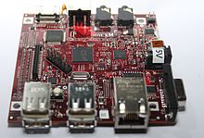
BeagleBoard
Includes TI OMAP processor, USB interfaces and camera header
Performs processing required for navigation
Outputs industry standard PWM directly into flight controller

Slide 20
System Diagram

Slide 21
IR Distance Sensors
Output analog voltage based upon distance to an obstacle
Linear response between 10cm and 150cm
ADC necessary to interface with Beagleboard

Slide 22
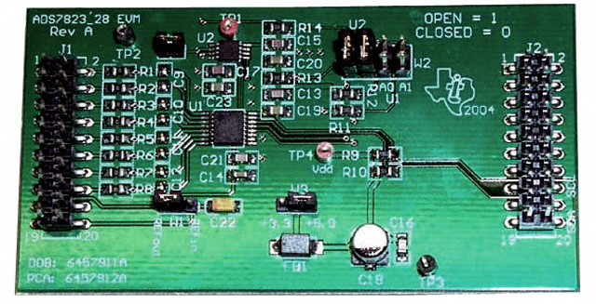
TI ADC
12-bit Octal ADC with I²C interface
Bridges logic between sensors and Beagleboard
50K samples per second

Slide 23
System Diagram

Slide 24
Accelerometer
Possibly used for orientation input to BeagleBoard

Slide 25
System Diagram

Slide 26
I²C Interface
Inter-Integrated Circuit
Master-slave 2-wire bus interface
Used to communicate between ADC, Accelerometer, and BeagleBoard
Additional logic level converter required to interface between BeagleBoard (1.8V) and ADC (5V)

Slide 27
System Diagram

Slide 28
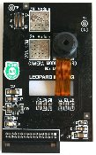
Camera
Captures images, send to BeagleBoard over serial communication
5-Megapixel image output with downsizing for processing speed

Slide 29
System Diagram

Slide 30
Laptop
Communicates via 802.11 wireless protocol to BeagleBoard
Transmits manual override controls to Beagleboard
Provides goal conditions for navigation
Can act as a data store for retrieved information

Slide 31
System Diagram

Slide 32
DSP
Images processed using Canny edge detection algorithm
Symbol detection using predefined symbols for navigation control
Communicates with processor using shared memory regions

Slide 33
System Diagram

Slide 34
OMAP ARM core
Interprets sensor information
Provides control outputs to platform
Monitors sensor inputs for proper goal conditions

Slide 35
Outline
Introduction
Goals
Project Description
Tests
Schedule

Slide 36
Tests to be performed
Tethered Testing
Takeoff and Landing
Move at constant altitude to a landmark
Change altitude during flight, continue to landmark
Move in straight line through narrow passageway
Un-Tethered Testing
Fly straight and return to starting position
Fly through narrow passageway and turn corner

Slide 37
Outline
Introduction
Goals
Project Description
Tests
Schedule

Slide 38
Division of labor
Austin
DSP and object recognition
Brad
Communication and networking
Nelson
Hardware interfacing and power management

Slide 39
Schedule
11/17-Camera and Joystick Interfacing
12/1-Wireless and I²C interfacing
1/19-PWM output design
1/26-PWM output testing
2/2-IR sensor interfacing
2/9-Platform Assembly
2/16-Platform Power Testing
2/23-Initial Navigation Design

Slide 40
Schedule contd
3/1-Navigation Design
3/8-Navigation Design
3/22-Navigation Design
3/29-Test Design
4/5-Testing and debugging
4/12-Testing and debugging
4/19-Testing and debugging
4/26-Presentation preparation

Slide 41
Questions?

