Slide 1
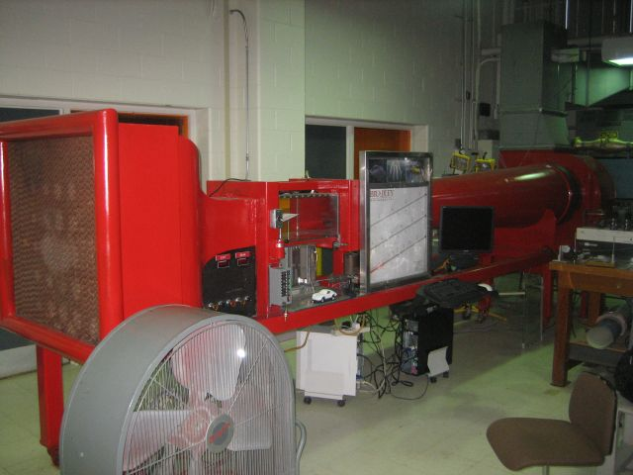
Automated Industrial Wind Tunnel Controller
By Daniel Monahan and Nick DeTrempe
Advised by Dr. Aleksander Malinowski
Notes:
1

Slide 2
Presentation Agenda
Project Scope
System Block Diagram
Microcontroller Work Completed
Wind Tunnel Hardware Work Completed
Labview/Server Work Completed
Milestones Remaining
Revised Schedule
Questions

Slide 3
Project Scope
The overall objective is to create an automated controller for an existing wind tunnel located in the Mechanical Engineering department of Bradley University.
This controller will allow a user to position objects inside the tunnel with linear actuators, turn on the wind tunnel and adjust speed.
A user will be able to control the tunnel through existing manual controls, on a local PC or remotely through the internet.

Slide 4
System Block Diagram

Slide 5
Microcontroller Work Completed
The Microcontroller has been configured so that all inputs and outputs can easily be connected.
The microcontroller software has been configured to periodically output all data from sensors while waiting for commands to be received from a user.

Slide 6
Microcontroller Interface

Slide 7
Wind Tunnel Hardware Work Completed
Two three-way AC switches (light switches) have been added to the setup to switch between electronic and manual control.
The blower relay has already been connected temporarily in parallel with the existing manual relay to verify operation.

Slide 8
Switches between controllers

Slide 9
Location of switches in system

Slide 10
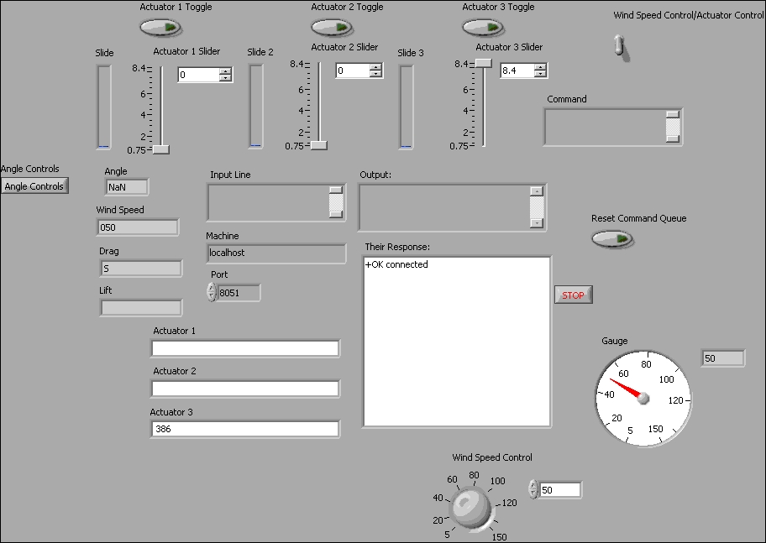
LabView/Server Work
A LabView client program has been developed to allow for testing and configuring the wind tunnel control
Figure 3: LabView Test Client Front Panel

Slide 11
LabView/Server Work
The client both displays data from and sends commands to the server, which relays the signals to microcontroller.
The front panel can be easily reconfigured to accept alternate methods of input or to display data differently
The client is easily deployed as a packaged executable requiring only the LabView engine to run.

Slide 12
LabView/Server Work
Figure 4: Segment of LabView code – Wind Speed control

Slide 13
Milestones Remaining
Configure LabView Client for Wind Tunnel Setup
Add security feature for the client/server connection
Setup web server and integrate security, webcams, and application download into website
Finish connecting relays to wind tunnel and microcontroller.
Integrate new sensors into microcontroller and LabView.
Test and debug all software and hardware on system.

Slide 14
Changes To Project
An ambient air pressure and ambient temperature sensor will be needed to be added to the setup.
A wiring harness will be needed to easily disconnect the microcontroller from the wind tunnel and connect another controlling system.

Slide 15
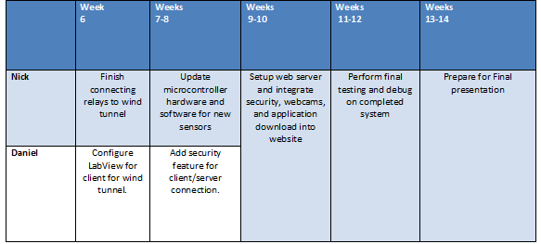
Revised Schedule of Upcoming Work

Slide 16
Questions?

