Slide 1
Alternating Current Power Factor Monitoring and Correction: Progress Presentation
Bryan Underwood
Advisor: Prof. Gutschlag

Slide 2
Power Factor
Power Factor is the ratio of the active power to the apparent power
P.F. = P/S
http://electrical-engineering-portal.com/how-reactive-power-is-helpful-to-maintain-a-system-healthy

Slide 3
Power Factor (cont.)
Poor power factor is due to inductive loads such as induction motors in air conditioners and refrigerators
A very low power factor usually results in the power company charging more on a utility bill

Slide 4
Standards
Ameren Illinois requires Residential (rate DS-1) and Non-Residential (rate DS-2, DS-3) to maintain a power factor of 0.90 while Non-Residential (rate DS-4) must maintain a power factor of 0.95
http://www.ameren.com/sites/aiu/Rates/Documents/AIel14rtds4.pdf
http://www.ameren.com/sites/aiu/Rates/Documents/AIel48rdimf.pdf

Slide 5
Power Company Charges
Ameren and ComEd require corrective devices to be installed
http://www.ameren.com/sites/aiu/Rates/Documents/AIel4otsq.pdf
Pacific Gas and Electric (PG&E) charges 0.6% per percentage point below a power factor of 0.85 more on a utility bill
http://www.pge.com/includes/docs/pdfs/mybusiness/customerservice/energystatus/powerquality/power%20factor--revised-8-9-07.pdf

Slide 6
Industry Averages
About 60% of load is electric motors
http://www.pge.com/includes/docs/pdfs/mybusiness/customerservice/energystatus/powerquality/power%20factor--revised-8-9-07.pdf
According to the U.S. Energy Information Administration (EIA), about 25,000 out of 200,000 companies, in the manufacturing industry, participate in PFC
http://www.eia.gov/emeu/mecs/mecs2002/data02/excel/table8.1_02.xls

Slide 7
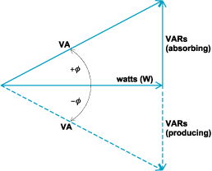
Power Factor Correction (PFC)
Usually done by capacitor banks
Generate “negative” reactive power
http://accessscience.com/content/Reactive-power/802370

Slide 8
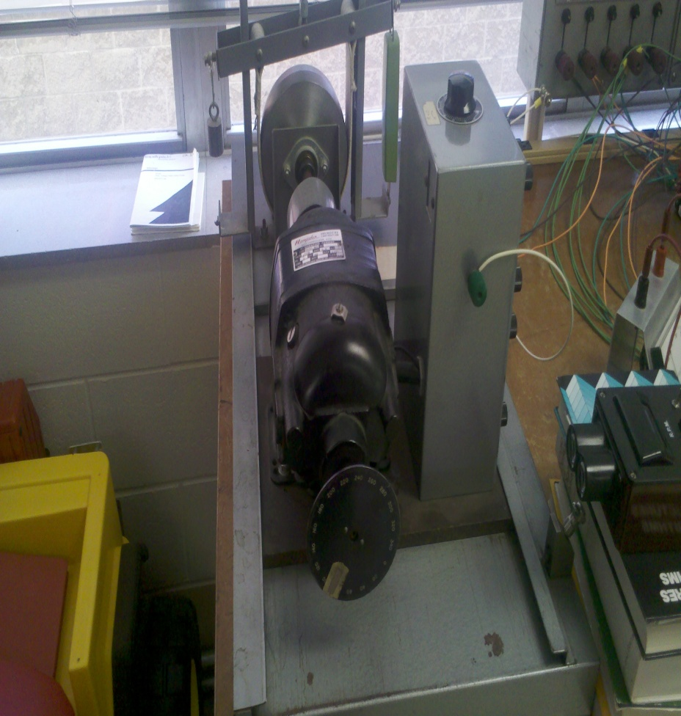
Changes to Equipment
Hampden Type WRM-100 3-Phase Motor
220 V
1.4 A
1725 RPM
1/3 HP

Slide 9
Changes (cont.)
SATEC PM172E-N 3-Phase Programmable Power Meter

Slide 10
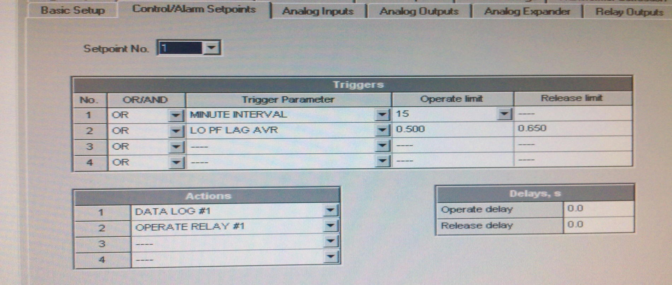
Software
SATEC Power Analysis Software V1.4 Build 5
Configure basic setup of meter, set trigger points, and view event logs and waveforms

Slide 11
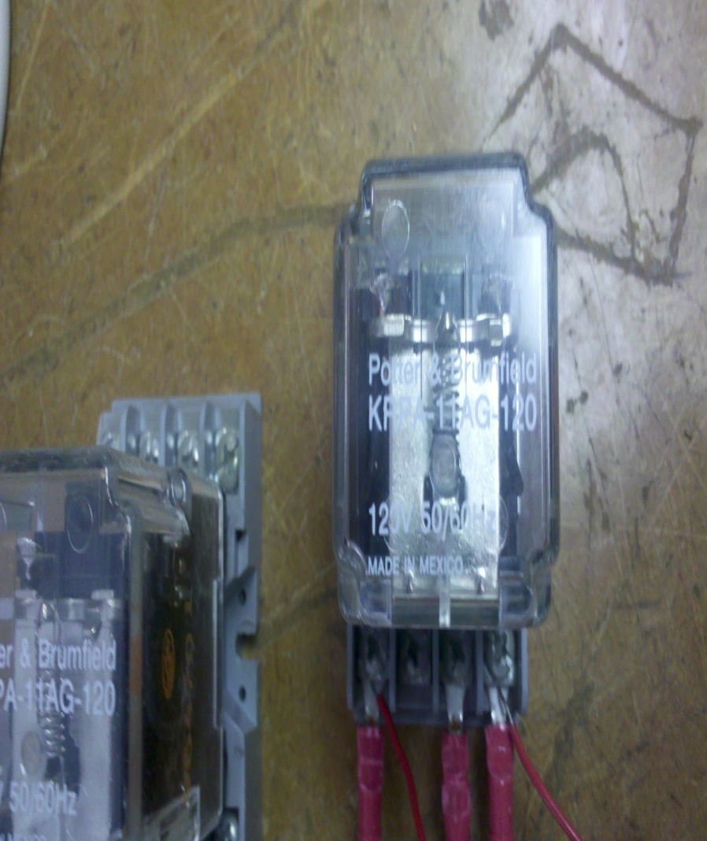
Other Equipment
Potter & Brunfield KRPA-11AG-120 Power Relays

Slide 12
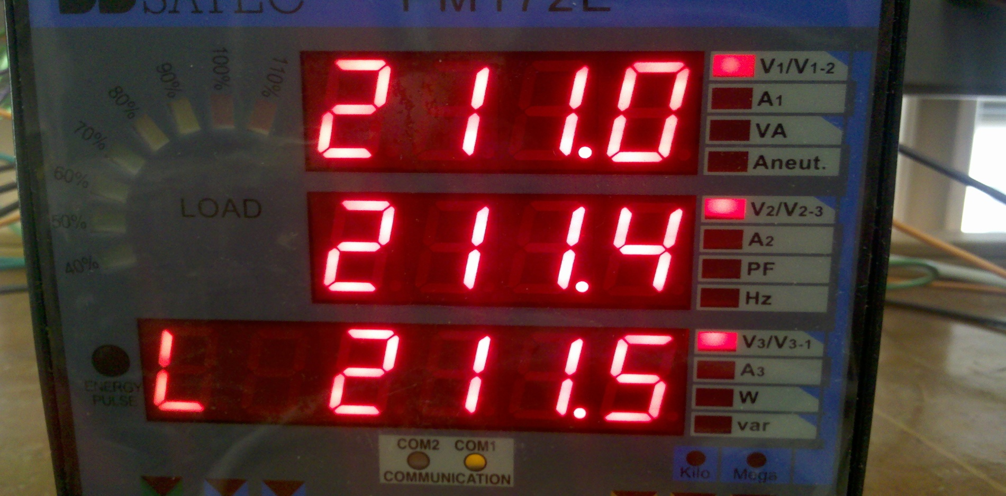
Current Progress
SATEC power meter used to measure power factor, active and apparent powers, line voltages and currents, and energize relay coils

Slide 13
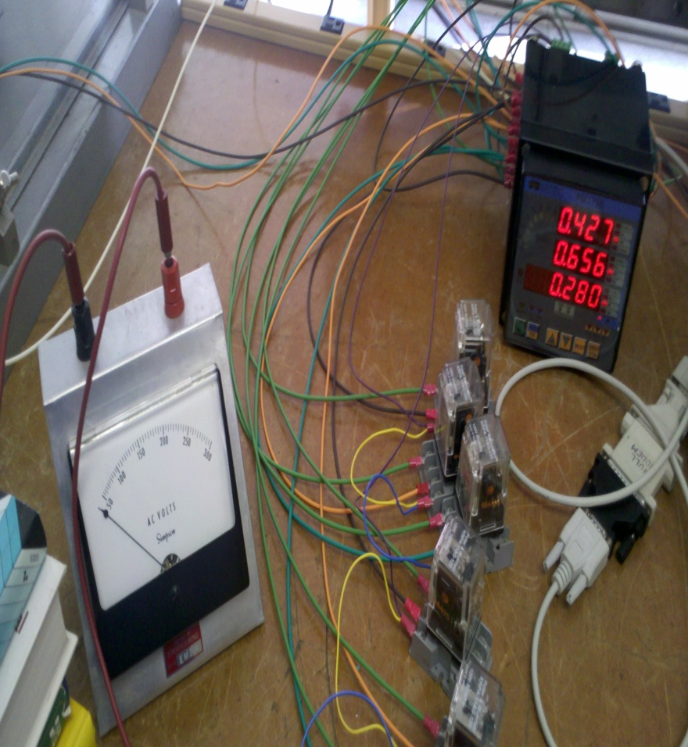
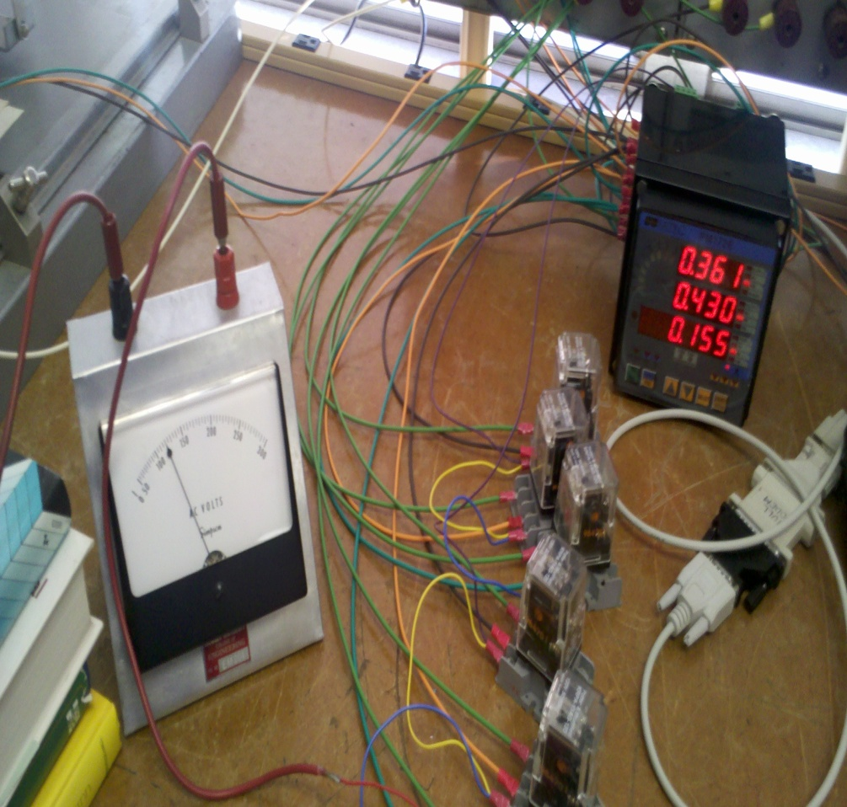
Progress (cont.)
Relay coils are energized from SATEC meter when the power factor drops below a certain point

Slide 14
Current System

Slide 15
Revised Schedule
2/28/2012 Determine value of capacitors needed and confirm power meter measurements
3/6/2012 Implement capacitors and further study SATEC software
3/13/2012
3/20/2012 Research methods of improving individual motor efficiencies with power factor correction installed
3/27/2012
4/7/2012
4/10/2012 Begin work on final project presentation and final paper
4/17/2012
4/24/2012
5/01/2012 Project presentation

Slide 16
Questions?

