Slide 1
Ultrasound Research Platform for Transmission of Coded Excitation Signals
Emma Muir, Sam Muir, Jacob Sandlund, & David Smith
Advisor: Dr. José Sánchez
Co-Advisor: Dr. James Irwin

Slide 2
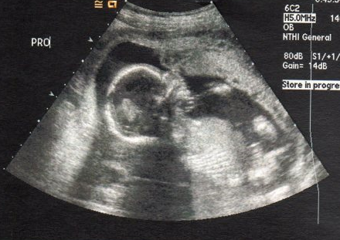
Ultrasound Imaging

Slide 3
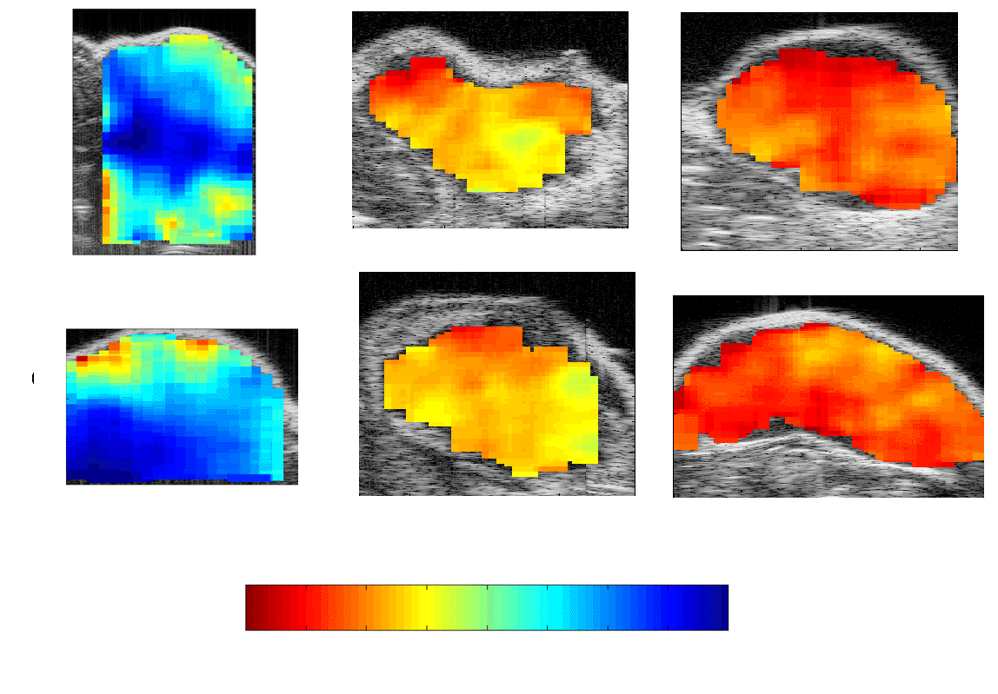
Quantitative Ultrasound
Benign
Malignant
[1]

Slide 4
Introduction Outline
Introduction
How Ultrasound Works
Coded Excitation
Objective
Motivation
Significance
Design Comparison

Slide 5
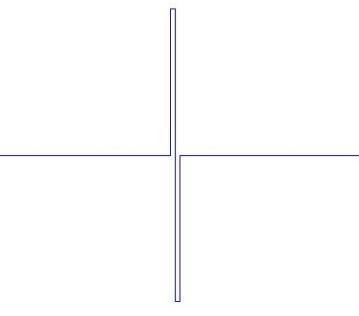
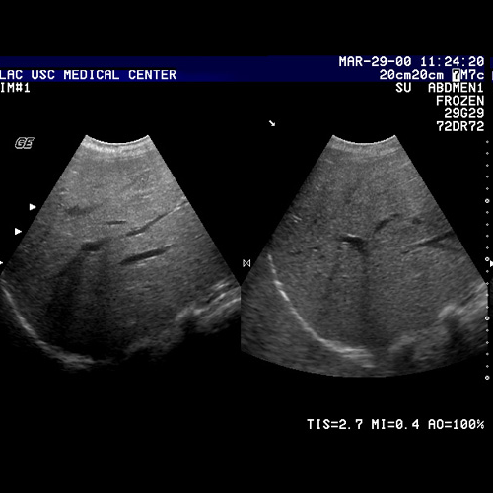
How Ultrasound Works

Slide 6

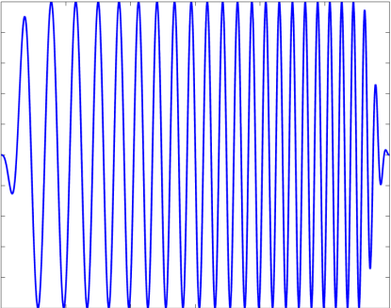
Coded Excitation
Conventional Ultrasound [2]
Coded Excitation Ultrasound [2]

Slide 7
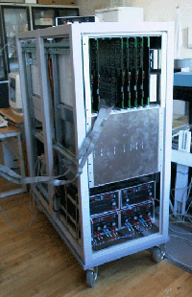
Coded Excitation Platforms
Research Platforms
Mostly single-element
Large multi-element
  RASMUS
RASMUS [3]

Slide 8
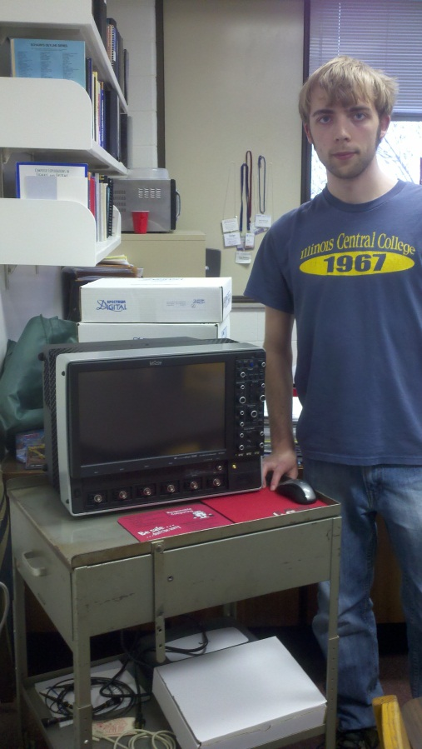
Objective
Ultrasound Research Platform Prototype
  Arbitrary Waveforms
    Coded excitation signals
  Multi-element
    Beamforming
  Reduced size and cost
Lecroy Oscilloscope

Slide 9
Motivation
Improve…
  Ultrasound Techniques
  Ultrasound Research
Reduce size and cost

Slide 10
Significance
Medical Applications
  Detect and Diagnose Tumors
  Noninvasive
  Faster Results

Slide 11

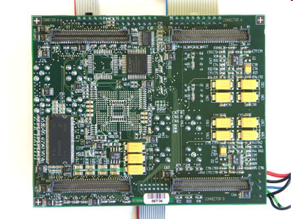

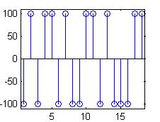
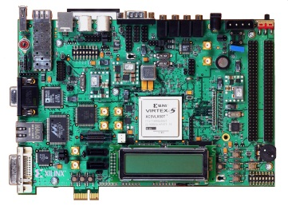

Design Comparison
Previous Designs:
Our Design:
Digital Device
Transducer
D/A
Amplifier
Digital Device
Transducer
Switching Amplifier

Slide 12
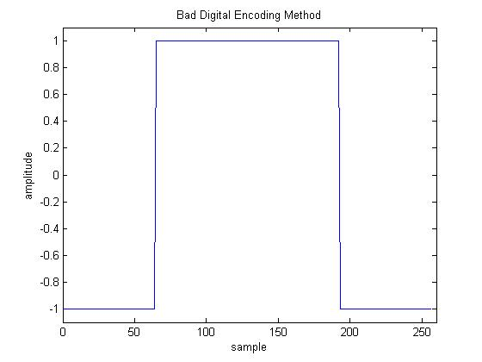
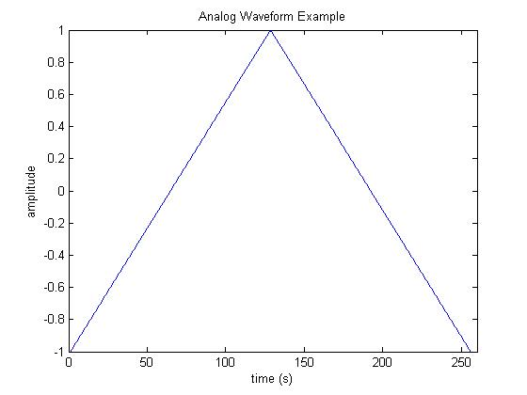
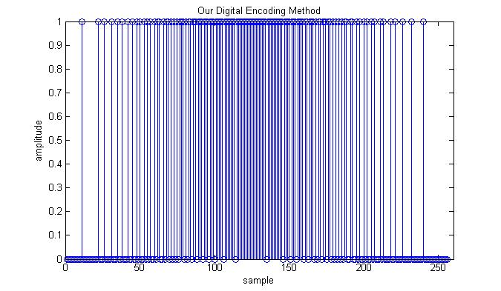
Our Method
Oversample
  1-bit
  Densities represent
  voltages

Slide 13
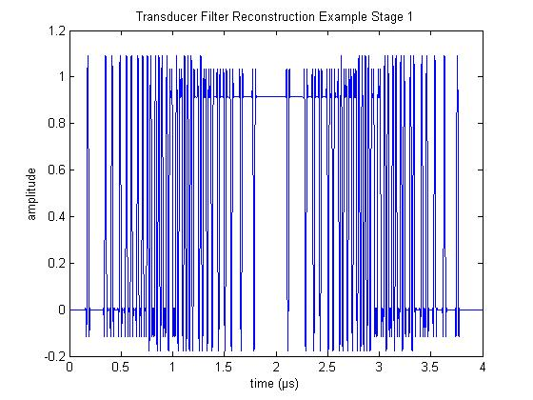
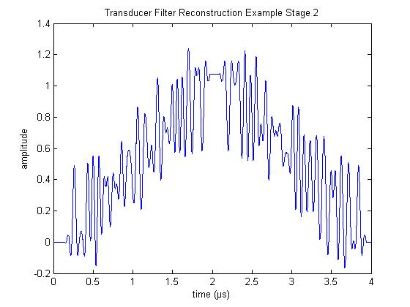
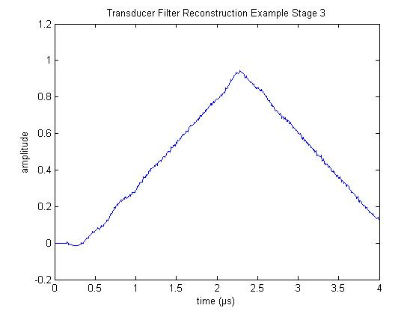
Our Method
Transducer acts as a (BP) filter
  Smooths / Averages

Slide 14
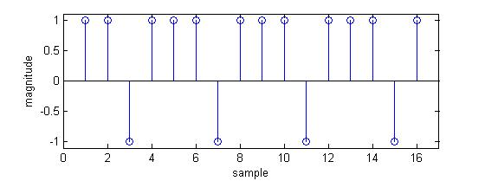
Encoding Differences
Example:
  0.5 V DC
  -1 to 1 V Dynamic range
8-bit Two’s Complement (-128 to 127):
  Value = 64 (0100 0000)
Sigma Delta Modulation:
  Oversample
  1-bit

Slide 15
Outline
Introduction
Functional Description
Methods
Results and Discussion
Conclusion
Questions

Slide 16
Outline
Introduction
Functional Description
Methods
Results and Discussion
Conclusion
Questions

Slide 17
System Requirements
Up to 4 transducer channels
Excitations <= 3 μs
SNR > 50 dB

Slide 18
System Block Diagram
18

Slide 19
System Block Diagram
Generate Waveform
19

Slide 20
System Block Diagram
Transmit Waveform
20

Slide 21
System Block Diagram
Receive Image
21

Slide 22
System Block Diagram
Create Image
22

Slide 23
PC Data Processing
23

Slide 24
PC Data Processing
24

Slide 25
PC Data Processing
25

Slide 26
PC Data Processing
26

Slide 27
PC Data Processing
27

Slide 28
Data Processing Methods:
Conversion to an Image
Time Gain Compensation (TGC)
  Attenuation
  TGC = Att * Depth * (Probe frequency)
  white noise for larger depths

Slide 29
PC Data Processing
29

Slide 30
Data Processing Methods:
Conversion to an Image
Envelope Detection
  Determines the bounds of the processed signal
  Detects width and contains the display information
  Absolute value of the Hilbert Transform

Slide 31
PC Data Processing
31

Slide 32
Outline
Introduction
Functional Description
Methods
Results and Discussion
Conclusion
Questions

Slide 33
Methods
Sigma Delta Modulation
PC/FPGA Interface
FPGA
Data Processing
  Pulse Compression
  Delay Sum Beamforming

Slide 34
System Block Diagram
34

Slide 35
Sigma-Delta Modulation Requirements
< 10% Mean Squared Error (MSE)
500 M samples/second
Accuracy vs. Overloading (Saturation)
  Order = 2nd
  OSR = 16
    must be a power of 2
    16*2 = 32 samples per period

Slide 36
Sigma-Delta Modulation Methods
[4]
36

Slide 37
Sigma-Delta Modulation Methods
[4]

Slide 38
Sigma-Delta Modulation Methods
38

Slide 39
Sigma-Delta Modulation Methods
[5]

Slide 40
System Block Diagram
40

Slide 41
PC/FPGA Interface Requirements
Assign waveform to pins
  Independent for each pin
  (3 μs) * (500 MHz) = 1500 bits/waveform
  1500 + 36 = 1536 bits/waveform (divisible by 512)
Assign delay to pins
  Increments of 4ns = (1/250 MHz)
  250 MHz = memory clock rate of FPGA

Slide 42
PC/FPGA Interface Requirements
Transfer information for 4 pins in < 1 sec
  <32 sec for 128 pins
  (4 pins) * (1536 bits/waveform) sent within 1 sec
  ~6 Kbps
Start transmission

Slide 43
PC/FPGA Interface Methods
UART connection
  115200 baud
    Fastest FPGA baud rate
  Sends as
    1 start bit
    8 data bits
    2 stop bits
  (1536/8)*11*4 = 8448 bits
  ~73 ms for 4 channels
  ~2.3 s for 128 channels
Start
Stop
Data

Slide 44
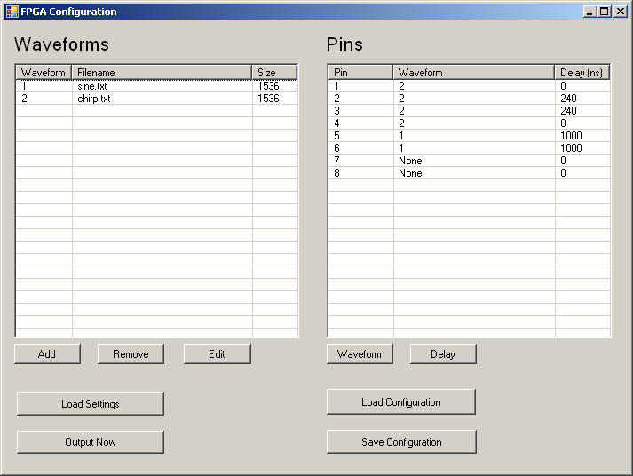
PC/FPGA Interface Methods

Slide 45
FPGA Requirements
Transmit at 500 MHz
Output waveforms in parallel
  4 individualized waveforms
  Length of 3 μs per waveform
  1536-bits per waveform

Slide 46
FPGA Methods
No
Yes

Slide 47
FPGA Methods
Transmit at 500 MHz
  Two 250 MHz clock edges (transmits on rising and falling edge)
  250 MHz * 2 = 500 MHz
XOR

Slide 48
System Block Diagram
48

Slide 49
Data Processing Requirements
Data Processing
  Less than 2 minutes
Display an image
  Depths between 0.25 cm and 30 cm
  Dynamic range between 40 dB and 60 dB

Slide 50
PC Data Processing
50

Slide 51
Data Processing Methods: Pulse Compression
Restore the spatial resolution
Match reflected wave to original excitation
Use Wiener filter
  Optimal solution between a match filter and an inverse filter [6]
  Solution determined by
    Smoothing Factor (SF)
    Predicted signal-to-noise-ratio (SNR)
Predict SNR = 50 dB

Slide 52
Data Processing Methods: Pulse Compression
Matched filter
  Cross correlation of original coded excitation and received signal
  Creates side lobes
  Does not amplify noise
  Optimal for large noise – small SNR
Inverse filter
  Inverse of the original coded excitation
  No side lobes
  Amplifies noise
  Optimal for no noise – large SNR

Slide 53
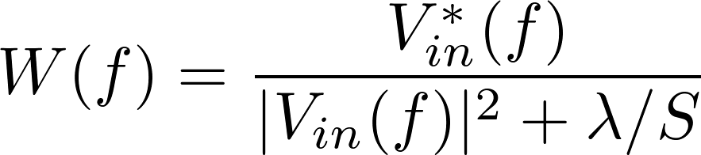
Data Processing Methods: Pulse Compression
Noise increases
SNR decreases
λ/S increases
Closer to a Match Filter
Noise decreases
SNR increases
λ/S decreases
Closer to an Inverse Filter
Wiener Filter Equation
= Coded Excitation
= Smoothing Factor
= SNR of system
[1]

Slide 54
Data Processing Methods: Pulse Compression
SNR = 60 dB

Slide 55
PC Data Processing
55

Slide 56

Data Processing Methods:
Beamforming
38.36 mm
128 Sensor Array Transducer
4 mm
Focal Point
Narrowest beam
Greatest amplitude
Beamforming not
necessary at this point
20 mm
Focal Point

Slide 57
Data Processing Methods: Beamforming
Sensors
Depth
Focal Point
Point
8
Amplitude at Point = Σ_{i=1} S_{i}( Depth + Delay(S_{i},Point)) [7]
Delay(S,P) = (D_{SP} - D_{SF})/c [7]
S = sensor
P = point
D_{SP} = distance from sensor to point
D_{SF} = distance from sensor to point
c = 1540m/s (speed of sound in tissue)

Slide 58
Outline
Introduction
Functional Description
Methods
Results and Discussion
Conclusion
Questions

Slide 59
Experiment
59

Slide 60
Experiment
60

Slide 61
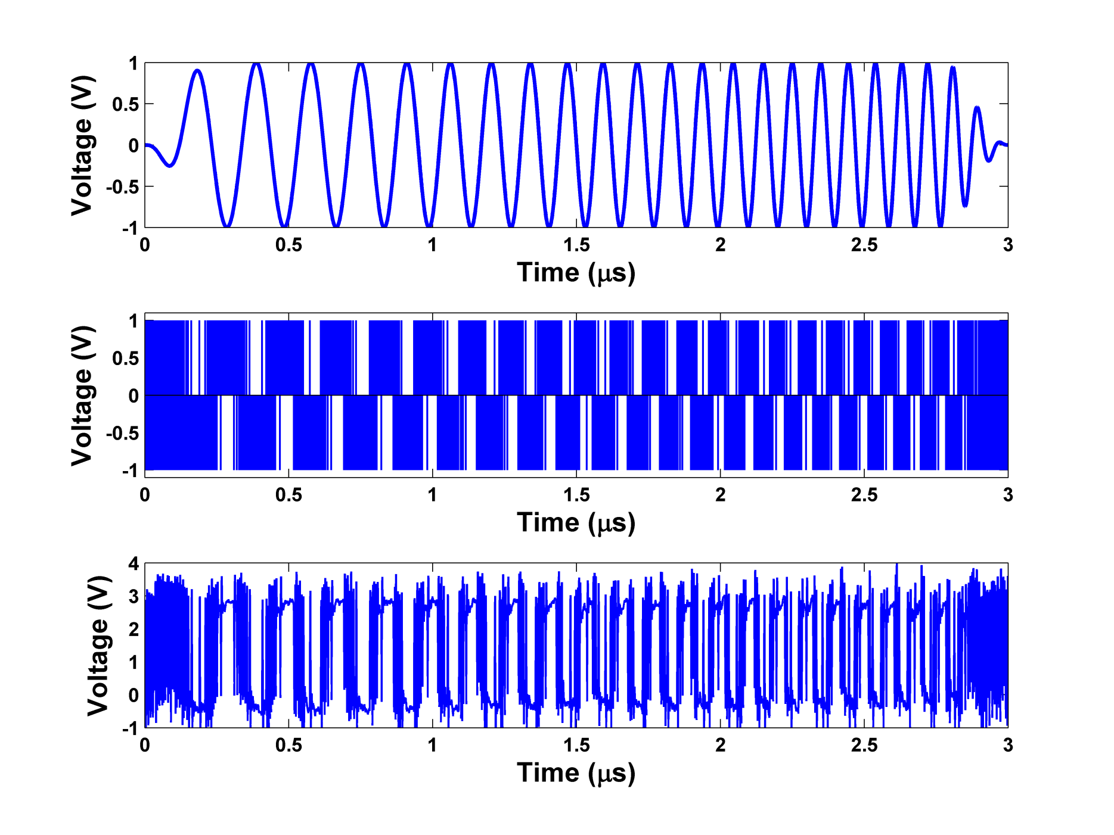
Chirp Transmission
61

Slide 62
Experiment
62

Slide 63
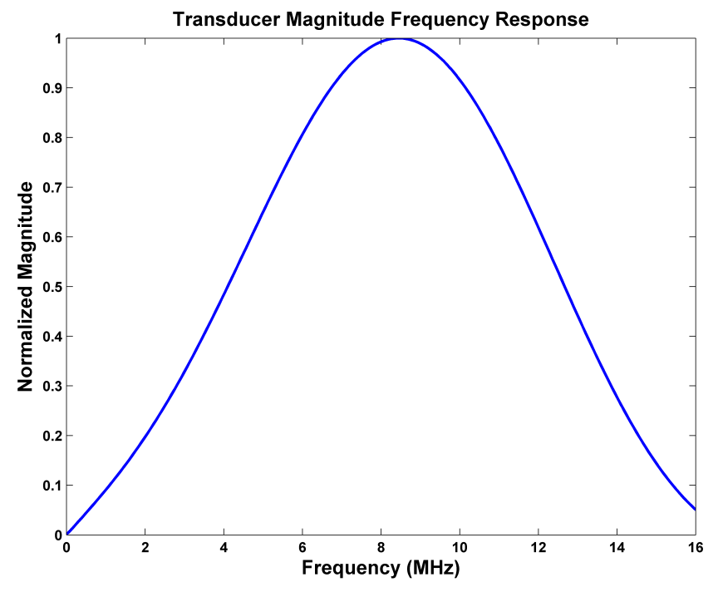
Transducer Model
63

Slide 64
Experiment
64

Slide 65
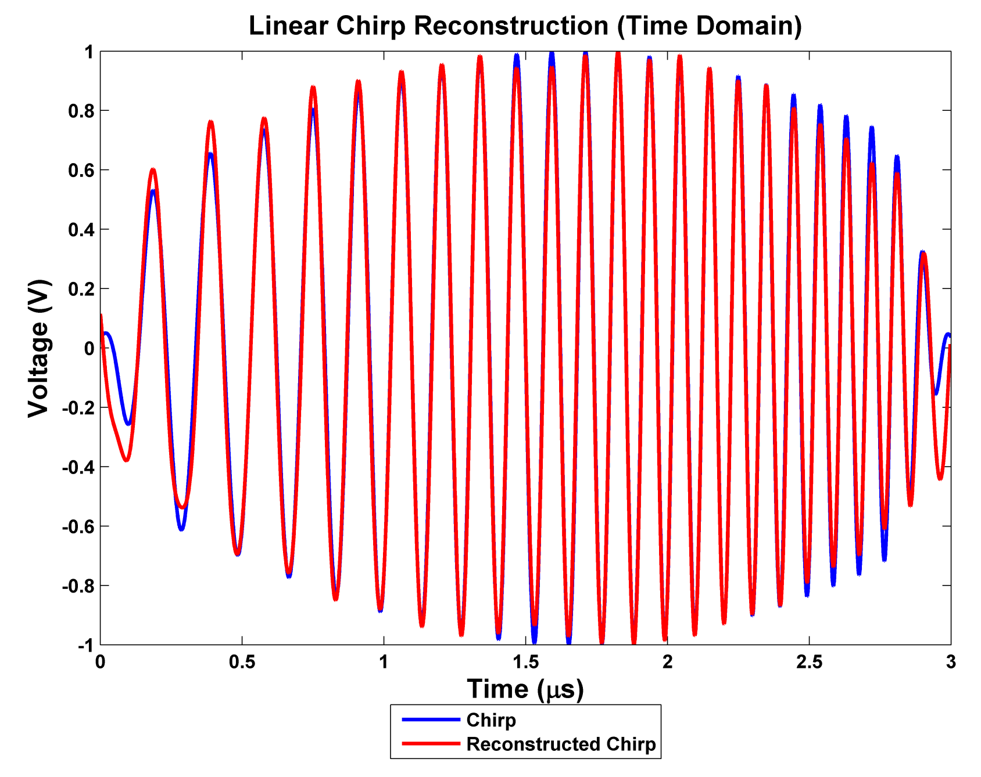
Chirp Reconstruction
65
1.34% MSE

Slide 66
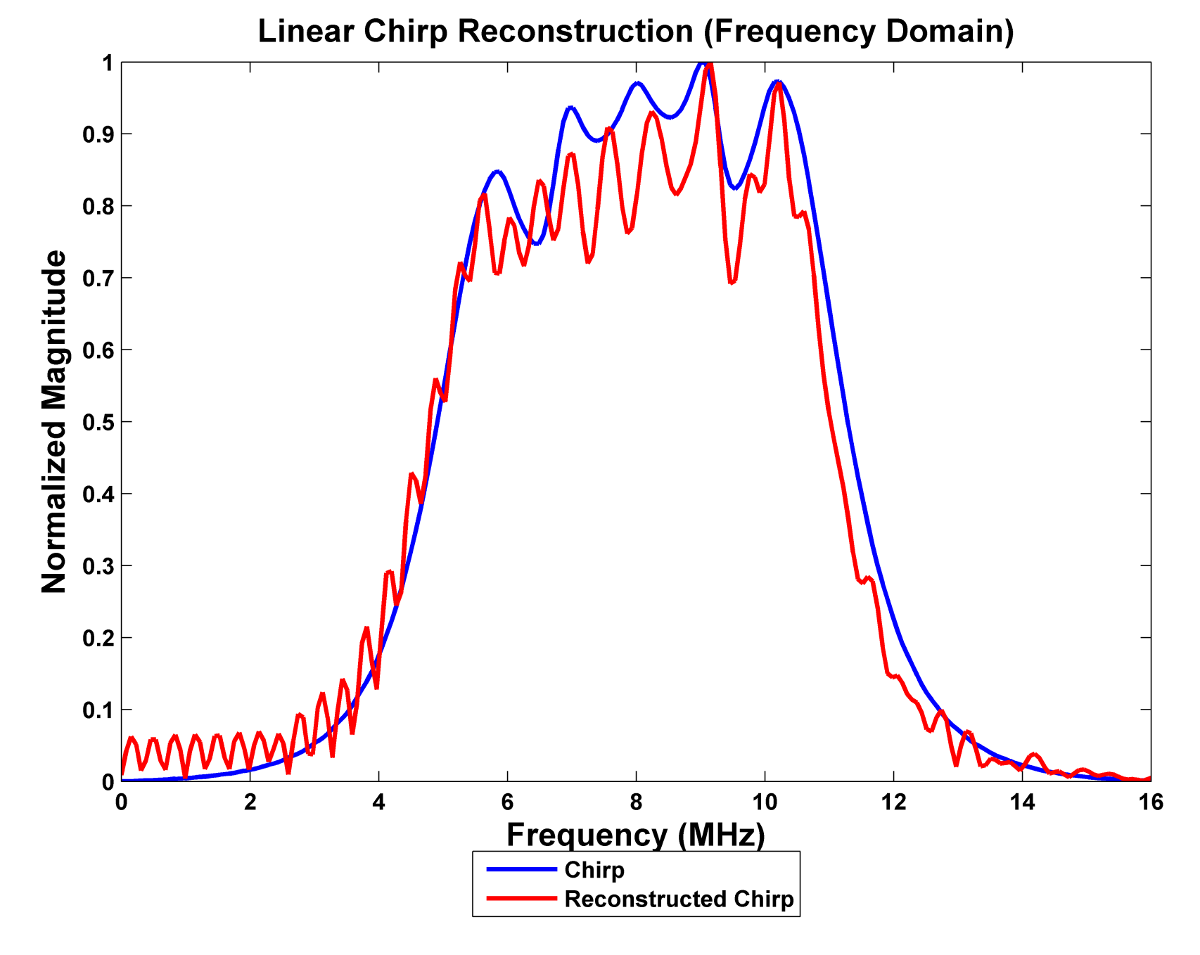
Chirp Reconstruction
66

Slide 67
Correlation Results
Correlations | Filtered Sigma-delta Modulated Linear Chirp | Filtered Captured Data
Filtered Linear Chirp | 99.84% | 99.33%
Filtered Sigma-delta Modulated Linear Chirp | -------- | 99.53%

Slide 68
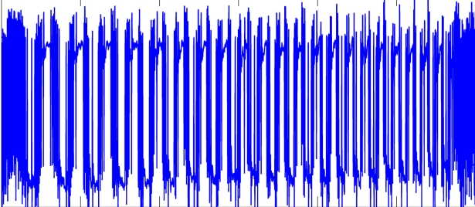
Correlation Results
Correlations | Filtered Sigma-delta Modulated Linear Chirp | Filtered Captured Data
Filtered Linear Chirp | 99.84% | 99.33%
Filtered Sigma-delta Modulated Linear Chirp | -------- | 99.53%

Slide 69
Correlation Results
Correlations | Filtered Sigma-delta Modulated Linear Chirp | Filtered Captured Data
Filtered Linear Chirp | 99.84% | 99.33%
Filtered Sigma-delta Modulated Linear Chirp | -------- | 99.53%

Slide 70
Correlation Results
Correlations | Filtered Sigma-delta Modulated Linear Chirp | Filtered Captured Data
Filtered Linear Chirp | 99.84% | 99.33%
Filtered Sigma-delta Modulated Linear Chirp | -------- | 99.53%

Slide 71
Experiment
71

Slide 72
Pulse Compression
72

Slide 73
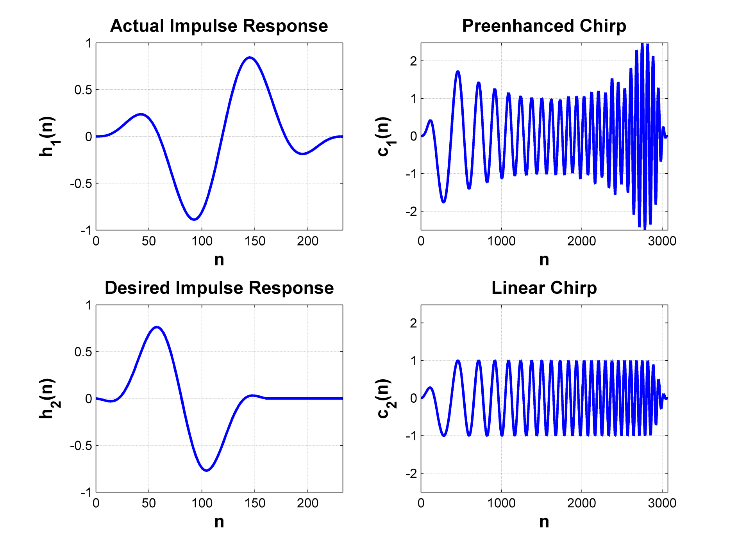
REC Chirp
73
h₁(n) * c₁(n) = h₂(n) * c₂(n)

Slide 74
Data Processing Simulations
20
10
0
Transducer
10
20
30
40
50
60
70
80
90
100
-10
Distance in mm
-20
Field II Software [8]
10 mm separation
46 dB SNR
74

Slide 75
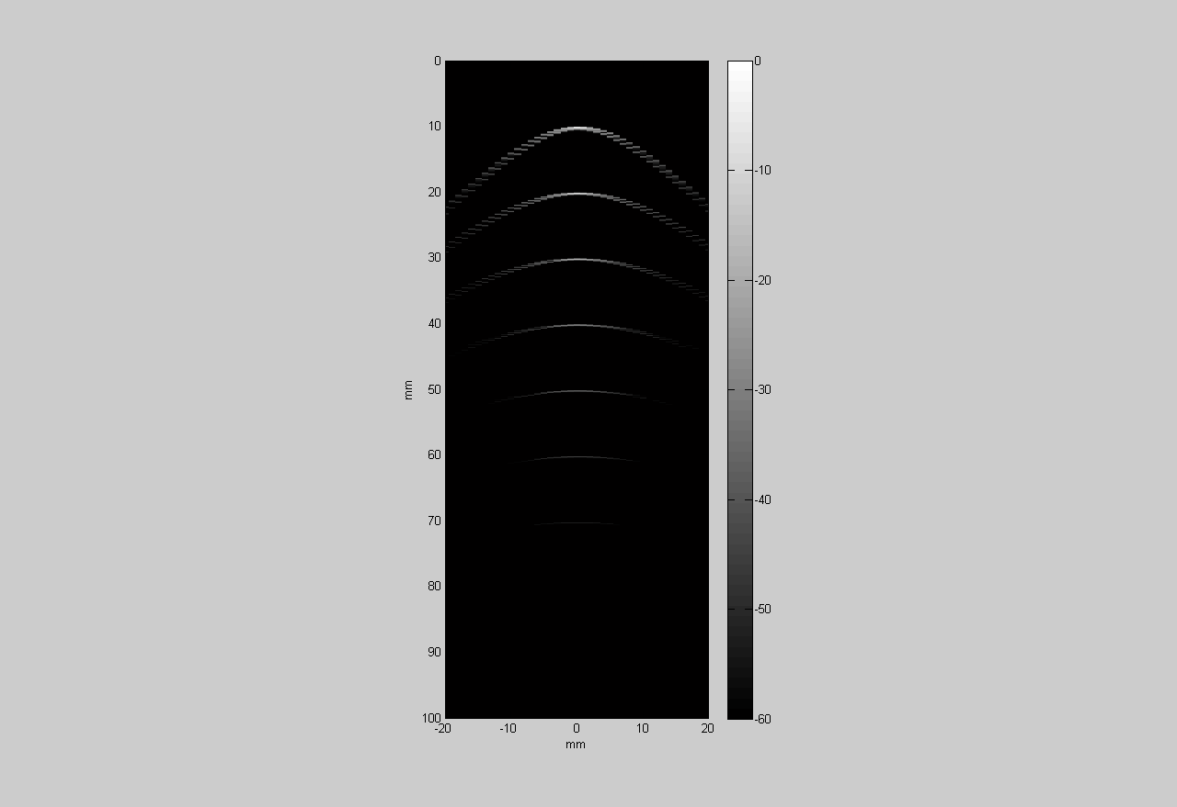

Beamforming Results
Without Beamforming
With Beamforming

Slide 76
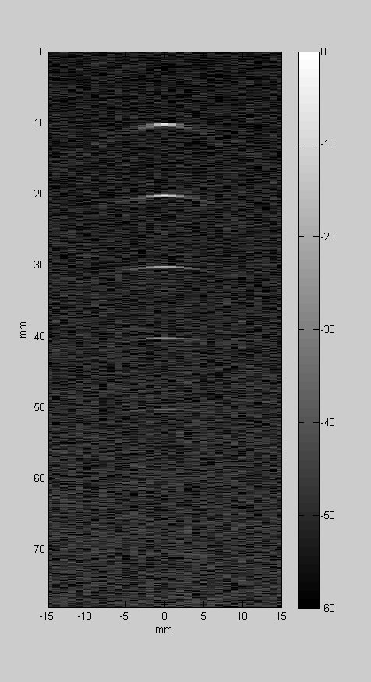
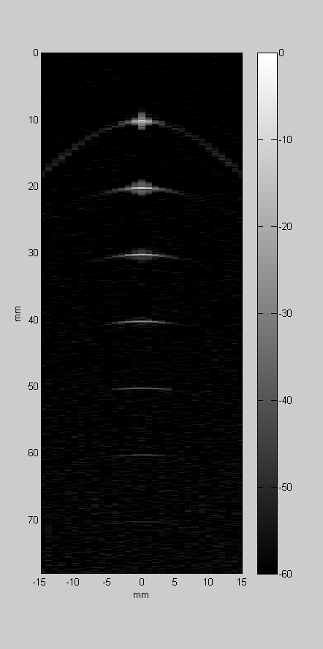
REC Chirp Simulation
Impulse Excitation
REC Excitation and Pulse Compression
76

Slide 77
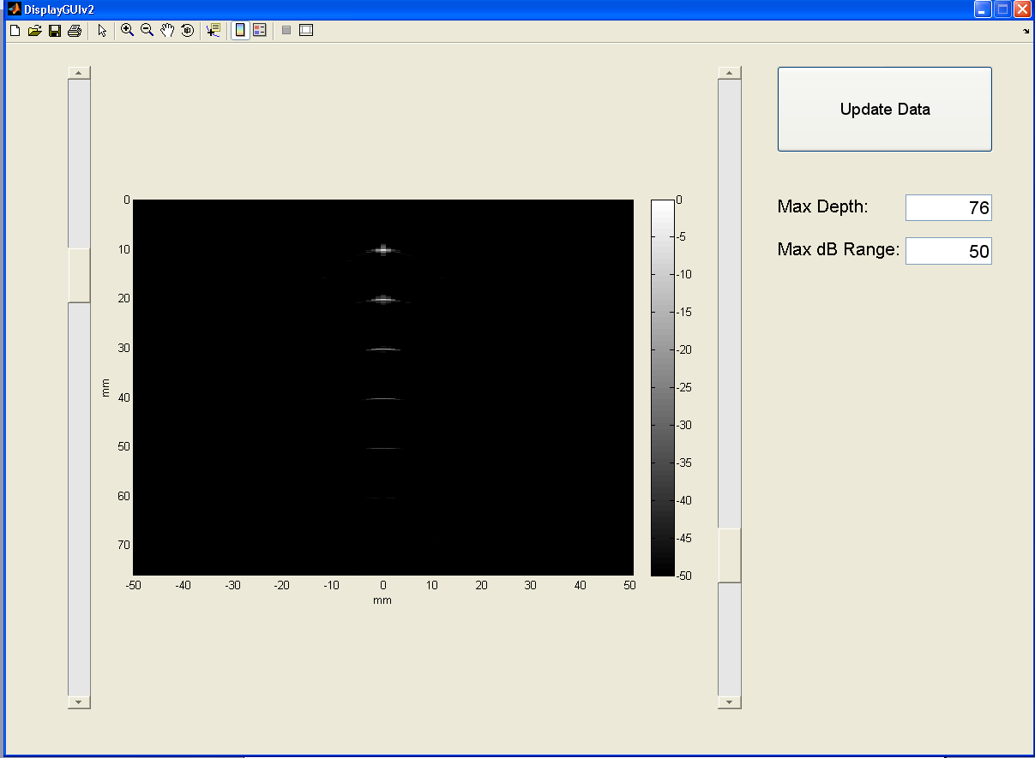
Graphical User Interface
77

Slide 78
Outline
Introduction
Functional Description
Methods
Results and Discussion
Conclusion
Questions

Slide 79
Conclusion
Valid waveform transmission
Portable system
Multi-channel
Research potential
Lecroy Oscilloscope

Slide 80
Acknowledgements
The authors would like to thank Analog Devices and Texas instruments for their donation of parts.
This work is partially supported by a grant from Bradley University (13 26 154 REC)
Dr. Lu
Mr. Mattus
Mr. Schmidt
Andy Fouts

Slide 81
References
[1] J. R. Sanchez et al., "A Novel Coded Excitation Scheme to Improve Spatial and Contrast Resolution of Quantitative Ultrasound Imaging," IEEE Trans. Ultrason. Ferroelectr. Freq. Control, vol. 56, no. 10, pp. 2111-2123, October 2009.
[2] "Clinical Image Library." GE Healthcare-. GE Healthcare. Web. 14 Apr. 2011. <http://www.gehealthcare.com/usen/ultrasound/ products/msul7im.html>
[3] J. A. Jensen et al., “Ultrasound Research Scanner for Real-time Synthetic Aperture Data Acquisition,” IEEE Trans. Ultrason., Ferroelect., Freq. Contr., vol. 52, no. 5, pp. 881–891, 2005.
[4] R. Schreier and G. C. Temes. Understanding Delta-Sigma Data Converters, John Wiley & Sons, Inc., 2005.
[5] R. Schreier, The Delta-Sigma Toolbox Version 7.3. Analog Devices, Inc, 2009.

Slide 82
References Cont.
[6] T. Misaridis and J. A. Jensen, “Use of Modulated Excitation Signals in Medical Ultrasound Part I: Basic Concepts and Expected Benefits,” IEEE Trans. Ultrason. Ferroelectr. Freq. Control, vol. 52, no. 2, pp. 177-191, February 2005.
[7] Thomeniu, Kai E. "Evolution of Ultrasound Beamformers." IEEE Ultrasonics Symposium (1996): 1615-622. Print.
[8] J.A. Jensen. Field: A Program for Simulating Ultrasound Systems, Medical & Biological Engineering & Computing, pp. 351-353, Volume 34, Supplement 1, Part 1, 1996.

Slide 83
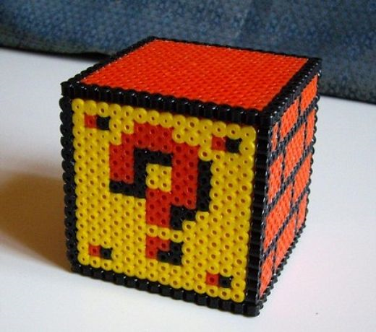
Questions?

