Slide 1
Observer-Based Engine
Cooling Control System
Students:
Andrew Fouts
Kurtis Liggett
Advisor:
Dr. Dempsey

Slide 2
Presentation Overview
Project Summary
Observer-based control
Equipment
Project Goals
System Block Diagram
Functional Requirements
Engine Subsystem
Thermal Subsystem
Results
Notes:
Quickly go through each part of presentation
- Project Summary, Observers, Equipment – Andrew
- Goals, System Block diagram, Functional Requirements, Engine Subsystem – Kurtis
- Thermal Subsystem, Results - Andrew

Slide 3
Project Summary
Engine cooling control workstation
Several control methods
  Proportional control
  PI control
  Feedforward
  Optimum Phase Margin
Observer-based control
CAN bus communication
Notes:
- Engine cooling control work station
> Consists of electric motor driving another motor as a generator
> Liquid cooling system with pump and radiator fan
> Continuation of project started in 2008
> Focus on theory, not on hardware
- Control methods – Proportional, proportional-integral, feedforward/optimum phase margin
- Focus of project – observer-based control
- CAN bus communication between two parts of system (didn’t quite get to this)
Now that we’ve looked at a what our project is, I’ll explain why observers and our project are important.

Slide 4
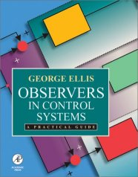
Observers in Controls
Overview
Advantages
  Reduced number of sensors
  Increase stability
Disadvantages
  Added complexity
  Computational Resources
  Response to large plant changes
George Ellis. “Observers in Control Systems”, Academic Press, 2002.
Notes:
- Observers – advanced component for control systems
- Models response of the system
- Advantages
> Reduces number of sensors needed to control system – cheaper
> Allow for more stable systems than traditional controllers – safer systems
- Disadvantages
> Complex – requires determining characteristics of system in order to simulate
> Computational resources – may need a more expensive microcontroller than traditional systems
> Plant changes – model is only accurate as long as the plant doesn’t change too drastically
- Other notes
> Differs from state-space method
> Similar to Luenberger, but doesn’t observe states separately
> Observer described in book by George Ellis
> PID tuning method
We’ll next look at the hardware that our project consisted of.

Slide 5
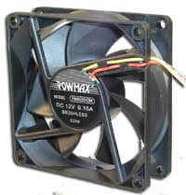
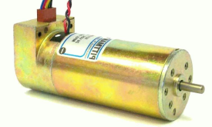
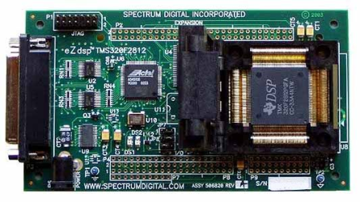
Equipment
Pittman motors (2)
Motor Heat Sinks
H-bridge
30 volt, 315 watt switching power supply
Control and interfacing circuitry
eZdsp F2812 TI DSP boards(2)
Fan
Radiator
Cooling block
Reservoir and pump
Flow meter
Coolant
Code Cathode
Temperature Sensors (3)
Tubing, clamps
Notes:
*Don’t spend too much time on this slide
All equipment was purchased & set up before our work

Slide 6
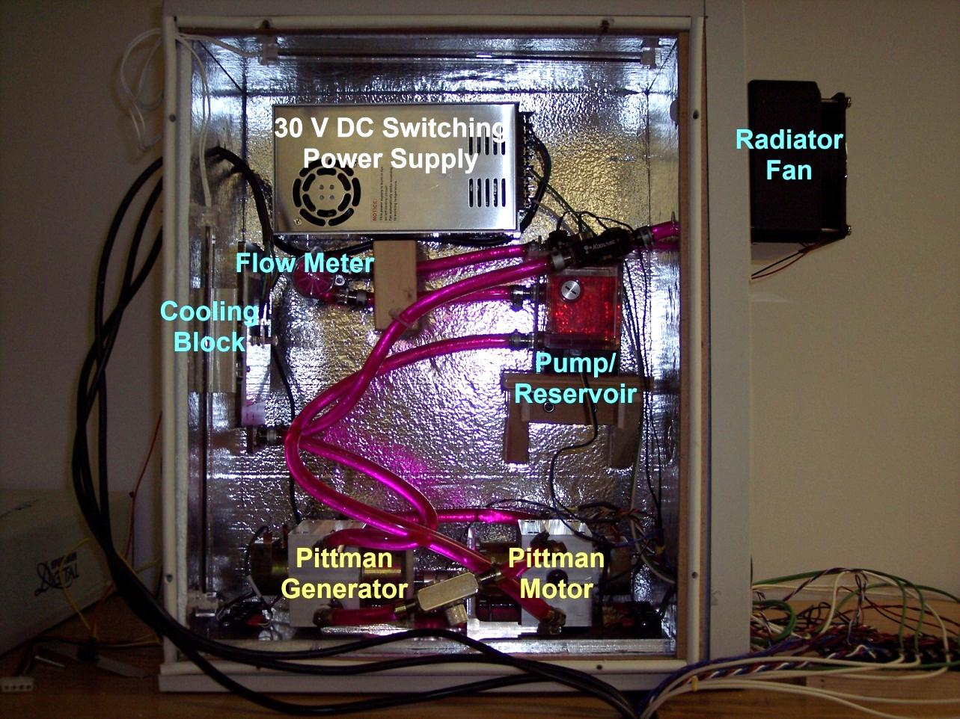
Project Workstation
Nick Schmidt
Notes:
Labels in yellow – engine system (2 Pittman motors)
Labels in blue – cooling system (pump, radiator fan, cooling block, flow meter, tubing, thermistors)
Work done by lab director Nick Schmidt on organizing & constructing system as well as previous group’s work

Slide 7
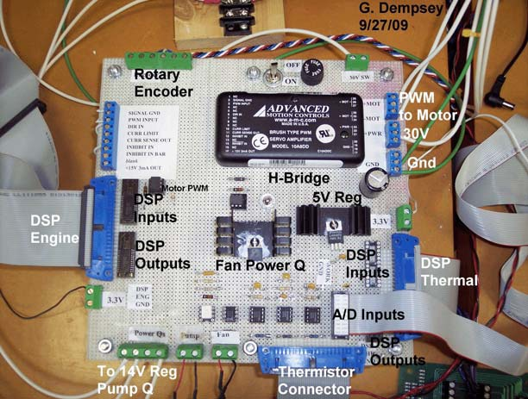
Power Electronics
Dr. Dempsey
Notes:
Reorganized circuitry from previous groups by Dr. Dempsey (wire wrap board)
Both DSP boards connected to circuitry here, but largely independent from each other
Now Kurtis will take over to show how we utilized this hardware in our project goals

Slide 8
Project Goals
  Learn software packages
  Design several types of controllers & evaluate performance of each
  Develop energy management control system in Simulink environment to regulate voltage/current to each subsystem
  Determine the limitations of the Simulink/DSP interface
Notes:
Learn software packages
Simulink & Matlab – used in previous classes & projects, but now using some more advanced features & models
Code Composer – auto code generation tool, allows quick conversion of controller designs to working systems
Design different types of controllers
Focus is observer-based control
Evaluate performance of each controller, compare pros and cons of each
Develop energy management system
Utilize CAN bus to communicate between parts of system
Measure power usage of different components & use information for system design
Determine limitations of software & hardware
Examine auto generated code for correct operation
Avoid resolution & quantization error

Slide 9
System Block Diagram

Slide 10
Functional Requirements
Engine control system:
Steady-state error = ± 5 RPM
Percent overshoot ≤ 10%
Rise time ≤ 30 ms
Settling time ≤ 100 ms
Phase margin = 45°
Thermal control system:
Steady-state error = ±2° Celsius
Percent overshoot ≤ 25%
Rise time ≤ 2 seconds
Settling time ≤ 10 seconds
Phase margin = 45°

Slide 11
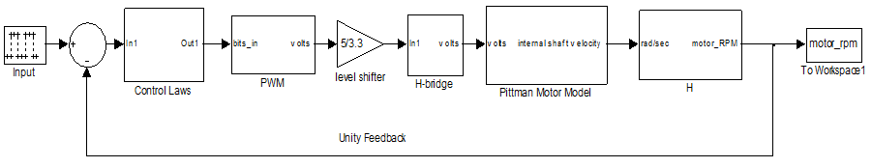
Engine Subsystem

Slide 12
Developing Engine Models
Simulink Model
  Easy to Build
  Scope Outputs
Control System Toolbox Model
  Frequency Domain Design
  Incorporate Time Delay
Model Comparison

Slide 13
Engine Model Comparison
Simulink
Step Response
Control System Toolbox Step Response

Slide 14
Lab Work - Engine
PWM, Quadrature Encoder, and A/D Tutorials
Mini-project implementation
Proportional control
PI control
Feedforward control
Observer-based control

Slide 15
Lab Work - Engine
PI Control
Feed Forward
Proportional

Slide 16
Lab Work - Engine
Observer Control
Observed Current
1/Ra

Slide 17
Lab Work – Engine (Simulink)
Observed Current

Slide 18
Lab Work – Engine (Simulink)
Observer Only
Switched Observer

Slide 19
Results – All Controllers (Simulink)
Rise Time - No Load

Slide 20
Results – All Controllers (Simulink)
Settling Time - No Load

Slide 21
Results – All Controllers (Simulink)
Steady State - No Load

Slide 22
Results – All Controllers (Simulink)
Steady State Error - No Load

Slide 23
Results – All Controllers
Engine Controller Summary
Controller | Advantages | Disadvantages
Proportional | Simple | Steady-state error
 | Very fast | Small operating range
 | Sensor cost
PI | Zero steady-state error | Longer rise time
 | Sensor cost
Feed forward | Zero steady-state error | More complex
 | Sensor cost
Observer | Zero steady-state error | Greatest computational resources
 | Reduced sensor cost
 | Observable states
Ultra Fast
Steady-State Error
External Changes
Predict States

Slide 24
Thermal Subsystem

Slide 25
Lab Work - Thermal
Thermistor-temperature calculation
Proportional controller design
System identification & proportional-integral controller design
Optimum-phase margin/frequency controller design
Anti-windup design
Observer-based controller design
Notes:
- Thermistor-temperature calc.
> Voltage to temperature equation (for 20-40 degree C range)
- Proportional controller design
> Found by tuning on actual system
- Explain next four steps in more detail

Slide 26
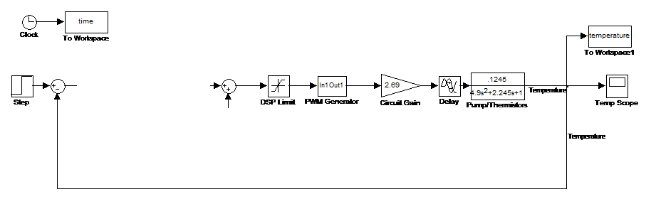
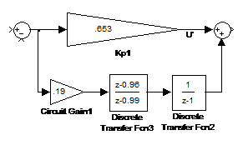
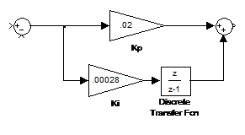
Lab Work - Thermal
PI Control
Optimum Phase Margin
Notes:
- System ID & PI controller
> Tuning on actual system was slow, wanted a model for better controller design & tuning
> Constructed system model by measuring step responses of system hardware
> Found PI controller by tuning on model & implementing in system

Slide 27
Lab Work - Thermal
Optimum phase margin – Bode diagram
Notes:
- Optimum phase margin
> Designed for 45 degree phase margin, peak of phase graph
> *Show peak on phase & shape of magnitude plot

Slide 28
Lab Work - Thermal
Anti-windup design
Notes:
- Anti-windup
> Implemented system to counteract integrator windup (accumulates large value at min/max)

Slide 29
Lab Work - Thermal
Observer-based control
Notes:
- Observer-based controller design
> Used model from system ID for design of system observer
> Models system & thermistors to “predict” system response
After creating all of these models, I tested each one and compared the results

Slide 30
Results – Thermal (models)
PI Model
  RiseTime: 6.07 s
  SettlingTime: 38.52 s
  Overshoot: 19.23%
  PeakTime: 15.72 s
OPM Model
  RiseTime: 4.14 s
  SettlingTime: 43.96 s
  Overshoot: 56.75%
  PeakTime: 13 s
Observer Model
  RiseTime: 6.70 s
  SettlingTime: 44.44 s
  Overshoot: 8.82%
  PeakTime: 26.85 s
Notes:
- PI model
> Cheapest & easiest to construct
> Moderate results
- OPM model
> Fastest system
> Very high overshoot (unexpected with 45 degree PM, due to time delay in system)
- Observer model
> Most stable system
> Good rise time, slow settling times

Slide 31
Results – All Controllers
Thermal Controller Summary
Controller | Advantages | Disadvantages
PI | Zero steady-state error | Slow speed
 | Low complexity | Moderate overshoot
OPM | Zero steady-state error | Moderate complexity
 | Fast speed | High overshoot
Observer | Zero steady-state error | High complexity
 | Low overshoot | Slow speed
Least complex
Fastest speed
Most stable
Notes:
Table summarizing what I just described
So now that we’ve seen the individual results of our systems, let’s look at a summary of the overall results of the project.

Slide 32
Overall Results
Successfully implemented observer in engine subsystem
Successfully implemented observer in cooling subsystem
Planned
  Engine governor system
  Cooling system power conservation
  Intersystem CAN bus communication

Slide 33

Questions
Notes:
Thank you for your time. We’ll now answer any questions you may have.

Slide 34
Other Specs
Thermal System sampling time
  500 ms (-2.9 degrees @ Wc = .2 rad/sec)
Thermal System time delay
  1.7 sec (-20 degrees @ Wc = .2 rad/sec)
Thermistor accuracy
  Average % error = 0.9%
DSP board specifications
  32-bit system
  12-bit A/D converter

Slide 35
Z-plane controllers
Thermal OPM controller

Slide 36
Z-plane controllers
Thermal OPM controller (zoomed in)

