Slide 1
Multiple Robot navigation and Mapping for Combat environment
By: Scott Tipton and Nick Halabi
Advisor: Dr. Aleksander Malinowski
Bradley University
February 23, 2010

Slide 2
Outline
Recap
Project Summary
Project Description
Past Progress
Completed Work
Current Progress
Future Schedule of Tasks

Slide 3
Project Summary
Military application – proof of concept
Combat/unknown environment
Indoor or outdoor
Map area and detect potential threats
Guide autonomous supply caravans or troops safely through a combat zone

Slide 4
Project Description
First robot scans and maps environment
Second robot uses path finding algorithm to designate safe route
Server/Central command
Pass information (map files)
User override via joystick

Slide 5
Completed Work
Improved Wall Following
Potential Field
Partial Server Setup
Force Feedback Joystick
Built 4 Metal Detectors
Modified Metal Detectors for 5V input
Tested Metal Detector Range
Schematic of Metal Detector holder

Slide 6
Past Progress
Mode 1 – 70% Complete
Mapping and navigation
Manual override with joystick
Metal Detector
Improve wall following
Mode 2 – 50%
Path planning using the grassfire approach
Possibly use the potential field approach or a combination of the two
Server – 0%

Slide 7
Improved Wall Following

Slide 8
Improved Wall Following

Slide 9
Potential Field
Better at avoiding obstacles
Doesn’t require use of maps
Calculates repulsive forces on the fly
Local minimas

Slide 10
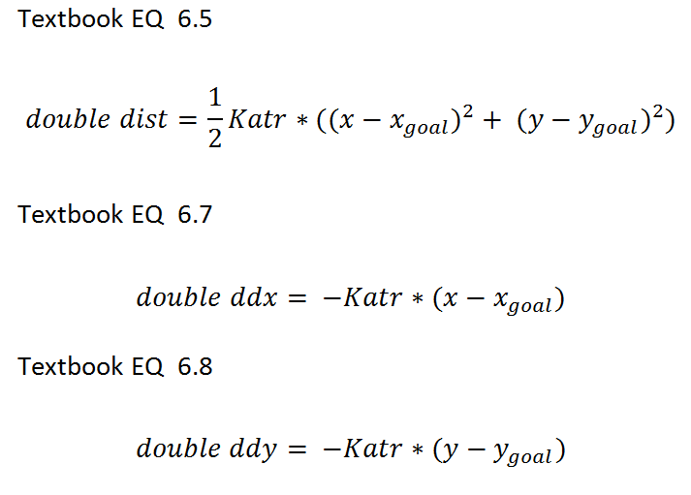
Potential Field Attractive

Slide 11
Potential Field Repulsive

Slide 12
Matlab Derivative
clear, syms Krep Rrep_inv xo yo x y;
d=sqrt((x-xo)^2+(y-yo)^2);
u=0.5*Krep*((1/d)-Rrep_inv)^2 ;
dx=diff(u,x);
dy=diff(u,y);

Slide 13
Dx and Dy Repulsive

Slide 14
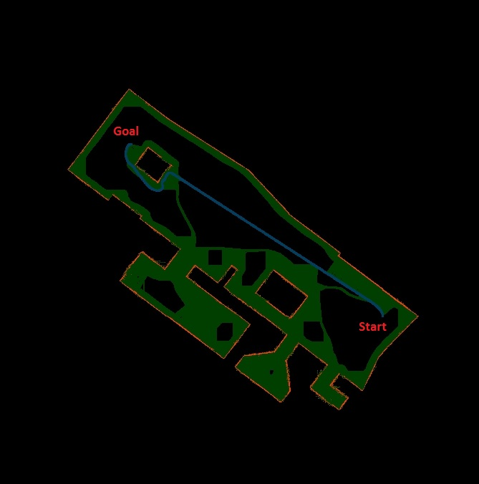
Potential Field
Potential Field Path Planning Complete

Slide 15
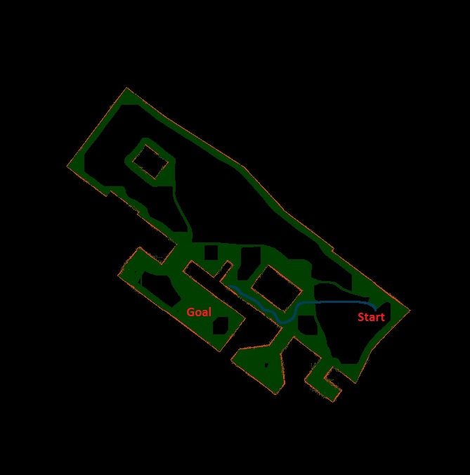
Potential Field
Issues

Slide 16
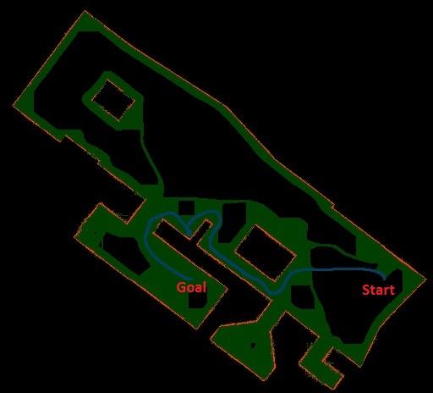
Potential Field
Solution

Slide 17
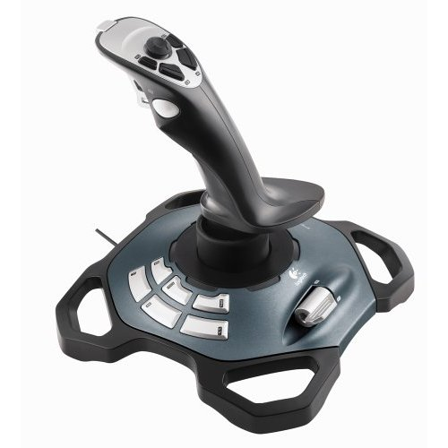
Force Feedback
Force 3D Pro

Slide 18
Server
Began work on multicast framework
Setup new user interface with 5 options
Map Environment (wall following)
Path Planning
Grassfire Approach
Potential Field
Manual Override
Bug2 Algorithm
Reorganized manual override code

Slide 19
Metal Detectors

Slide 20
Initial metal detector schematic

Slide 21
12 to 5 volts modifications

Slide 22
Metal Detector holder
Current wood enclosure will be replaced in order to install metal detectors.

Slide 23
IR Sensors
Previously Installed IR Sensors
Will be connected to microcontroller along with Metal Detectors.

Slide 24
Past VS. Current Progress
Mode 1 – 70% Complete
Mapping and navigation
Manual override with joystick
Metal Detectors
IR Sensors
Improve wall following
Mode 2 – 50%
Path planning using the grassfire approach
Possibly use the potential field approach or a combination of the two
Server – 0%
Mode 1 – 80%
Metal Detector integration
IR Sensor integration
Mode 2 – 100%
Server – 20%

Slide 25
Future Schedule of Tasks
2/22/2010 – 3/11/2010
Integrate IR sensors
Integrate Metal detectors with enclosure
Program Microcontroller board
Force Feedback Joystick
3/13/2010 – 3/22/2010
Spring break
Setup testing environment
Final troubleshooting and programming
Server Setup
3/22/2010 – 3/31/2010
Conclude Testing
Begin final presentation
Conference paper

Slide 26
Questions?

