Slide 1
Multiple Robot navigation and Mapping for Combat environment
By: Scott Tipton and Nick Halabi
Advisor: Dr. Aleksander Malinowski
Bradley University
April 29, 2010

Slide 2
Outline
Project Application
Project Description
Goals
System Overview
Hardware
Subsystems
Work Completed
Future Work

Slide 3
Project Application
Military application – proof of concept
Combat/unknown environment
Indoor or outdoor
Map area and detect potential threats
Guide autonomous supply caravans or troops safely through a combat zone

Slide 4
Project Description
First robot scans and maps environment
Second robot uses path finding algorithm to designate safe route
Server/Central command
Pass information (map files)
Control’s robot mode
User override via joystick

Slide 5
Goals
Robot Navigating
Sonar Sensors
IR Sensors
Environment Mapping
Metal Detector
Path Finding
Server Infrastructure

Slide 6
System Overview

Slide 7
System Platform
Pioneer 3D-X
8 Sonar sensors (+90 to -90)
2 wheels for navigation, 1 for stability
Navigation Computer (Laptop)
C++ program with Visual Studio 2005
Aria
MobileSim

Slide 8
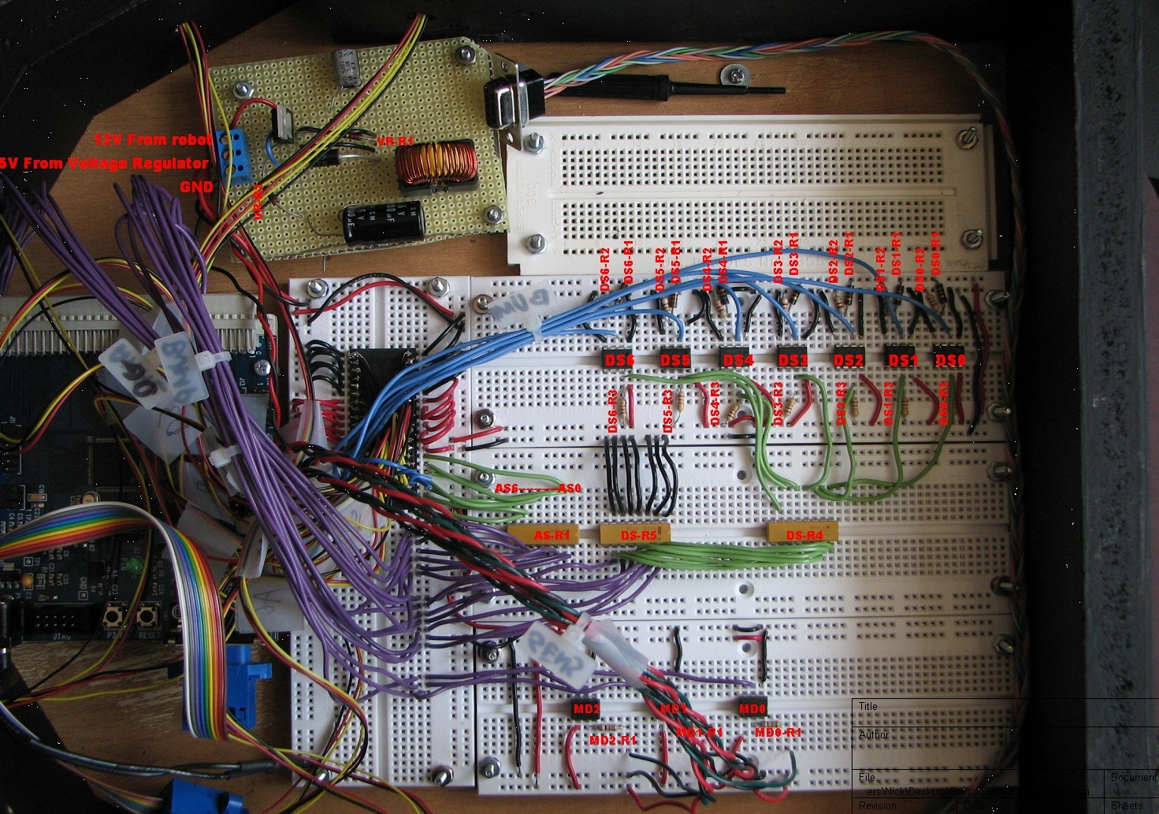
Robot Hardware

Slide 9
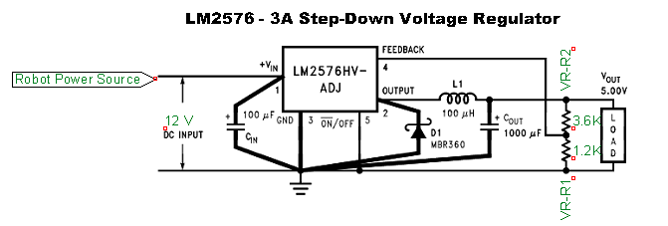
12V to 5V Regulator
LM2576
Steps down voltage from 12 volts to 5 volts

Slide 10
Metal Detectors

Slide 11
Initial metal detector schematic

Slide 12
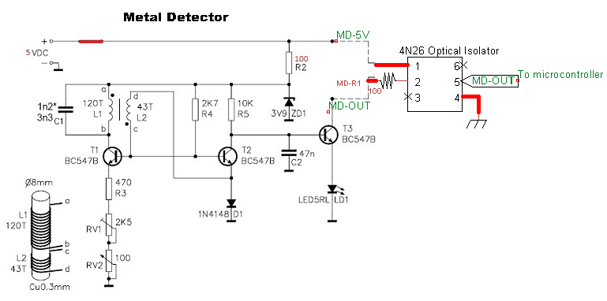
12 to 5 volts modifications

Slide 13
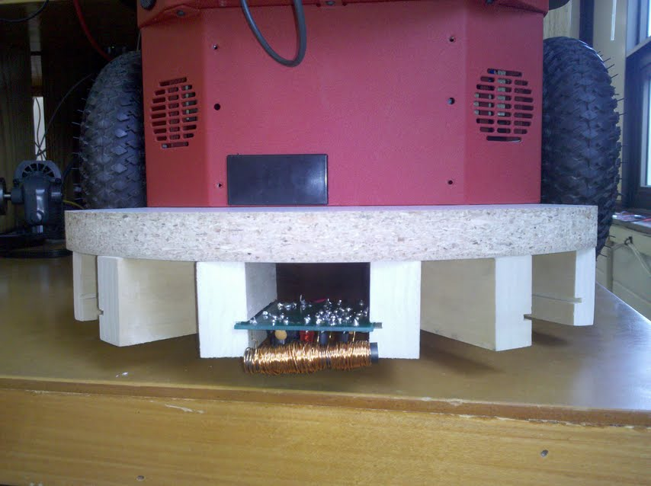
Metal Detector holder
Current wood enclosure can hold three metal detectors.

Slide 14
IR Sensors
Previously Installed IR Sensors
They are connected to microcontroller along with Metal Detectors.

Slide 15
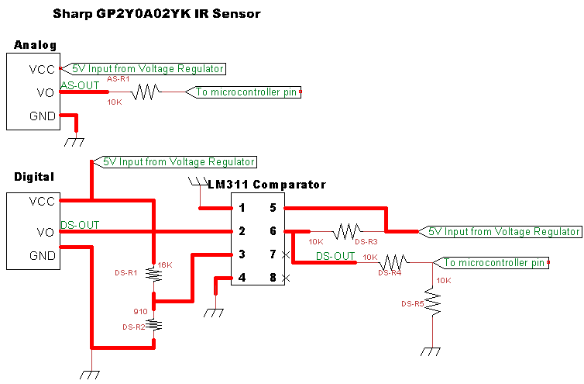
IR Sensor Hardware

Slide 16
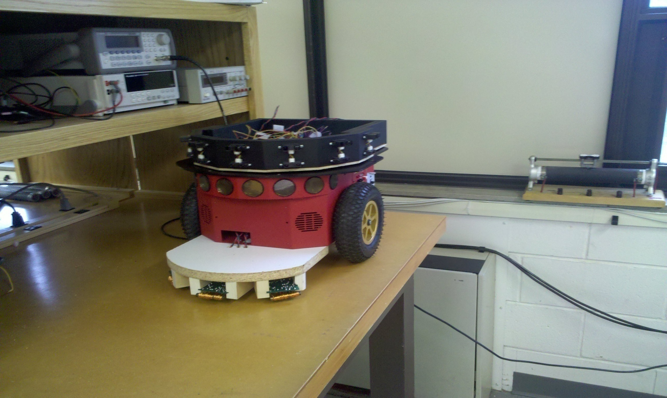
Robot Hardware

Slide 17
Subsystems – Mode 1
Find closest wall and drive to it
Use wall following algorithm
Perform random movement when finished to scan interior
Map environment
Relay map to server

Slide 18
Mode 1 – Wall Following

Slide 19
Mode 1 – Mapping

Slide 20
Mode 2 – Path Planning
2 Approaches – Grassfire Approach and Potential Field
Grassfire:
Shortest Distance
Must compute entire map
Narrow passageways

Slide 21
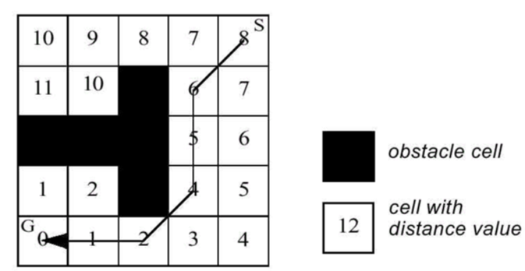
Grassfire
Obstacles – 32,000
Non-reachable – 0

Slide 22
Grassfire

Slide 23
Grassfire

Slide 24
Potential Field
Better at avoiding obstacles
Doesn’t require use of maps
Calculates repulsive forces on the fly
Local minimas

Slide 25
Potential Field Forces

Slide 26
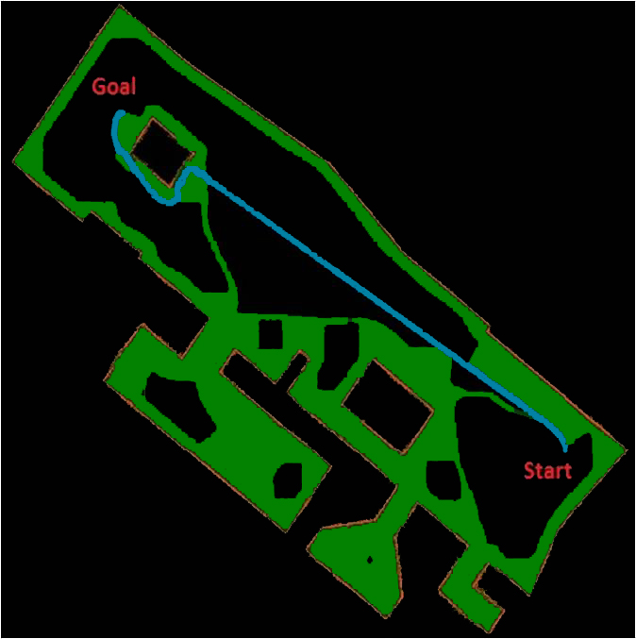
Potential Field
Potential Field Path Planning Complete

Slide 27
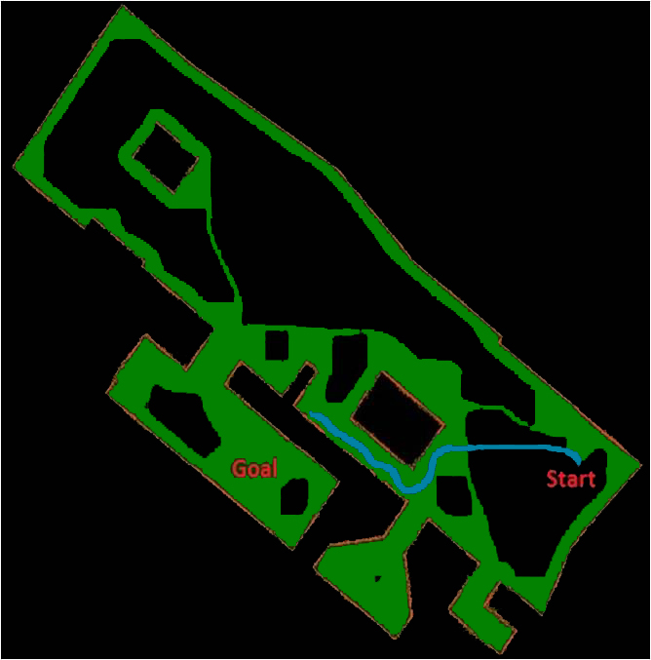
Potential Field
Issues

Slide 28
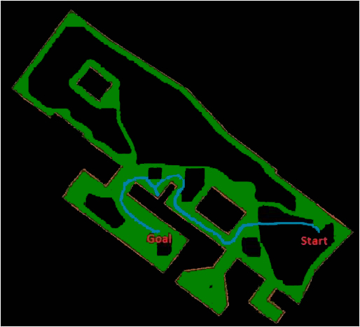
Potential Field
Solution

Slide 29
Grassfire vs. Potential Field
Which is the best?
Grassfire – complete map with minimum changes
Potential – No map or constantly changing environment

Slide 30
Server
View Robots and Status (Webcam)
Sends and Receives Maps
Control Mode - 5 options
Map Environment (wall following)
Path Planning
Grassfire Approach
Potential Field
Manual Override (Joystick)
Random Movement
Quit
Set Goal Coordinates

Slide 31
Server Control

Slide 32
Work Completed
Mode 1 and Mode 2 - Complete
Server architecture - Complete
Hardware for metal detectors and IR sensors - Complete
Software for integration of metal detectors and IR sensors – 75% complete

Slide 33
Potential Field Demo

Slide 34
Demo Map

Slide 35
Future Work
Fully Integrate IR Sensors and Metal Detector
Localization
3D-Mapping
Potential Field Oscillation
AVR32 Board or ARM

Slide 36
Questions?

Slide 37
Mode 1 – Trigonometry

Slide 38
Mode 1 – Wall Following

Slide 39
Potential Field Repulsive

Slide 40
Matlab Derivative
clear, syms Krep Rrep_inv xo yo x y;
d=sqrt((x-xo)^2+(y-yo)^2);
u=0.5*Krep*((1/d)-Rrep_inv)^2 ;
dx=diff(u,x);
dy=diff(u,y);

