Slide 1
Software Defined GPS Receiver
Sam Price
Advisor: Dr. In Soo Ahn

Slide 2
Why use a software defined GPS receiver?
Test and implement algorithms
Implement on multiple platforms
Reduce cost of hardware
Software upgrades
Reduce development time
Notes:
Test & implement algorithms
Implement on multiple platforms
Reduce cost of hardware
Patch software later.
Reduce development time
Digital camera geocaching
25Mb’s for position when sampling just over nyquist rate.
36 seconds at 3Mhz

Slide 3

Overview of GPS
Notes:
GPS is the global positioning system.
It is currently the only fully working Global navigation system.
Developed by the DOD, launched in 1993.
32 satellites in medium earth orbit.
GPS works as telemetry problem

Slide 4



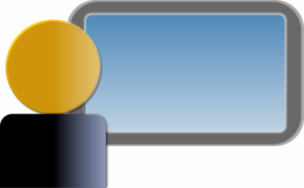
Telemetry
Hello
Echo
Hey its 1:00
Hey its 1:06
Hey its 1:12
Notes:
You know the time delay,
Triangulate you need to know the satellites position.

Slide 5
Notes:
Cell phones
Time takes to send a message tower and back.
Satellites
Don’t communicate to satellite, and satellite is always moving.

Slide 6
Notes:
Gps uses triangluation to form a solution.
Current time + ephemeris = satellite position.
Messages are sent at known intervals, measure the delay.
X,Y,Z 3 unknowns need 3 equations.

Slide 7
?
Known
Notes:
Receiver can see when the first, and last satellite has arrived.
Using its internal clock it can make a guess at when that message was transmitted, and how long it took to arrive.
Now Imagine that our receiver clock is slower than the satellites clock by a few milliseconds.
The receiver would think that signal took longer to arrive.
300,000 m = 1ms 3 hundred thousand meters.
For those less familiar with english units this relates to 190 miles.

Slide 8
?
?
Known
Notes:
Gps uses triangulation to form a solution.
Current time + ephemeris = satellite position.
Messages are sent at known intervals, measure the delay.
X,Y,Z 3 unknowns need 3 equations.
How do the satellites send information?

Slide 9
Signal properties
L1 1575.42 MHz
  Navigation Messages
  Coarse-Acquisition (C/A) code
  Encrypted Precision P(Y) code
L2 1227.60 MHz
  P(Y) code
  Military applications

Slide 10

Signal information
Navigation messages
  Ephemeris information
  Time of day
  50Hz
C/A code
  Unique to each satellite
  1.023MHz
  Orthogonal
Notes:
Nav
Ephemeris / Flight path
Time of day
50Hz
C/A code
Unique to each sat
1 Mhz
Orthogonal each other & themselves / Ill explain what orthognal means.

Slide 11
BPSK
Binary phase-shift keying
Carrier wave
Data signal
Output
Notes:
Carrier wave is sent at 1Ghz

Slide 12
GPS signal
Carrier wave
1575.42MHz
C/A code
1.023MHz
Navigation data
50 Hz
X
Notes:
How does receiver lock onto this?

Slide 13
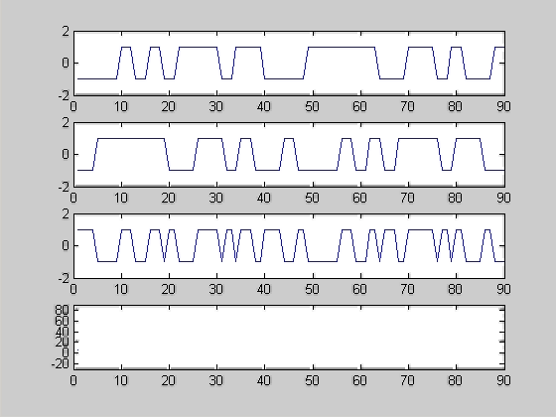
Orthogonality
Source
Incoming
Product
Sum
Notes:
Imagine your in a room of people talking, and you wanted to understand someone across the room.
Take turns.
Talk at different frequencies.
Talk in different languages.
CDMA – Code division multiple access, cell phones
1023 bit code
32 bit shown as an example.
Unique to each satellite
Orthogonal
Used for tracking, and determination of message arrival.

Slide 14
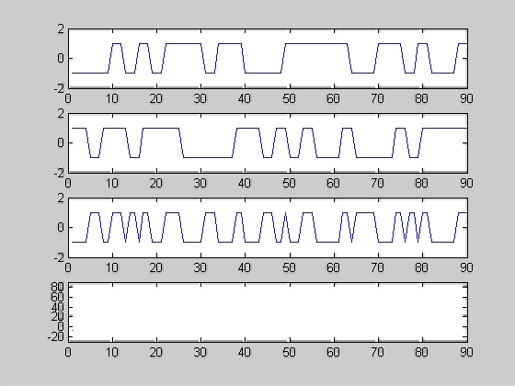
C/A code (cont)
Notes:
How do I bring an analog signal into software

Slide 15
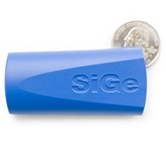
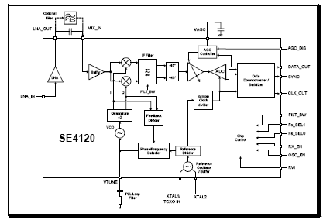
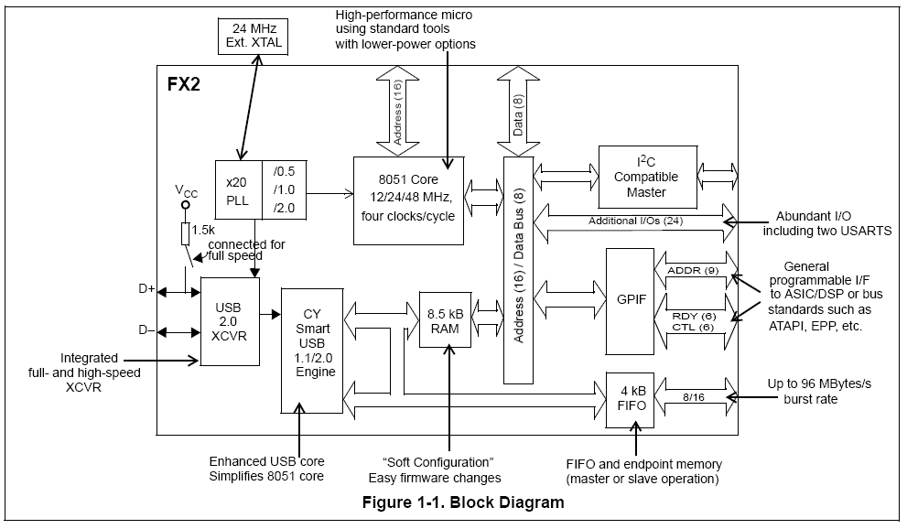
Hardware used
SiGe GN3S Sampler v1
SiGe Semiconductor SE4120
Cypress Semiconductor
EZ-USB FX2
Notes:
How do I receive the signal in the computer?
Down converter 1.5GHz to 4Mhz
Low noise amplifier.
A to D converter at sampling rate at 16Mhz
2 bit quantifier -3,-1,1,3
Data sent to the cypress semiconductor
provides the sub interface.
In total 2 chips, 1 rf design
Once have data time to process

Slide 16
Previous project by Tony Corbin
Sample
Sampler 30 seconds
Buffer 600MB
Acquisition:
50 seconds /20ms
Tracking:
3½ Min/30 sec
Provide a single position update.
Buffer
Acquisition
Tracking
Decode
Calculate position
Notes:
Sampler was limited to 30 seconds
Buffer was limited to 600 Mb’s
Acquisition took 50 seconds / 20ms of data
Tracking 3 ½ Min / 30 sec
Only provides a single position update.
My project was to make these run in parallel.
Now going to describe acquisition - tracking

Slide 17
Acquisition
Notes:
Find 32 satellites based on their CA code.
Doppler effect
Data is divided up into frequency blocks and searched for in the frequency domain
By searching in the frequency domain time information is lost/ ca offset.
Then translated back into the time domain.

Slide 18
Tracking algorithm
CA(t) N(t) Cos(F t)
D(t) = CA(t) N(t)
Cos(A)Cos(A) = ½ Cos(0)+ ½ Cos(2A)
D(t) Cos(F t) Cos(F t) = ½ D(t)Cos(0) + ½ D(t) cos(2F t)
Signal
Carrier Frequency Off
Notes:
Tracking algorithm is responsible for keeping track of the signal, and decoding the data
Keeps track of the C/A code offset, and carrier frequency.
Correlation is done on
Satellites signal will be come faster or slower

Slide 19
Tracking algorithm
Prompt
E
P
Early
Late
L
Notes:
Tracking algorithm is responsible for keeping track of the signal.
Satellites signal will be come faster or slower

Slide 20
Tracking algorithm (cont)
Prompt
Early
Late
Notes:
When correlations are off a nice triangle is not formed.
Then addjust the code offset, and carrier frequency accordingly.
Last project took 3.5 min to do this

Slide 21
Tracking algorithm
Reference C/A code
1
-1
1
-1
-1
Early
1
-1
1
-1
-1
1
Data
Prompt
1
-1
1
-1
-1
Data
Late
-1
1
-1
1
-1
-1
Data
Notes:
Spent the first semester on improving the tracking loop
3.30 minutes -> 23 seconds
Data * reference wave.

Slide 22
Tracking improvement
-1
1
-1
1
-1
-1
1
Early
Data
Data
Prompt
Data
Data
Data
Late
Data
Data
Notes:
7 for loops
Center loop shares 1021 chips.

Slide 23
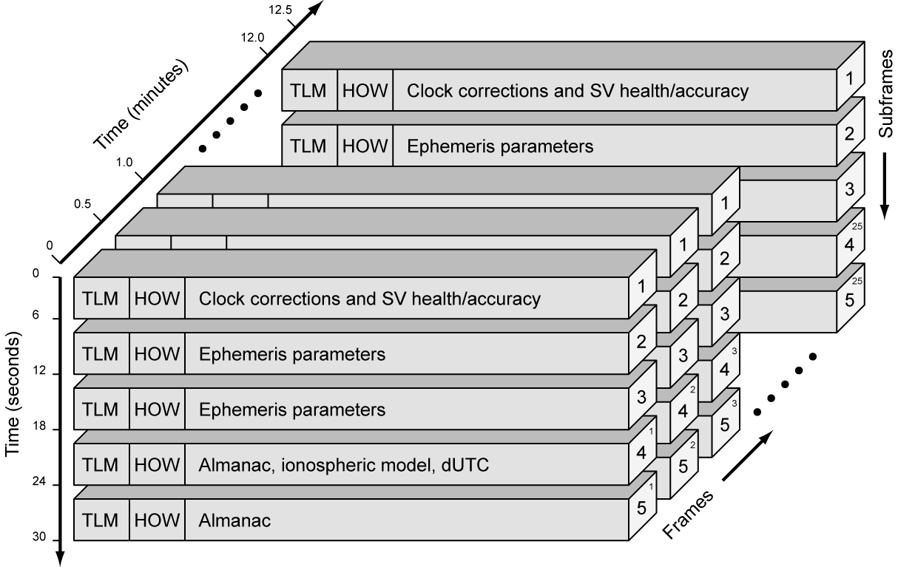
Decoding the data
Notes:
Satellites message.
Look for sign change after 20 ca correlations
Look for preamble / sf increase in next sf / time increased by 6.
Position Updates are done at the start of every word. .6 seconds

Slide 24
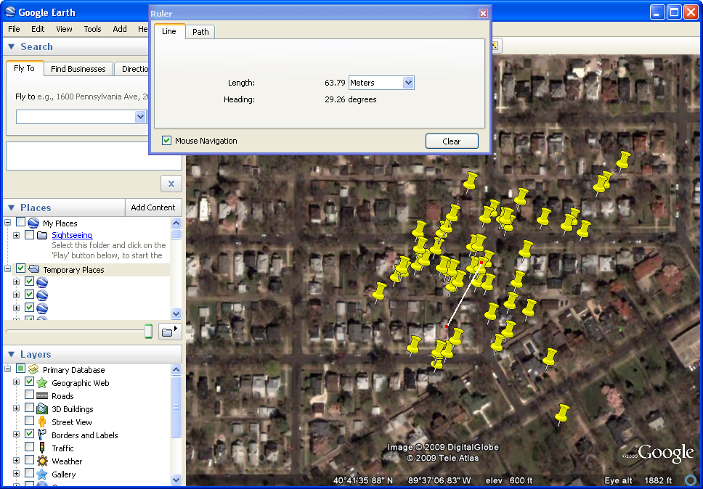
Final result

Slide 25
High level overview of design
Sampler
Buffer
Acquisition
Course
Fine
Course
Course
Fine
Course
Course
Fine
Course
Coarse
Acquisition
Fine
Acquisition
Position
Updates
Fine
Fine
Fine
Tracking
/
Decoding
Notes:
Sampler
Takes in samples from GN3S and places them in a 2 second buffer. 30Mb of ram.
Acquisition
Takes 20 ms of data,
searches for satellites CA codes, carrier frequency, and code offset
Tracking loop
Performs correlation on 1ms of data, and passes the -1, or 1 result off to a decoding routine.
Position update runs every .6 seconds before.
Freezes the currently tracking satellites
Grabs their current time, and

Slide 26
Current real-time open source software
GPS-SDR
  C++
  USRP
  Linux
  Mac
OSGPS
  C
  Multiple drivers
  Linux
Current project
  C++
  GN3S v1
  Windows

Slide 27
Comparison to previous project
Feature | Previous project | Current project
Continuous updates | No | 1 second updates
Buffer size | 600 MB | 30 MB
Tracking time | 210 sec / 30 sec | 22 sec / 30 sec
Hot start | Yes | Yes
Maximum data set | 40 sec | 40 min
Sampling frequency | 300Hz off | Calibrated

Slide 28
Conclusions
Successfully implemented real-time software defined GPS receiver
Implemented on windows
60m average position error
Approximately 1 second position updates
50% average CPU usage
Warm start implemented
Notes:
Successfully implemented real-time software defined GPS receiver
Implemented on windows
60m average position error
Approximately 1 second position updates
50% average CPU usage
Warm start implemented

Slide 29
Future recommendations.
Investigate improvements of acquisition, and tracking on GPU / FPGA
Optimize acquisition stage
Analysis of multipath effects
Weak signal tracking
Purchase of USRP2
  Control sampling rate
  preprocess data on FPGA
  Reuse for other communication projects.

Slide 30
References
Borre, Kai et.al. Software-Defined Gps and Galileo Receiver. Basel: Birkhhäuser, 2007.
Tsui, James. Fundamentals of Global Positioning System Receivers. Hoboken: John Wiley & Sons Inc, 2005.

Slide 31
Thank You
Dr. In Soo Ahn
Dr. Yufeng Lu
Dr. Aleksander Malinowski
Michele Bavaro
Northrop Grumman

Slide 32
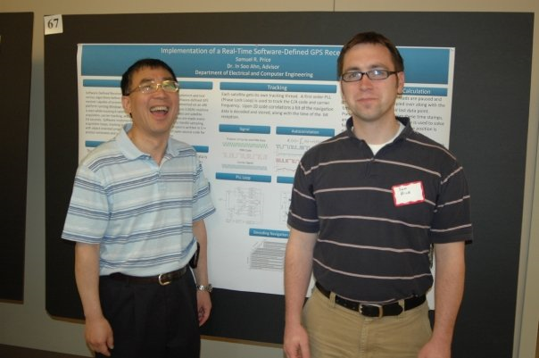
Any Questions?

