Slide 1
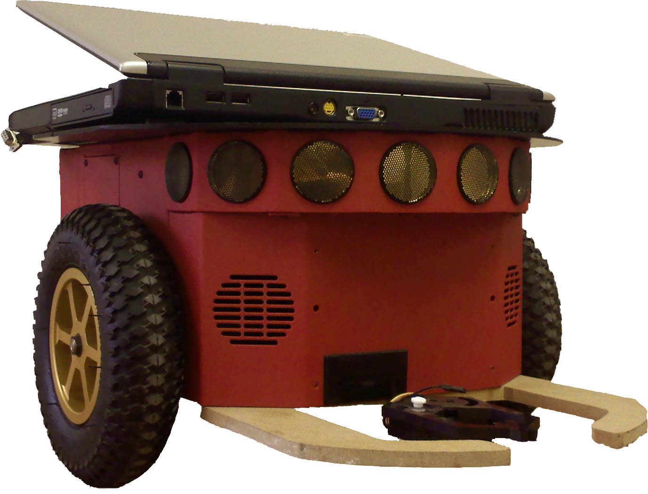
Robotic Delivery System
with SLAM
Blakely Boyd
Kyle Elmer
Phillip Faber
Project Advisors:
Dr. Aleksander Malinowski
Dr. In Soo Ahn

Slide 2
Outline
Inspiration and Introduction
Project Overview
Project Development
Sensors
Mapping
Wi-Fi
Navigation
Results
Future Recommendations
Questions
RDS with SLAM

Slide 3
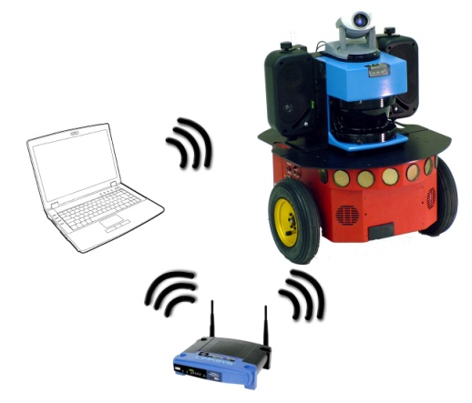
Introduction
Autonomous delivery system
Uses existing Wi-Fi access points
Works from any laptop
RDS with SLAM

Slide 4
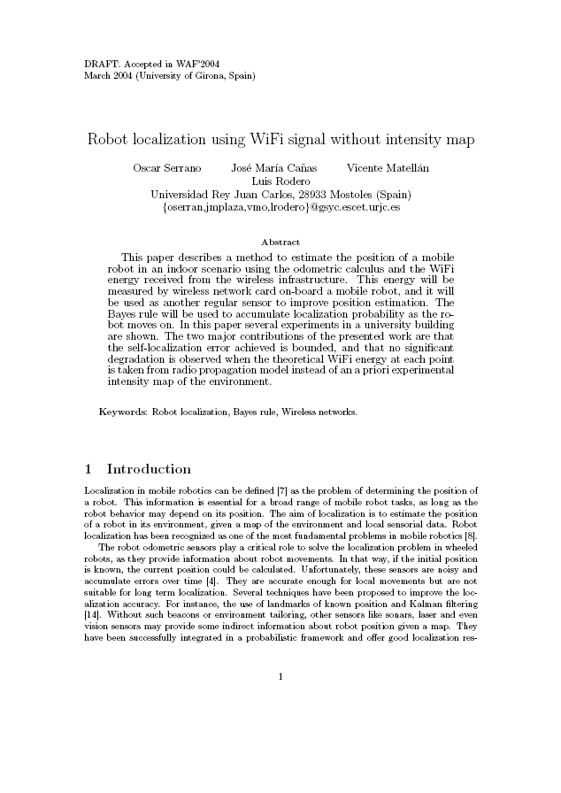
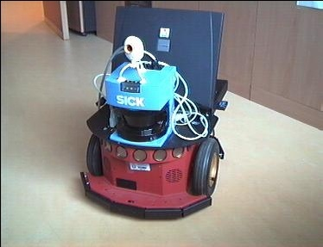
Other Projects
RDS with SLAM

Slide 5
Project Goals
Wi-Fi signal strength acquisition
Robotic obstacle avoidance
Localization and mapping
Best path algorithm
RDS with SLAM

Slide 6
Project Requirements
Deliver within .5m of user
Detect and navigate openings .81m
Sensors range: .5 – 1m
Minimum three Wi-Fi routers
RDS with SLAM
Notes:
6

Slide 7
System Platform
Pioneer p3dx
44cm x 38cm x 22cm aluminum body
Laptop interface
ARIA library
RDS with SLAM

Slide 8
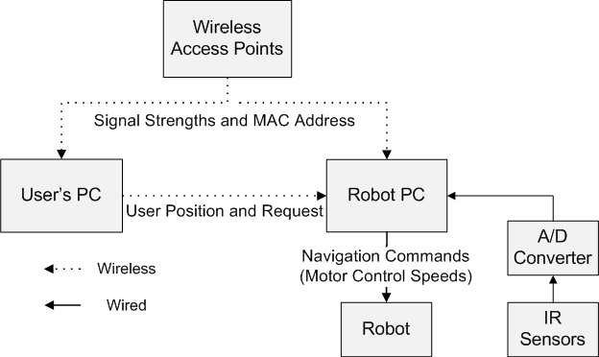
System Diagram
RDS with SLAM

Slide 9
Project Division
Phillip Faber
Sonar and IR Testing and Interfacing
Robot Navigation
Kyle Elmer
Grid Mapping
Wi-Fi Data Filtering
Blakely Boyd
Wi-Fi Navigation
Artificial Potential Field
RDS with SLAM

Slide 10
Software Overview
RDS with SLAM

Slide 11
Sonar Sensors
RDS with SLAM

Slide 12
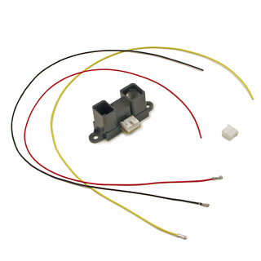
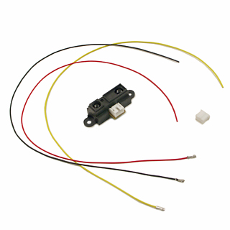
IR Sensors
Sharp GP2Y0A02YK0F
20cm to 150cm
0 – 2.7V
Sharp GP2D15
24cm
“Touch-less Bump Sensors”
[1],[2]
RDS with SLAM

Slide 13
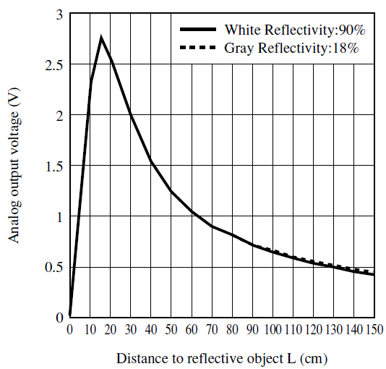
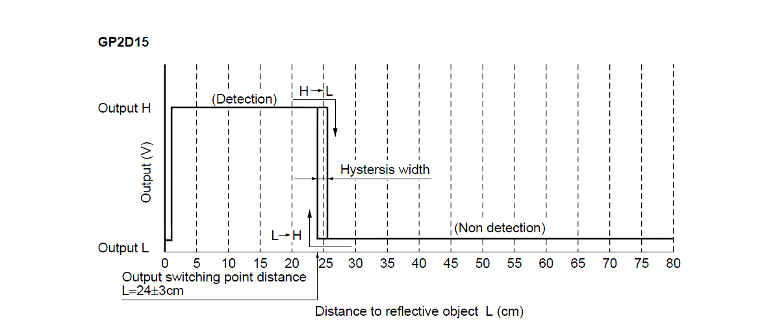
IR Sensors
Analog Sensor
Digital Sensor
[1],[2]
RDS with SLAM

Slide 14
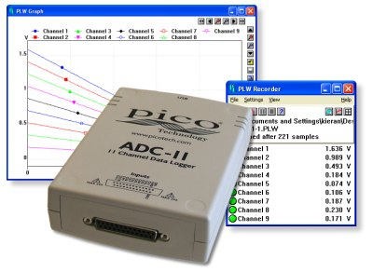
Interfacing
Pico Tech USB ADC-11/10
USB
Open Source
Sensor Class in Aria
11 channel/10 bit
[3]
RDS with SLAM

Slide 15
Conversion
Conversion from mV to mm
1.27 (2.096E⁻¹² · x⁵ - 8.128E⁻⁹ · x⁴ + 9.827E⁻⁶ · x³ - .00182 · x² - 4.130 · x + 2714.530)
[3]
RDS with SLAM

Slide 16
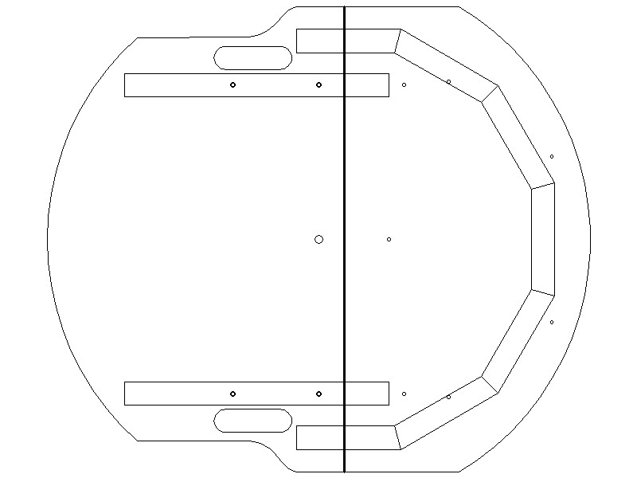
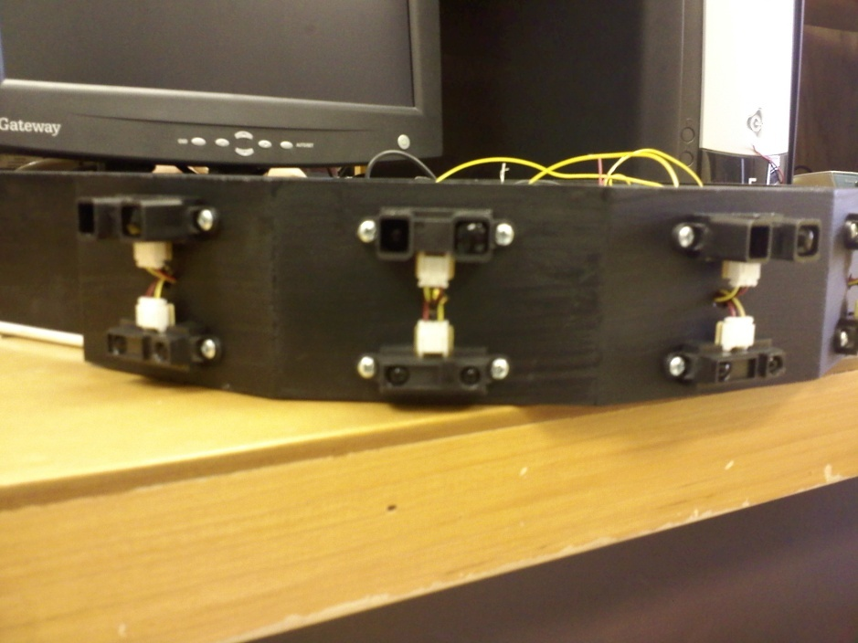
Sensor Mount
RDS with SLAM

Slide 17
IR Sensor Testing
RDS with SLAM

Slide 18
Software Overview
RDS with SLAM

Slide 19
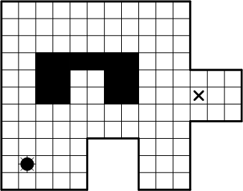
Grid Mapping
Used to:
Localize robot in the environment
Store specific Wi-Fi information
Find best path using potential field
Multiple Approaches
Store full map in memory
Windowed map
Windowed map is ideal
Status: Clear
Potential: 13
Networks: 00:1C:DF:4D:20:0A 100
00:1C:10:58:09:BA 68
00:18:39:41:64:EB 60
00:1B:11:66:E6:59 49
00:18:39:58:4C:C4 47
Status: Obstacle
Potential: N/A
Networks: N/A
[4]
RDS with SLAM

Slide 20
Grid Mapping
Initial mapping with obstacle detection
Which grid square should be marked?
x = cos(Ѳ) * (distance measured / grid size)
y = sin(Ѳ) * (distance measured / grid size)
Ѳ = rotation of robot + angle of sensor
Position in reference to robot
RDS with SLAM

Slide 21
Grid Mapping
Need to test using our sensor setup
Simulator for P3Dx is ideal
Needed to specify
Position of sensors (from center)
Angle of sensors
Allows testing of all software components without robot
RDS with SLAM

Slide 22
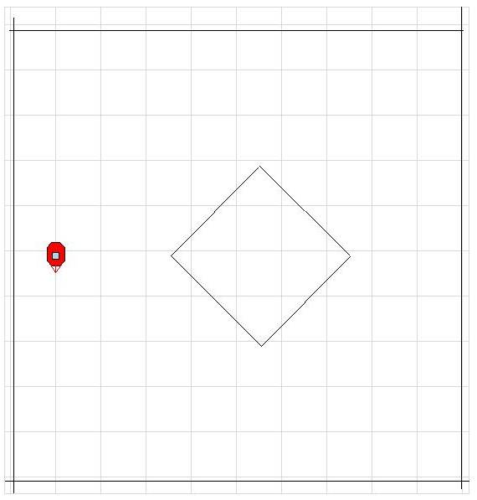
Grid Mapping
A simple grid map
RDS with SLAM

Slide 23
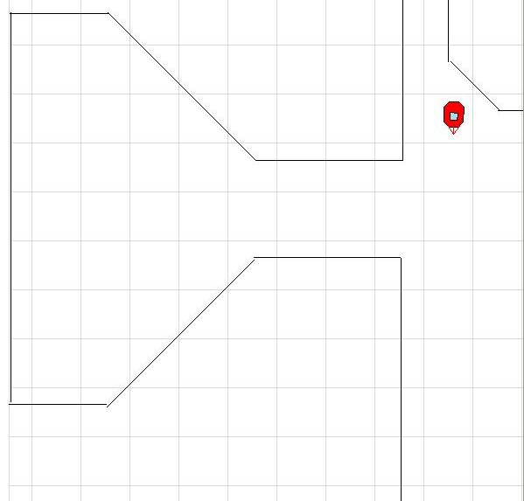
Grid Mapping
A bit more complex…
RDS with SLAM

Slide 24
Software Overview
RDS with SLAM

Slide 25
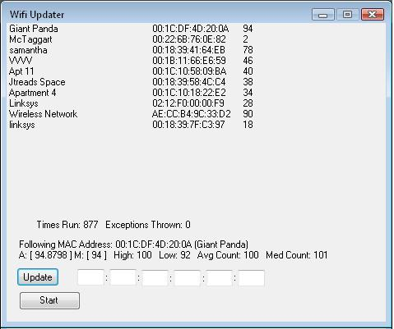
Wi-Fi Sampling
Software created in C#
Utilizes NativeWifi.dll
Tracks user specified MAC address
Output gathered data to files for future manipulation
RDS with SLAM

Slide 26
Wi-Fi Sampling
Smoothing of Wi-Fi signal
Averaging
Median Filter
Tested both techniques
Consistency
Transition
Reaction Time
Using Averaging
100 Samples
Smoother transitions
RDS with SLAM

Slide 27
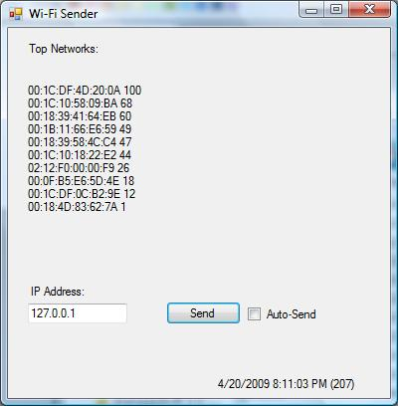
Wi-Fi Sender
Measures local strength values
Moving average
User Datagram Protocol (UDP)
RDS with SLAM

Slide 28
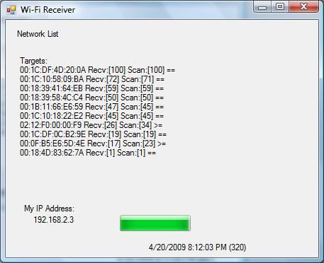
Wi-Fi Receiver
Measures local strength values
Initial mapping data
Generates navigation
RDS with SLAM

Slide 29
Software Overview
RDS with SLAM

Slide 30
Localization
Minimum three unique signals
RDS with SLAM
Notes:
30

Slide 31
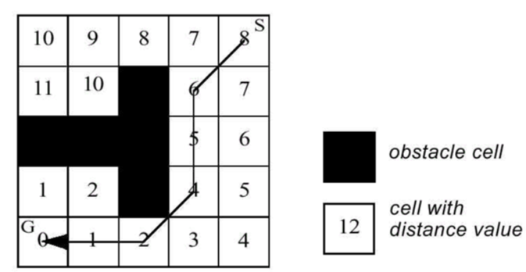
Potential Field
Artificial Potential Field
[5]
RDS with SLAM

Slide 32
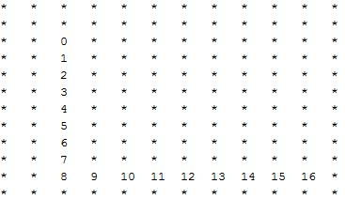
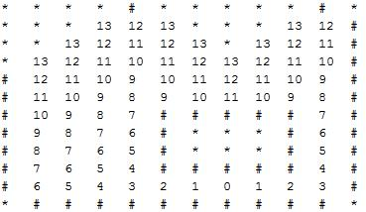
Potential Field
Potential generated from goal
Avoids local minima
Simple path creation
RDS with SLAM

Slide 33
Results
Simulator
Robot
Wi-Fi strength acquisition
Initial mapping
Potential field generation
Navigation of potential field
RDS with SLAM
Notes:
33

Slide 34
Results
RDS with SLAM
Notes:
34

Slide 35
Results
RDS with SLAM
Notes:
35

Slide 36
Final Hardware
Part Number | Description | Quantity | Part Price | Total
Pioneer p3dx | Robotic Platform | 1 | $0.00 | $0.00
Dell Laptop | Project Computer | 1 | $0.00 | $0.00
GP2Y0A02YK0F | Analog Sensors | 8 | $12.50 | $100.00
GP2D15 | Digital Sensors | 8 | $12.50 | $100.00
AD7224 | DA Converter | 1 | $9.10 | $9.10
USB ADC-11/10 | USB AD Sensor Interface | 1 | $262.35 | $262.35
Total |  | 20 |  | $471.45
RDS with SLAM

Slide 37
Future Recommendations
More robust navigation
Implement docking station
Port Sender program to mp3 player
Develop mechanism for getting objects
Implement IR sensors into ARIA library
Use with EE-SLAM
Use Wi-Fi software for other uses
RDS with SLAM
Notes:
37

Slide 38
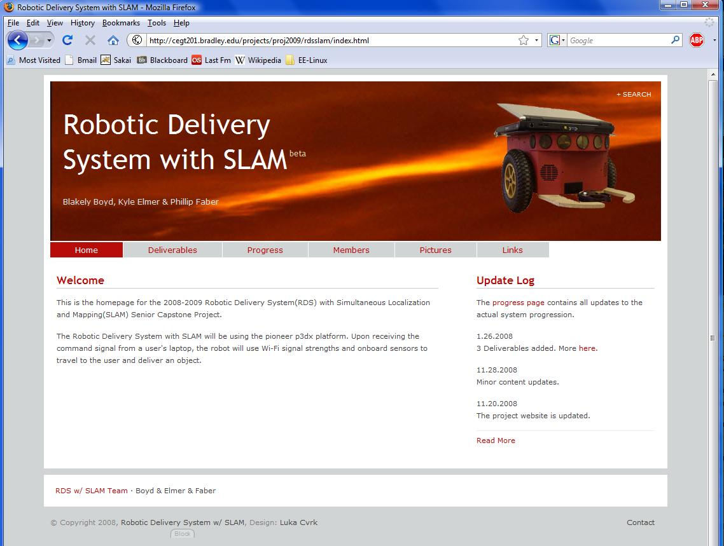
Website
http://cegt201.bradley.edu/projects/proj2009/rdsslam/
RDS with SLAM

Slide 39
Video
RDS with SLAM
Notes:
39

Slide 40
Thank you
Project Advisors
Dr. Aleksander Malinowski
Dr. In Soo Ahn
RDS with SLAM

Slide 41
Thank you
Consultants
Dr. Joel Schipper
Mr. Steve Gutschlag
Mr. Nick Schmidt
Joe Buckner and Nir Chezrony
RDS with SLAM
Notes:
41

Slide 42
References
[1] Nourbakhsh, Illah R., and Roland Siegwart. Introduction to Autonomous Mobile Robots (Intelligent Robotics and Autonomous Agents.) London: The MIT Press, 2004 .
[2] Serrano, Oscar, Jose Marıa, Canas Vicente Matellan, and
Luis Rodero. Universidad Rey Juan Carlos, 28933 Mostoles (Spain): 4 Dec. 2008
<http://gsyc.es/jmplaza/papers/waf04.pdf>
[3] Lim, Chin-Heng, Yahong Wan, Boon-Poh Ng, and Chong-Meng Samson See. "A Real-Time Indoor WiFi Localization System Utilizing Smart Antennas." IEEE Transactions on Consumer Electronics 53 (2007): 618-622. 4 Dec. 2008 <http://ieeexplore.ieee.org/stamp/stamp.jsp?arnumber=04266950>.
RDS with SLAM

Slide 43
References
[4] Sharp, GP2Y0A02YK0F Datasheet
<http://www.acroname.com/robotics/parts/gp2y0a02_e.pdf>
[5]Sharp, GP2D12-15 Datasheet <http://www.acroname.com/robotics/parts/SharpGP2D12-15.pdf>
RDS with SLAM

Slide 44
Picture References
[1] http://www.acroname.com/robotics/parts/R49-IR15.jpg
[2] http://www.acroname.com/robotics/parts/R144-GP2Y0A02YK.jpg
[3] http://images.picotech.com/adc11.jpg
[4] Nilsson, Nils. Artificial Intelligence: A New Synthesis. San Francisco, Calif: Morgan Kaufmann, 1998.
[5] Nourbakhsh, Illah R., and Roland Siegwart. Introduction to Autonomous Mobile Robots (Intelligent Robotics and Autonomous Agents.) London: The MIT Press, 2004 .
RDS with SLAM

Slide 45
Questions?

