Slide 1
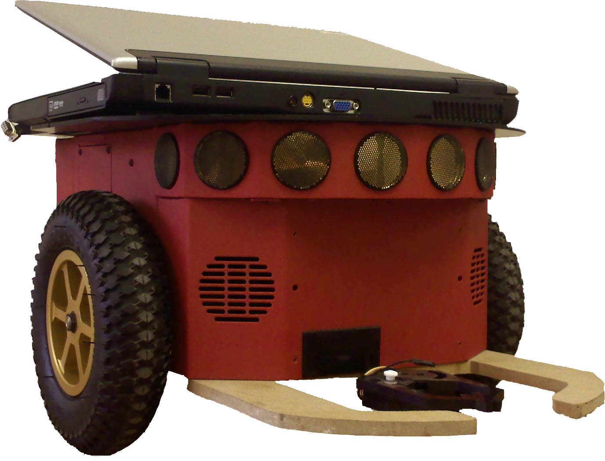
Robotic Delivery System
with SLAM
Blakely Boyd
Kyle Elmer
Phillip Faber
Project Advisors:
Dr. Aleksander Malinowski
Dr. In Soo Ahn

Slide 2
Outline
Introduction
Project Overview
Project Progress
Sensors
Wi-Fi
Questions
RDS with SLAM

Slide 3
Introduction
Autonomous Delivery System
Uses existing Wi-Fi Access Points
Works from any laptop
RDS with SLAM

Slide 4
Project Goals
Wi-Fi signal strength acquisition
Robotic obstacle avoidance
Localization and mapping
Best path algorithm
RDS with SLAM

Slide 5
System Platform
Pioneer p3dx
Laptop interface
RDS with SLAM

Slide 6
System Diagram
RDS with SLAM

Slide 7
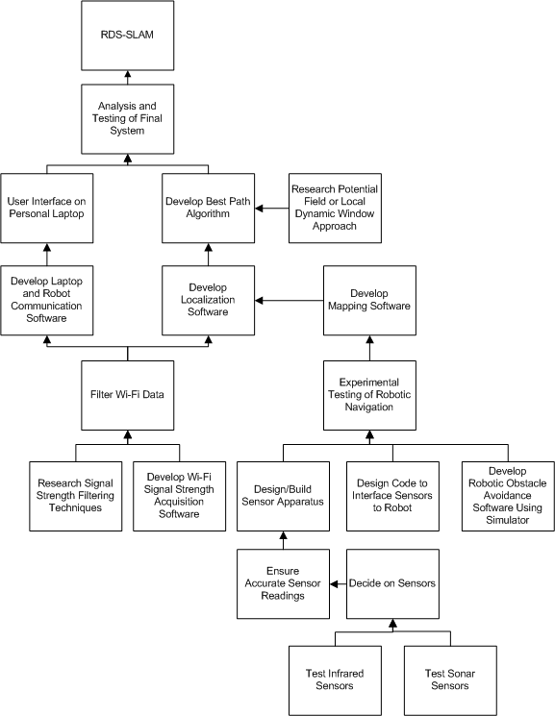
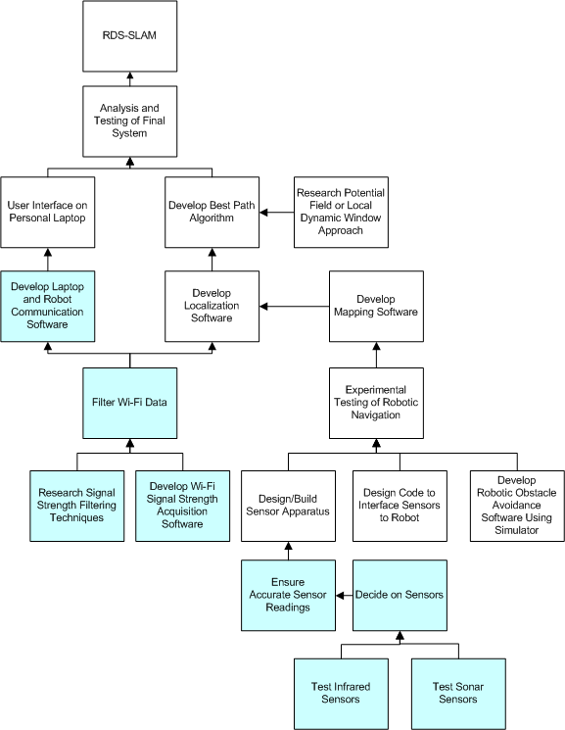
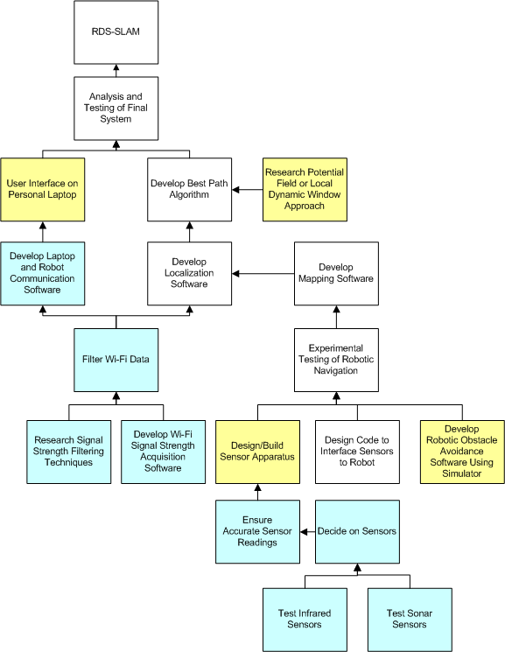
Project Progress
RDS with SLAM

Slide 8
Project Division
Phillip Faber
Sonar and IR testing/interfacing
Kyle Elmer
Wi-Fi Data Filtering
Obstacle Avoidance
Blakely Boyd
Wi-Fi Navigation
RDS with SLAM

Slide 9
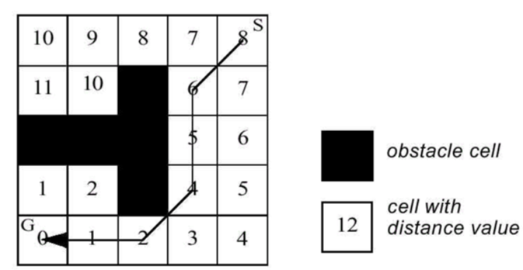
Navigation
Obstacle Avoidance
Initial Mapping
Best Path Algorithm
[1]
RDS with SLAM

Slide 10
Sonar Sensors
RDS with SLAM

Slide 11
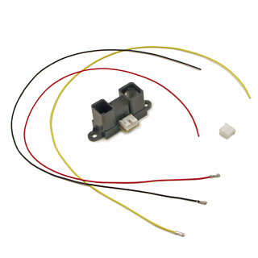
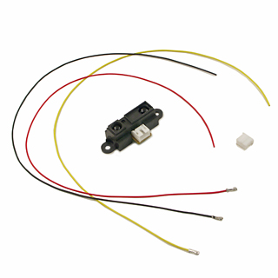
IR Sensors
Sharp GP2Y0A02YK0F
20cm to 150cm
Sharp GP2D15
24cm
[6],[7]
RDS with SLAM

Slide 12
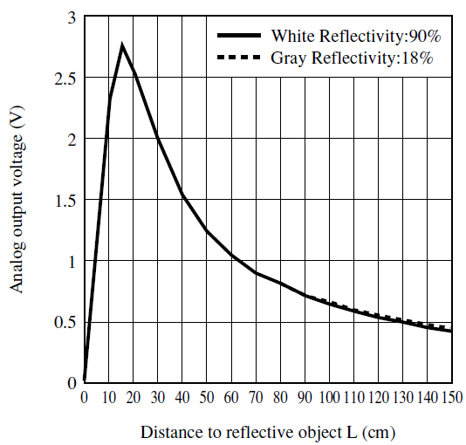
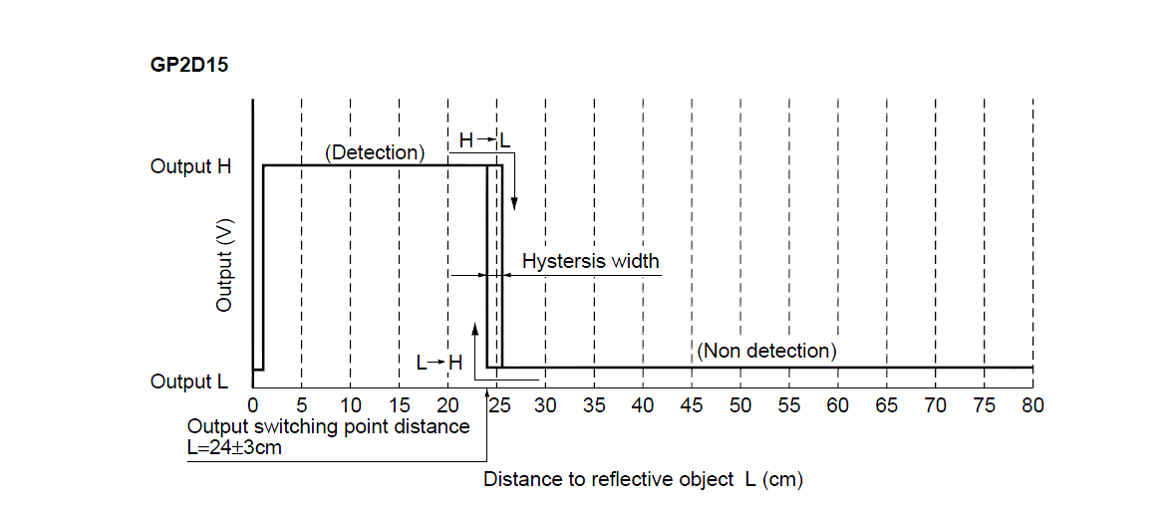
IR Sensors
Analog Sensor
Digital Sensor
[4],[5]
RDS with SLAM

Slide 13
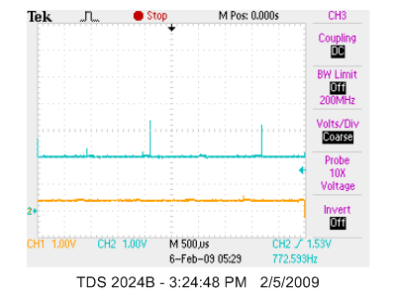
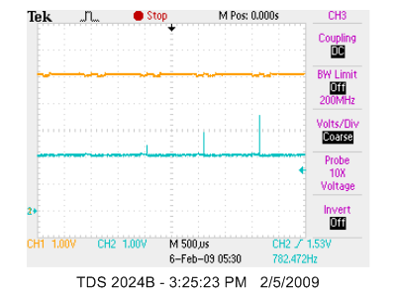
Sensors Testing
Far
Near
RDS with SLAM

Slide 14
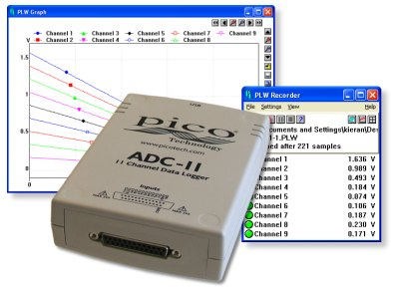
Interfacing
Pico Tech USB ADC-11/10
Pros
USB
Open Source
Sensor Class in Aria
11 channel/10 bit
Cons
From the UK
[8]
RDS with SLAM

Slide 15
Wi-Fi Sampling
Averaging and Median filter react the same
Both techniques smooth the data efficiently
Averaging: 200 samples
Median: 201 samples
RDS with SLAM

Slide 16
Wi-Fi Sampling
Averaging provides smoother transitions
Median filter jumps too much
Averaging: 200 samples
Median: 105 samples
RDS with SLAM

Slide 17
Wi-Fi Sampling
Averaging provides consistent data trends
Test started in the same position
Test finished after 10 meters
RDS with SLAM

Slide 18
Wi-Fi Sampling
What about update time?
Stopped around 900th sample
Took ~80 samples to get within a reasonable range
RDS with SLAM

Slide 19
Wi-Fi Sampling
What about 100 samples?
Stopped around 920th sample
Within a reasonable range within a couple samples
RDS with SLAM

Slide 20
Wi-Fi Navigation
Prototype navigation
Send signal strengths
Receive/compare data
Control robot
Evaluate closeness
RDS with SLAM

Slide 21
Wi-Fi Navigation
Closeness calculations
E = ∑|R_{n} – D_{n}|
E = ∑|R_{n}² – D_{n}²|
E = ∑w_{n} * |R_{n} – D_{n}|
RDS with SLAM

Slide 22
Wi-Fi Navigation
RDS with SLAM

Slide 23
Wi-Fi Navigation
RDS with SLAM

Slide 24
Wi-Fi Navigation
Improving accuracy
Time-based weights
Discarding erratic data
Updating destination data
RDS with SLAM

Slide 25
Hardware
 | Part Number | Description | Quanity | Part Price | Total
Have | Pioneer 3pdx | Robotic Platform | 1 | $0.00 | $0.00
 | Dell Laptop | Project Computer | 1 | $0.00 | $0.00
 | GP2Y0A02YK0F | Analog Sensors | 8 | $12.50 | $100.00
 | GP2D15 | Digital Sensors | 8 | $12.50 | $100.00
Want | USB ADC-11/10 | USB Sensor Interface | 1 | $262.35 | $262.35
 | Total |  | 18 |  | $462.35
RDS with SLAM

Slide 26
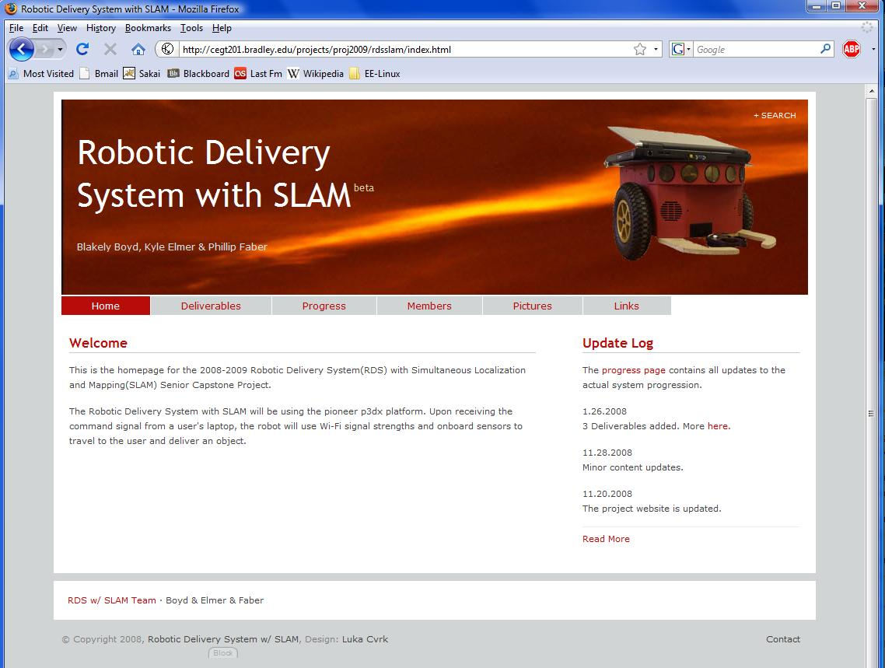
Website
RDS with SLAM

Slide 27
References
[1] Nourbakhsh, Illah R., and Roland Siegwart. Introduction to Autonomous Mobile Robots (Intelligent Robotics and Autonomous Agents.) London: The MIT Press, 2004 .
[2] Serrano, Oscar, Jose Marıa, Canas Vicente Matellan, and
Luis Rodero. Universidad Rey Juan Carlos, 28933 Mostoles (Spain): 4 Dec. 2008
<http://gsyc.es/jmplaza/papers/waf04.pdf>
[3] Lim, Chin-Heng, Yahong Wan, Boon-Poh Ng, and Chong-Meng Samson See. "A Real-Time Indoor WiFi Localization System Utilizing Smart Antennas." IEEE Transactions on Consumer Electronics 53 (2007): 618-622. 4 Dec. 2008 <http://ieeexplore.ieee.org/stamp/stamp.jsp?arnumber=04266950>.
RDS with SLAM

Slide 28
References
[4] Sharp, GP2Y0A02YK0F Datasheet Jan. 2009
<http://www.acroname.com/robotics/parts/gp2y0a02_e.pdf>
[5]Sharp, GP2D12-15 Datasheet Jan. 2009 <http://www.acroname.com/robotics/parts/SharpGP2D12-15.pdf>
[6] Sharp, GP2D15 Jan. 2009
<http://www.acroname.com/robotics/parts/R49-IR15.jpg>
[7] Sharp GP2Y0A02YK Jan. 2009
<http://www.acroname.com/robotics/parts/R144-GP2Y0A02YK.jpg>
[8] ADC USB 11/10 Jan. 2009
<http://images.picotech.com/adc11.jpg>
RDS with SLAM

Slide 29
Questions?

